Slide 1
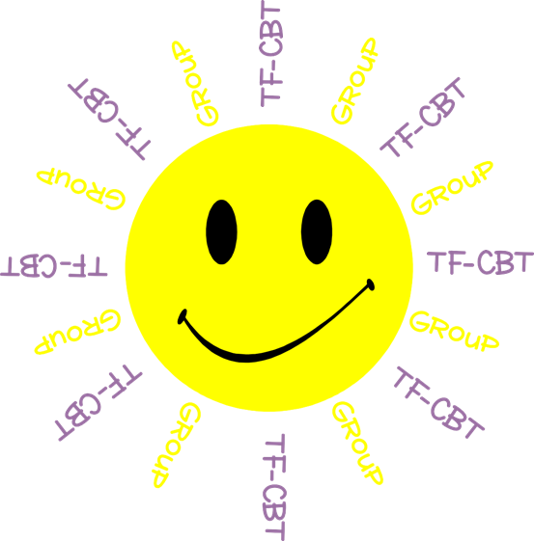
Welcome to TF-CBT Group!
Today is Group 5 of 5.
Child Trauma Services Program
© 2021 The Board of Regents of The University of Oklahoma

Slide 2
Acknowledgment
This treatment session manual for implementation of Trauma-Focused Cognitive-Behavioral Therapy (TF-CBT) in a group format was originally developed under a grant from the Oklahoma Department of Mental Health and Substance Abuse Services awarded to Drs. Susan Schmidt and Elizabeth Risch from the University of Oklahoma Health Sciences Center. This manual was developed with support by the TF-CBT treatment developers Esther Deblinger, PhD, Anthony Mannarino, PhD, and Judith Cohen, MD. The federal government’s Substance Abuse and Mental Health Services Administration has recognized TF-CBT as a Model Program due to the extensive outcome data from randomized controlled trials that support its effectiveness in improving a variety of problems in youth who have experienced trauma.
The current TF-CBT Group Curriculum Manual was developed and refined through many years of application of the treatment. Amanda Mitten, Natalie Gallo, Hannah Frye, Melissa Bernstein, and Saba Shahid contributed significantly to previous revisions of the manual. We wish to also thank Lindsey Peters, Kate Theimer, and Ashley Galsky for their assistance. This manual and work is dedicated to the families who have cared for children with a trauma history with whom we have worked.
Copyrighted The Board of Regents of the University of Oklahoma
All rights reserved. The materials contained herein are copyright protected by the University of Oklahoma and are provided for review only. No part of this publication may be reproduced, distributed, transmitted, derived or practiced in any form or by any means without the prior written permission of the University of Oklahoma, except in the case of brief quotations embodied in critical reviews and certain other noncommercial and non-medical uses permitted by copyright law.
Contact Information
OKTF-CBT
University of Oklahoma Health Sciences Center
Center on Child Abuse and Neglect
1100 NE 13th Street
Oklahoma City, OK 73117
(405) 271-5700
OKTF-CBT@ouhsc.edu
Child Trauma Services Program
© 2021 The Board of Regents of The University of Oklahoma

Slide 3
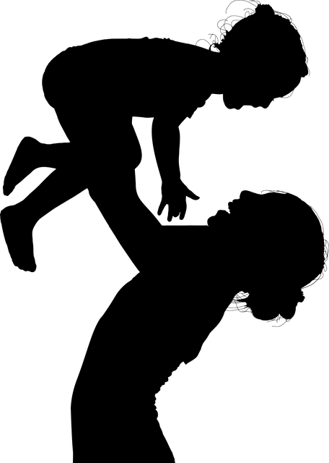
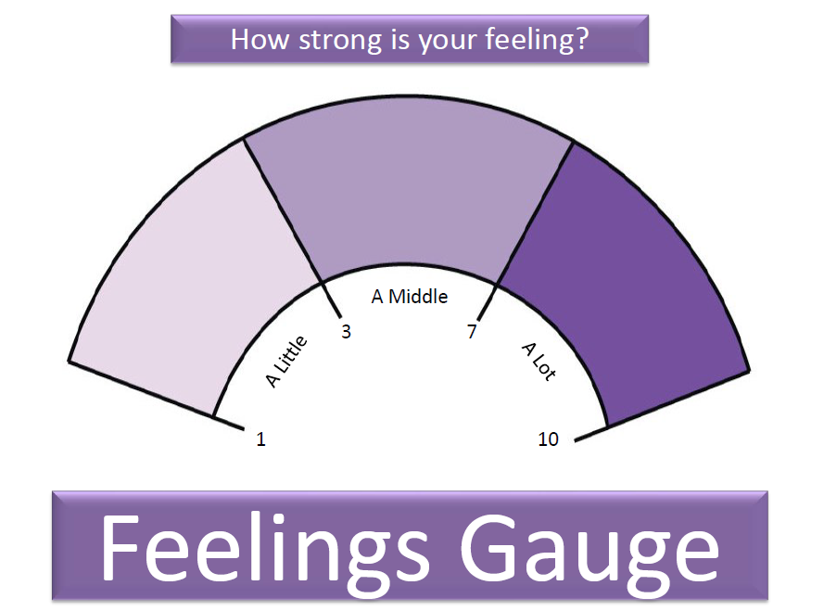
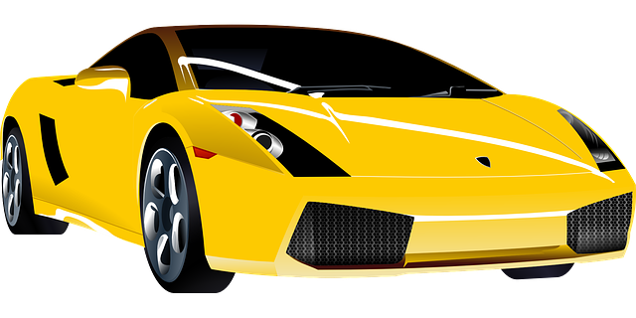
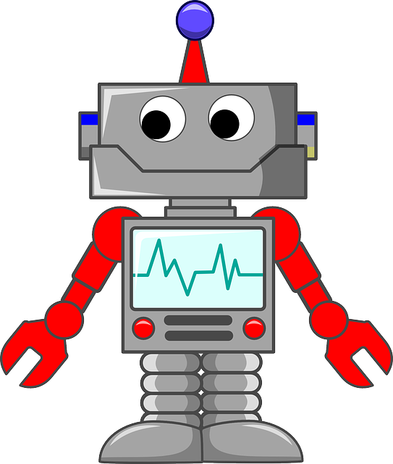
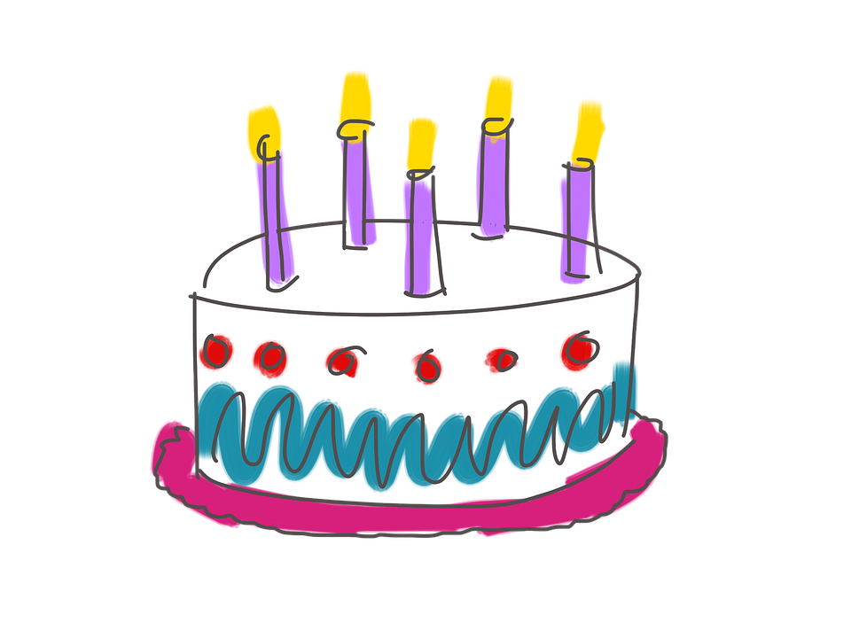
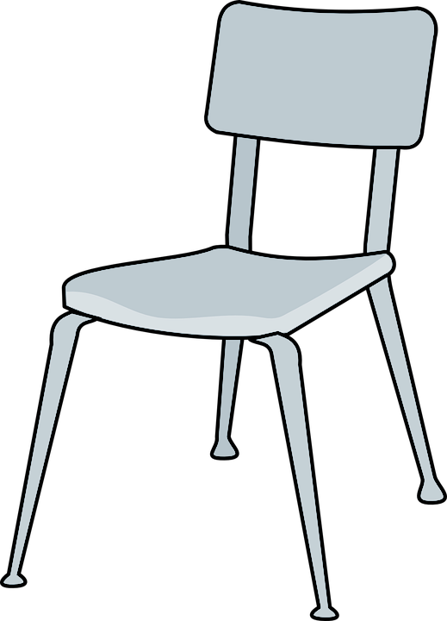
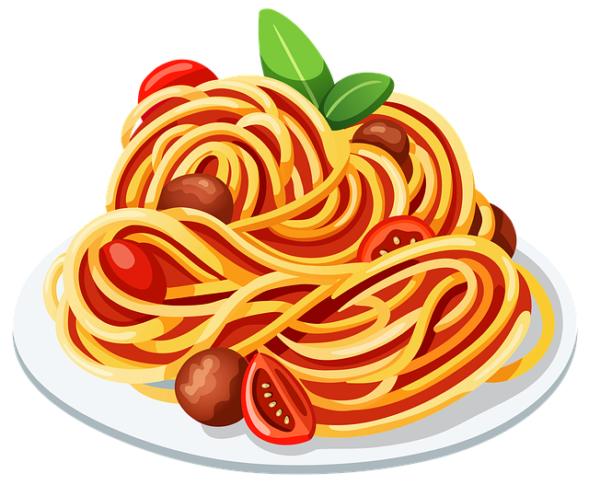
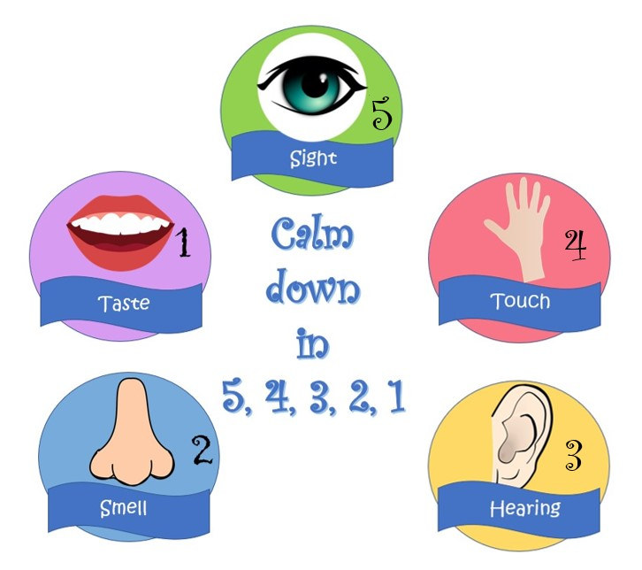
Child Trauma Services Program
© 2021 The Board of Regents of The University of Oklahoma

Slide 4
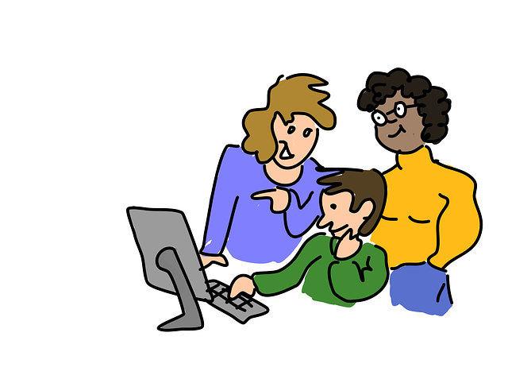
GROUP RULES
Use the bathroom before or after group.
Be in a private space.
Keep everyone’s information private or confidential.
Take turns talking.
Keep yourself on mute.
Keep your camera on.
Be nice.
Just Be On Zoom!
Child Trauma Services Program
© 2021 The Board of Regents of The University of Oklahoma

Slide 5
Youth A
Youth B
Youth C
Youth D
Youth E
Youth F
Child Trauma Services Program
© 2021 The Board of Regents of The University of Oklahoma

Slide 6
Child Trauma Services Program
© 2021 The Board of Regents of The University of Oklahoma

Slide 7
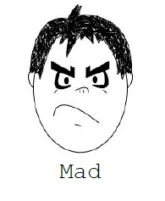
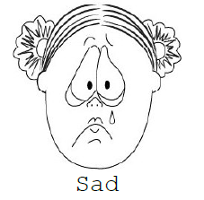
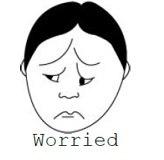
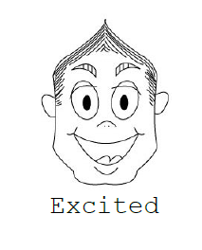
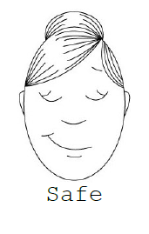
Child Trauma Services Program
© 2021 The Board of Regents of The University of Oklahoma

Slide 8
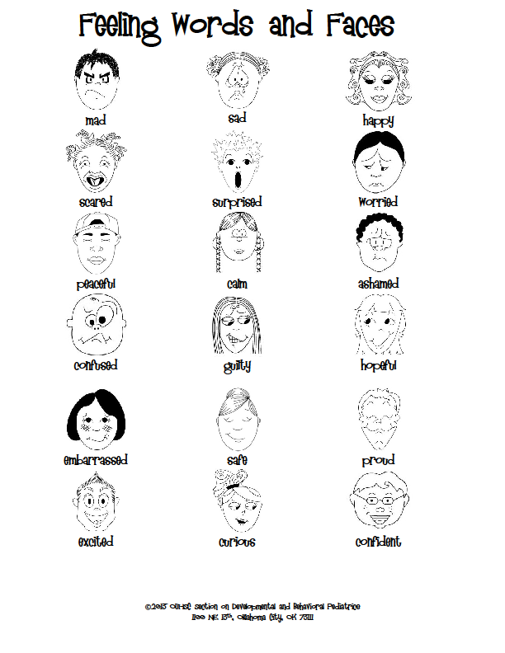
Child Trauma Services Program
© 2021 The Board of Regents of The University of Oklahoma

Slide 9
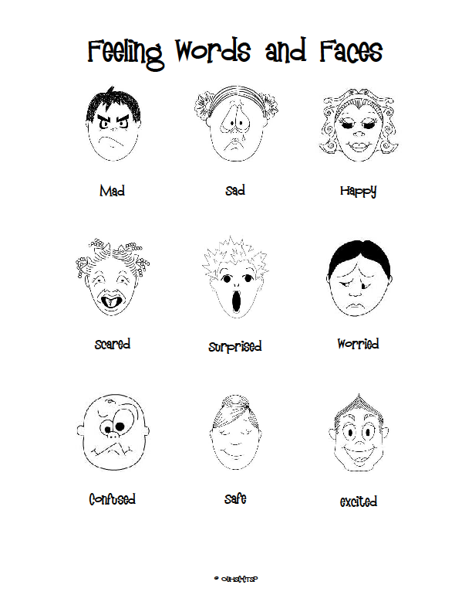
Child Trauma Services Program
© 2021 The Board of Regents of The University of Oklahoma

Slide 10
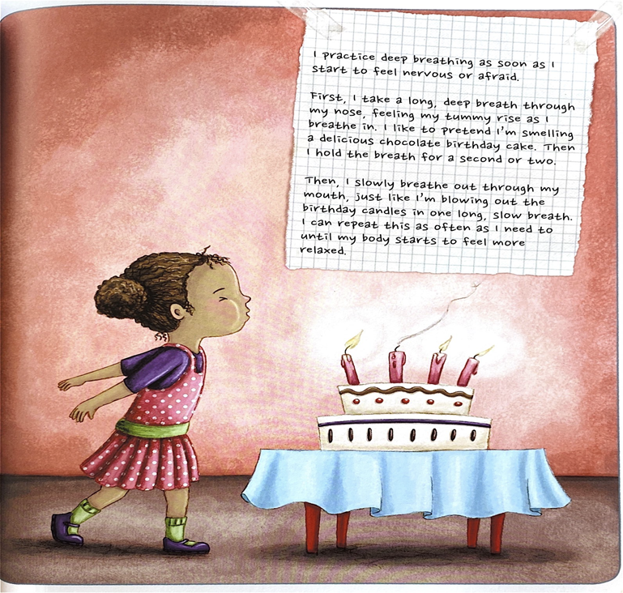
Deep Breaths
STRAUS, S. (2013). HEALING DAYS. MAGINATION Press.
Child Trauma Services Program
© 2021 The Board of Regents of The University of Oklahoma

Slide 11
Power breaths
Breathing is the most efficient and helpful way to
calm our bodies down when we feel stress, fear, sadness, or anger. Breathing in specific ways actually tricks our brain into thinking we are at rest, and our body (our lungs and heart) follow the brain’s lead. Power breathing for 15-30 seconds can calm our bodies down without anyone else even having to know.
Put a hand on your chest and one on your stomach.
Breathe in through your nose for 4 seconds. Focus on breathing as steadily as possible and fill your lungs and stomach as much as you can.
Breathe slowly and consistently out of your mouth for 8 full seconds.
Repeat this step 3-4 times to calm your body down.
**To put our body back at rest, we have to breathe at a ratio of 1:2, which means that however long we breathe in, we need to breathe out for twice as long**
Child Trauma Services Program
© 2021 The Board of Regents of The University of Oklahoma

Slide 12
Muscle Relaxers
Child Trauma Services Program
© 2021 The Board of Regents of The University of Oklahoma

Slide 13
Sit in a comfortable chair. Now imagine that you are piece of cooked spaghetti. Tighten both your fists and arms, squeeze your legs and stomach and make your whole body as stiff as possible, so that you can’t bend. Keep your whole body tense until you count to five. Now relax.
Pretend that you are now a piece of cooked spaghetti. Let your whole body become loose and floppy. Let go of all of the tension in your body. Relax your shoulders and stomach, take a deep breath, and let your body be as loose and floppy as cooked spaghetti. Which feels better, being cooked or uncooked spaghetti?
Now become raw spaghetti again. Squeeze all the muscles in your body until you are as stiff as raw spaghetti. Even make your face tense – squeeze all the muscles in your mouth and forehead. Squeeze your shoulders up to your ears. Make fists with your hands. Squeeze your eyes shut and push your feet into the floor. Hold your body stiff like raw spaghetti until the count of five.
Now relax your whole body. Go floppy like raw spaghetti. Relax your face, your shoulders, your stomach, your arms and your legs. Now which felt better, being cooked or uncooked spaghetti?
Become the raw spaghetti one last time and tense your whole body from head to toe. Make every part of your body as tense and stiff as you can until the count of five.
Now relax your body like raw spaghetti. It takes a lot of work to be as tense as raw spaghetti, and can make you feel tired to do this all day. When you notice that your body is feeling stiff or tense, don’t forget that you can make yourself feel like cooked spaghetti by relaxing the muscles in your body.
Child Trauma Services Program
© 2021 The Board of Regents of The University of Oklahoma

Slide 14
5 Senses Grounding
5
4
3
Child Trauma Services Program
© 2021 The Board of Regents of The University of Oklahoma

Slide 15
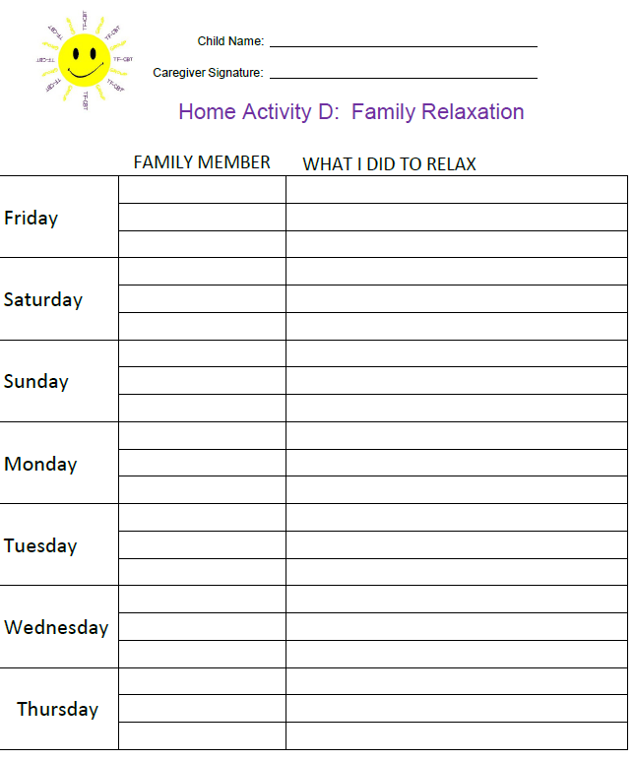
HOMEWORK REVIEW
Share what you and your family did as relaxers last week.
Child Trauma Services Program
© 2021 The Board of Regents of The University of Oklahoma

Slide 16
Understanding Trauma
Let’s learn about types of traumas that often happen to kids.
Work together in the youth group to answer the first question.
Then you can add an object to the pictures for each trauma type that has happened in your life.
In the combined youth/caregiver group, families will take turns answering a question about each trauma type.
Child Trauma Services Program
© 2021 The Board of Regents of The University of Oklahoma
Notes:
\

Slide 17
Common Trauma Types
Moving Homes
Loss of a Loved One
Abuse
Neglect
Family Fighting
Family Member Substance Abuse
Other Trauma Types
Child Trauma Services Program
© 2021 The Board of Regents of The University of Oklahoma

Slide 18
Youth Group
Our Group
Combined Group
Moving Homes
Child Trauma Services Program
© 2021 The Board of Regents of The University of Oklahoma

Slide 19
When kids have to move to a new home or leave their grown-ups or brothers and sisters.
Moving Homes
Youth
Group
Child Trauma Services Program
© 2021 The Board of Regents of The University of Oklahoma

Slide 20
How do youth feel when they can’t live with their parents?
Confused
Sad
Worried
Angry
Lonely
Moving Homes
Child Trauma Services Program
© 2021 The Board of Regents of The University of Oklahoma

Slide 21
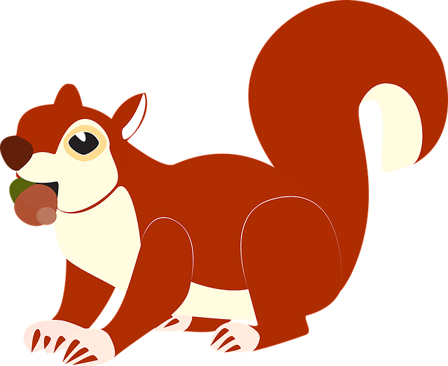
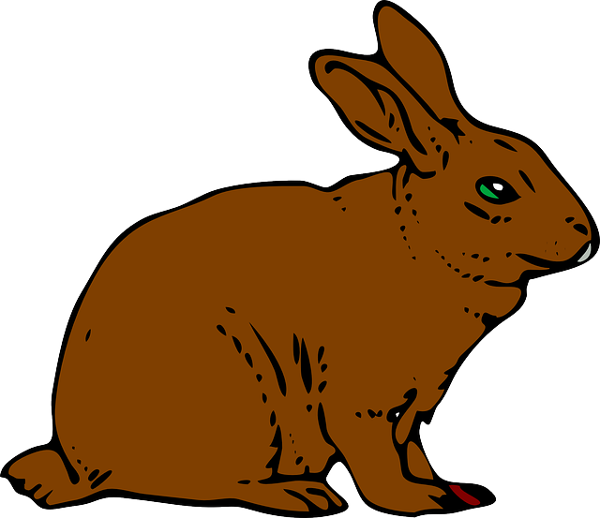
Moving Homes
Child Trauma Services Program
© 2021 The Board of Regents of The University of Oklahoma

Slide 22
When family members live apart, they may miss talking to and seeing each other. What are 3 ways family members who live apart can still feel close to each other when they can’t see or talk to each other?
Moving Homes
Caregiver Group
Child Trauma Services Program
© 2021 The Board of Regents of The University of Oklahoma

Slide 23
Youth Group
Our Group
Combined Group
Loss of a Loved One
Child Trauma Services Program
© 2021 The Board of Regents of The University of Oklahoma

Slide 24
When a youth loses a relationship with someone close to them through separation or death of the loved one.
Loss of a Loved One
Youth
Group
Child Trauma Services Program
© 2021 The Board of Regents of The University of Oklahoma

Slide 25
What are some reasons that a youth may not be able to live with a parent?
Loss of a Loved One
Parents may be separated or divorced
A parent may have trouble taking good care of their child’s needs
A parent may have died
Child Trauma Services Program
© 2021 The Board of Regents of The University of Oklahoma

Slide 26
How do people feel when a loved one dies?
May feel sad that they won’t see their loved one again.
May feel lonely
May feel mad that their loved one died
May be confused about why their loved one died
May feel worried about the health or safety of other loved ones
Loss of a Loved One
Child Trauma Services Program
© 2021 The Board of Regents of The University of Oklahoma

Slide 27
Loss of a Loved One
Child Trauma Services Program
© 2021 The Board of Regents of The University of Oklahoma

Slide 28
When a loved one dies, family members can feel especially sad around the loved one’s birthday or on special holidays. What are 3 ways families can remember their loved one in a good way during these special times?
Loss of a Loved One
Combined Group
Child Trauma Services Program
© 2021 The Board of Regents of The University of Oklahoma

Slide 29
Youth Group
Our Group
Combined Group
Abuse
Child Trauma Services Program
© 2021 The Board of Regents of The University of Oklahoma

Slide 30
Physical - When a grown-up hurts a youth’s body
Verbal - When a grown-up hurts a youth with their words
Sexual - When a person looks at or touches a youth’s private body parts or makes them look at or touch another’s private body parts.
Abuse
Youth
Group
Child Trauma Services Program
© 2021 The Board of Regents of The University of Oklahoma

Slide 31
What are some ways that an adult might hurt a youth using their words or actions?
Emotional and Physical Abuse
Calling the youth hurtful names
Hitting or slapping
Using hurtful punishments or consequences
Child Trauma Services Program
© 2021 The Board of Regents of The University of Oklahoma

Slide 32
1 in 4 or 5 girls
1 in 6 or 7 boys
How many youth experience sexual abuse before age 18?
Sexual Abuse
Child Trauma Services Program
© 2021 The Board of Regents of The University of Oklahoma

Slide 33
TRUE or FALSE:
Youth are usually abused by strangers.
Sexual Abuse
FALSE: Youth are most often abused by someone they know like a relative or family friend.
Child Trauma Services Program
© 2021 The Board of Regents of The University of Oklahoma

Slide 34
Do most youth immediately tell an adult after being abused?
No. Most youth don’t tell right away after abuse happens. There are lots of reasons youth may not tell, like:
Fear that they or the other person may get in trouble
Worry that no one will believe it happened.
The other person may have threatened that something bad might happen if the youth tells.
It’s a brave thing for a youth to tell at all!
Sexual Abuse
Child Trauma Services Program
© 2021 The Board of Regents of The University of Oklahoma

Slide 35
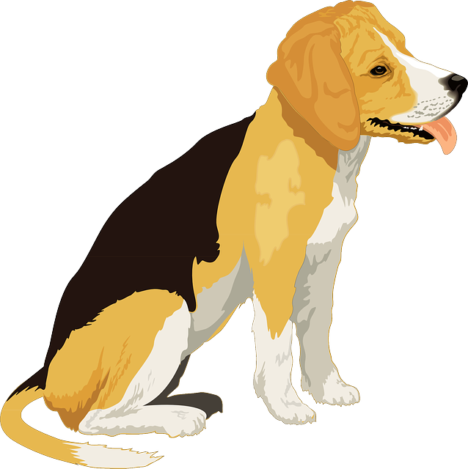
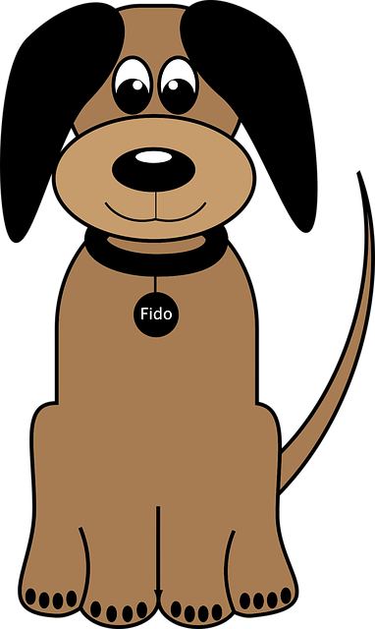
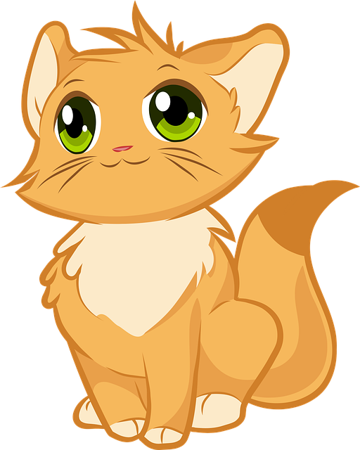
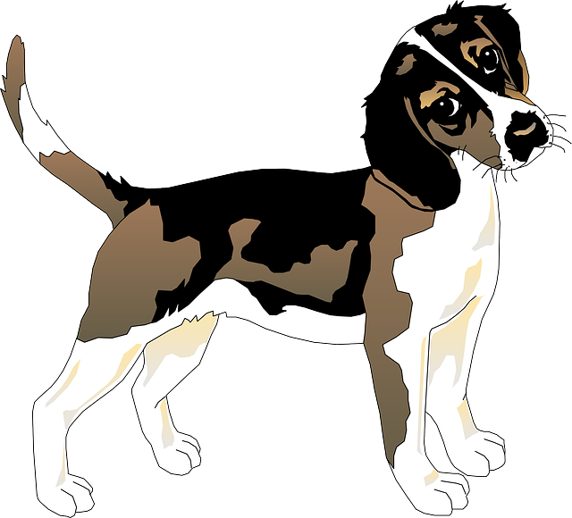
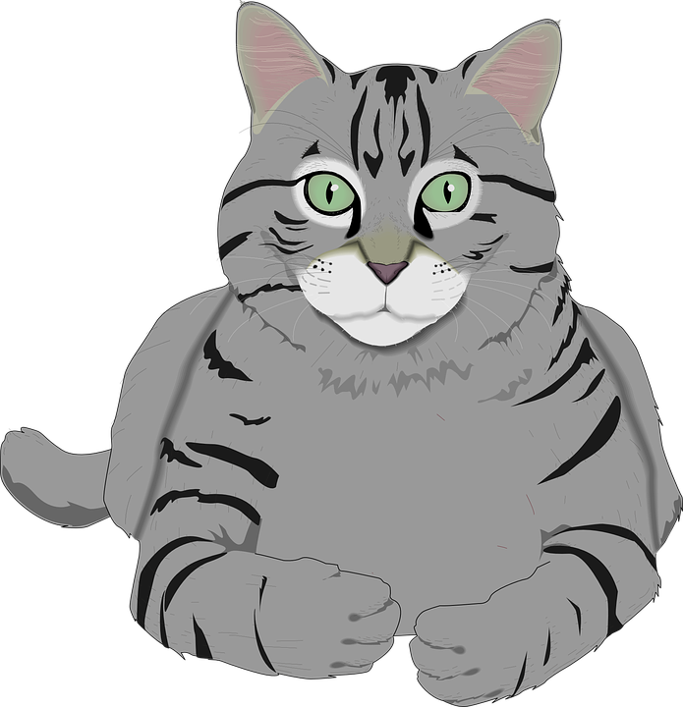
Abuse
Child Trauma Services Program
© 2021 The Board of Regents of The University of Oklahoma

Slide 36
It can be tough for youth to talk in counseling about having been physically, emotionally or sexually abused. Caregivers, can you share how proud you are of youth in this group for talking in counseling about difficult trauma memories?
Abuse
Combined Group
Child Trauma Services Program
© 2021 The Board of Regents of The University of Oklahoma

Slide 37
Youth Group
Our Group
Combined Group
Neglect
Child Trauma Services Program
© 2021 The Board of Regents of The University of Oklahoma

Slide 38
When a youth doesn’t have food, clothes, a safe place to live, medical care, supervision, schooling, or the love and support they need.
Neglect
Youth
Group
Child Trauma Services Program
© 2021 The Board of Regents of The University of Oklahoma

Slide 39
What are some ways a parent may not take care of their child’s needs?
Not giving their child enough food
Having an unsafe home
Not taking care of their child’s medical needs
Not making sure their child gets an education
Not providing their child with love
Neglect
Child Trauma Services Program
© 2021 The Board of Regents of The University of Oklahoma

Slide 40
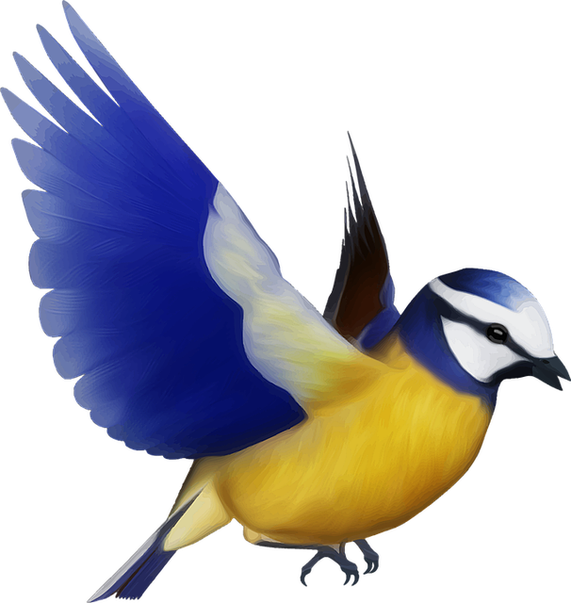
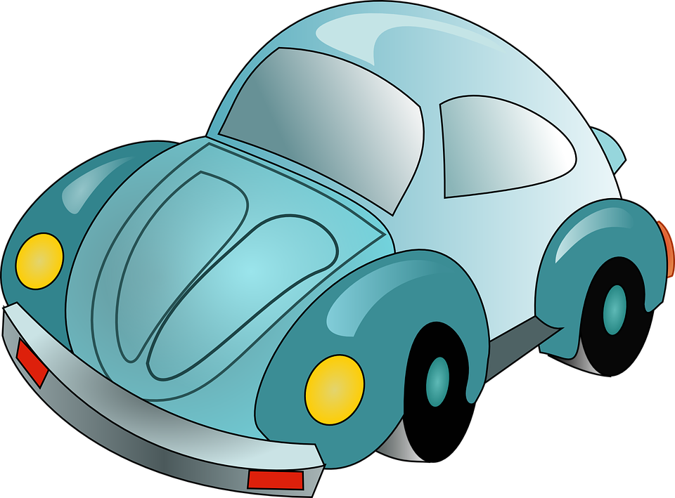
Neglect
Child Trauma Services Program
© 2021 The Board of Regents of The University of Oklahoma

Slide 41
After youth have gone through times when they didn’t have enough food or other things they needed, they may still sometimes worry if it will happen again. How could a caregiver help their child feel safer when they have these worries?
Neglect
Combined Group
Child Trauma Services Program
© 2021 The Board of Regents of The University of Oklahoma

Slide 42
Youth Group
Our Group
Combined Group
Family Fighting
Child Trauma Services Program
© 2021 The Board of Regents of The University of Oklahoma

Slide 43
When grown-ups in a youth’s family hurt each other through their words or behaviors. Family fighting can also be called domestic violence.
Family Fighting
Youth
Group
Child Trauma Services Program
© 2021 The Board of Regents of The University of Oklahoma

Slide 44
TRUE. Up to 1 in 9 youth live in a family where domestic violence happens.
TRUE OR FALSE?
Family fighting (or domestic violence) is something that happens in lots of families.
Family Fighting
Child Trauma Services Program
© 2021 The Board of Regents of The University of Oklahoma

Slide 45
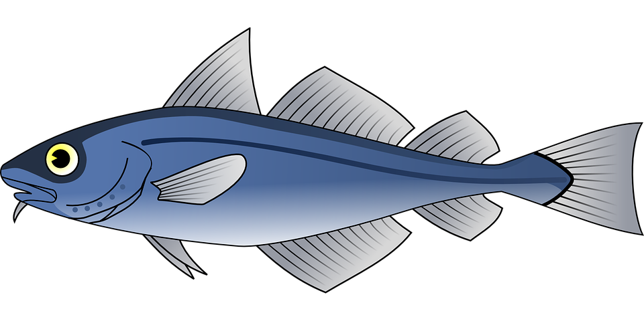
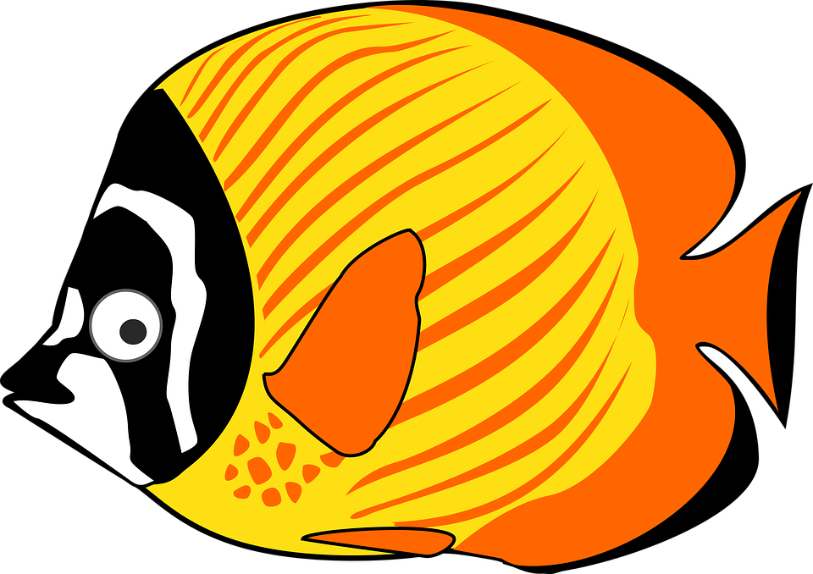
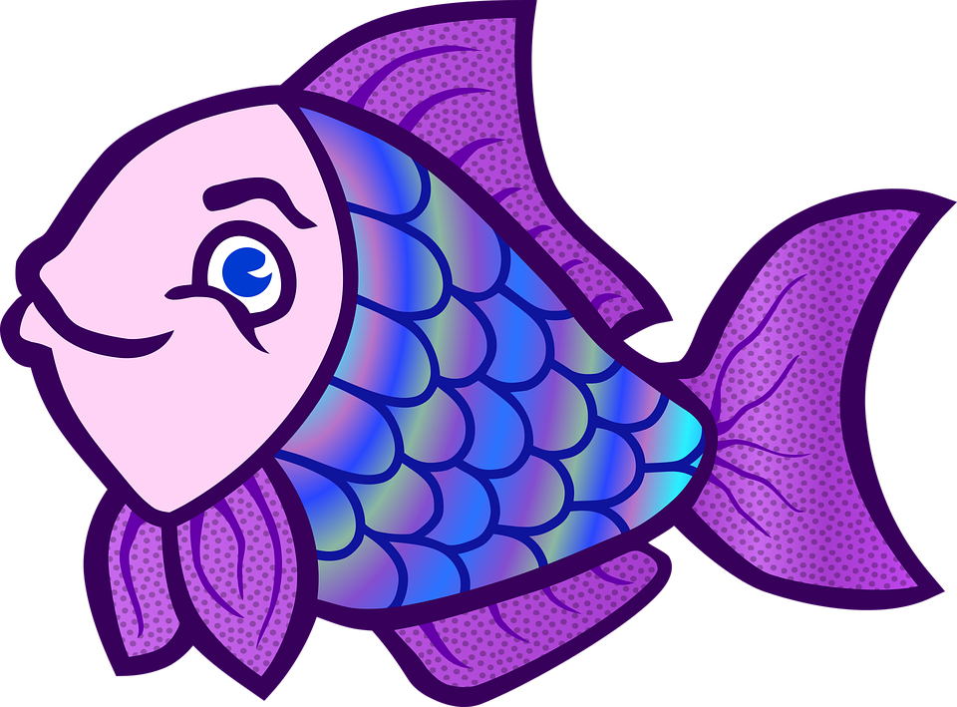
Family Fighting
Child Trauma Services Program
© 2021 The Board of Regents of The University of Oklahoma

Slide 46
When a youth has experienced family fighting (or domestic violence), their body alarm system may go off when they’re reminded of these memories. Name 3 examples of things that could remind a youth of family fighting.
How could a youth let their caregiver or a trusted adult know when their body alarm system is going off inside? How could that adult help?
Family Fighting
Combined Group
Child Trauma Services Program
© 2021 The Board of Regents of The University of Oklahoma

Slide 47
Youth Group
Our Group
Combined Group
Family Member Substance Abuse
Child Trauma Services Program
© 2021 The Board of Regents of The University of Oklahoma

Slide 48
Misusing or overusing drugs or alcohol can hurt a family member’s health and keep them from making safe and healthy choices for themselves and others. When using alcohol or drugs becomes hard for a person to control or stop, this is called “addiction.”
Family Member Drug or Alcohol Abuse
Youth
Group
Child Trauma Services Program
© 2021 The Board of Regents of The University of Oklahoma

Slide 49
How might a youth feel if their parent is abusing alcohol or drugs?
Family Member Drug or Alcohol Abuse
Some ways a youth may feel:
Worried about their parent’s health
Sad that their parent isn’t the same as they used to be before they started abusing drugs or alcohol
Confused about what is happening to their parent
Angry that their parent isn’t caring for them as well as they were before starting to use drugs and alcohol.
Child Trauma Services Program
© 2021 The Board of Regents of The University of Oklahoma

Slide 50
Family Member Drug or Alcohol Abuse
Child Trauma Services Program
© 2021 The Board of Regents of The University of Oklahoma

Slide 51
Alcohol and drug abuse affects many families. 1 in how many families have a family member who has struggled with alcohol or drugs? Treatment can help family members recover from alcohol or drug abuse!
Family Member Drug or Alcohol Abuse
Combined Group
Child Trauma Services Program
© 2021 The Board of Regents of The University of Oklahoma

Slide 52
Youth Group
Our Group
Combined Group
Other Trauma Types
Child Trauma Services Program
© 2021 The Board of Regents of The University of Oklahoma

Slide 53
- Scary weather events - Scary medical care - Seeing scary events at school, around others or in the community - Bullying - Other types of scary experiences
Other Trauma Types
Youth
Group
Child Trauma Services Program
© 2021 The Board of Regents of The University of Oklahoma

Slide 54
What are some ways someone might be bullied?
Hurtful teasing
Name calling
Physically threatening or hurting
Peer pressuring the youth to do something they don’t want to do
Bullying
Child Trauma Services Program
© 2021 The Board of Regents of The University of Oklahoma

Slide 55
What is cyberbullying?
How many youth experience cyberbullying?
Cyberbulling is bullying that takes place online
Around 1 in 7 youth experience cyberbullying.
Bullying
Child Trauma Services Program
© 2021 The Board of Regents of The University of Oklahoma

Slide 56
Other Trauma Types
Child Trauma Services Program
© 2021 The Board of Regents of The University of Oklahoma

Slide 57
After someone has gone through a tornado, reminders of that day can feel scary and make the person worry that another tornado will happen. Name 3 things that might remind someone of a tornado. What can a family do to feel safer and more prepared for future bad weather?
Other Trauma Types
Combined Group
Child Trauma Services Program
© 2021 The Board of Regents of The University of Oklahoma

Slide 58
Group Celebration
Child Trauma Services Program
© 2021 The Board of Regents of The University of Oklahoma

Slide 59
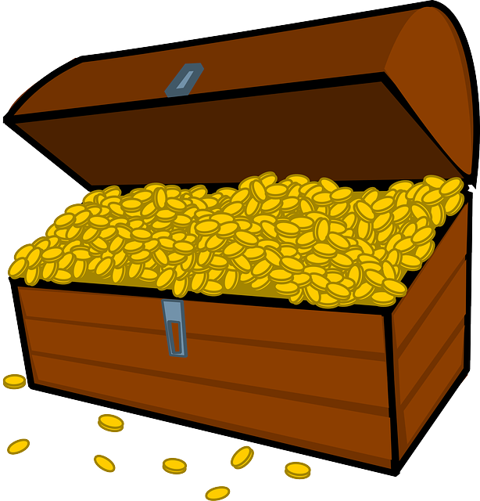
I spy,
with my little eye
Child Trauma Services Program
© 2021 The Board of Regents of The University of Oklahoma

Slide 60
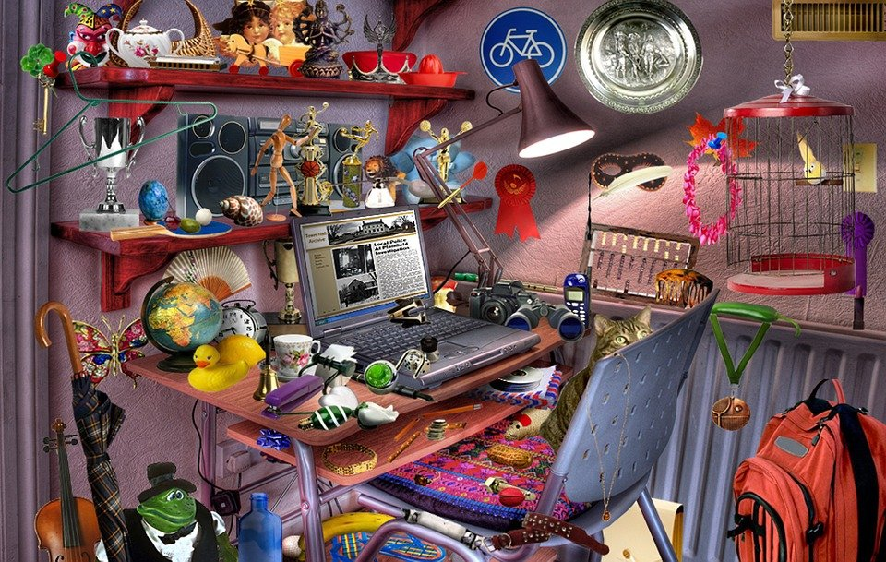
Child Trauma Services Program
© 2021 The Board of Regents of The University of Oklahoma

Slide 61
Find something that starts with the first letter of your name | Find something made of plastic | Find something that makes you smile
Find something that is green | Find something with numbers on it | Find something with a face on it
Find something with wheels | Find something that you made | Find something something you love
Child Trauma Services Program
© 2021 The Board of Regents of The University of Oklahoma

Slide 62
Welcome to TF-CBT Group Combined Time!
Child Trauma Services Program
© 2021 The Board of Regents of The University of Oklahoma

Slide 63
Combined Time Instructions
Group members will take turns sharing with their caregivers definitions for different trauma types.
During our youth group time, group members added special symbols to pictures that represent each trauma type. During this combined time, caregivers will get to see how many youth have been brave to share which trauma types they experienced.
Family members will take turns answering questions about different trauma types that are common to families who attend this program.
Family members can help each other when needed!
Child Trauma Services Program
© 2021 The Board of Regents of The University of Oklahoma

Slide 64
HOME
Activity
Some people who have been through a trauma will have heavy feelings and thoughts about what happened. When that happens to you, then you can use the coping skills learned in the group to help you lighten your thoughts and feelings.
Write about a time during the week when you have a heavy thought or feeling about your trauma.
Write which coping skill you use to help lighten your thought or feeling.
What is your feeling after using your coping skill?
Child Trauma Services Program
© 2021 The Board of Regents of The University of Oklahoma

Slide 65
HOME Activity Prize drawing
Who completed their weekly home activity?
Child Trauma Services Program
© 2021 The Board of Regents of The University of Oklahoma

Slide 66
Participation prize
Child Trauma Services Program
© 2021 The Board of Regents of The University of Oklahoma

