Slide 1
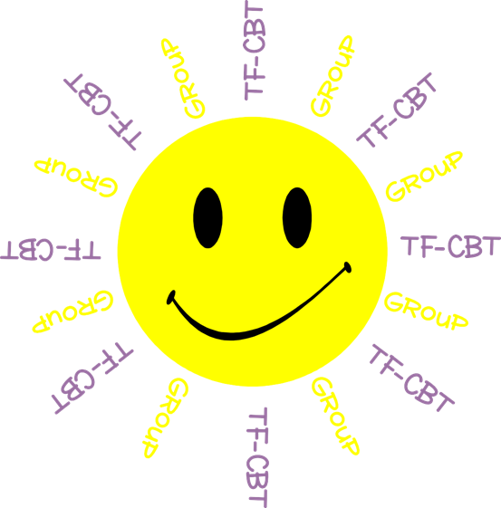
Welcome to TF-CBT Group!
Today is Group 4 of 5.
Child Trauma Services Program
© 2021 The Board of Regents of The University of Oklahoma

Slide 2
Acknowledgment
This treatment session manual for implementation of Trauma-Focused Cognitive-Behavioral Therapy (TF-CBT) in a group format was originally developed under a grant from the Oklahoma Department of Mental Health and Substance Abuse Services awarded to Drs. Susan Schmidt and Elizabeth Risch from the University of Oklahoma Health Sciences Center. This manual was developed with support by the TF-CBT treatment developers Esther Deblinger, PhD, Anthony Mannarino, PhD, and Judith Cohen, MD. The federal government’s Substance Abuse and Mental Health Services Administration has recognized TF-CBT as a Model Program due to the extensive outcome data from randomized controlled trials that support its effectiveness in improving a variety of problems in youth who have experienced trauma.
The current TF-CBT Group Curriculum Manual was developed and refined through many years of application of the treatment. Amanda Mitten, Natalie Gallo, Hannah Frye, Melissa Bernstein, and Saba Shahid contributed significantly to previous revisions of the manual. We wish to also thank Lindsey Peters, Kate Theimer, and Ashley Galsky for their assistance. This manual and work is dedicated to the families who have cared for children with a trauma history with whom we have worked.
Copyrighted The Board of Regents of the University of Oklahoma
All rights reserved. The materials contained herein are copyright protected by the University of Oklahoma and are provided for review only. No part of this publication may be reproduced, distributed, transmitted, derived or practiced in any form or by any means without the prior written permission of the University of Oklahoma, except in the case of brief quotations embodied in critical reviews and certain other noncommercial and non-medical uses permitted by copyright law.
Contact Information
OKTF-CBT
University of Oklahoma Health Sciences Center
Center on Child Abuse and Neglect
1100 NE 13th Street
Oklahoma City, OK 73117
(405) 271-5700
OKTF-CBT@ouhsc.edu
Child Trauma Services Program
© 2021 The Board of Regents of The University of Oklahoma

Slide 3
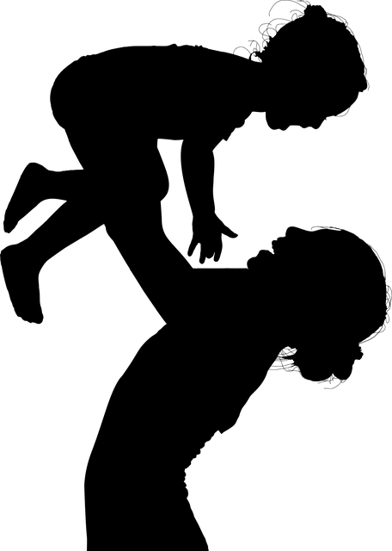
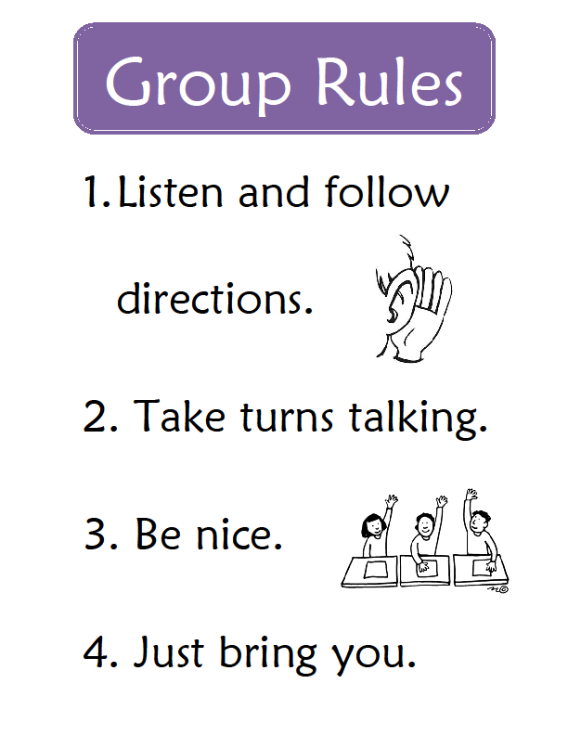
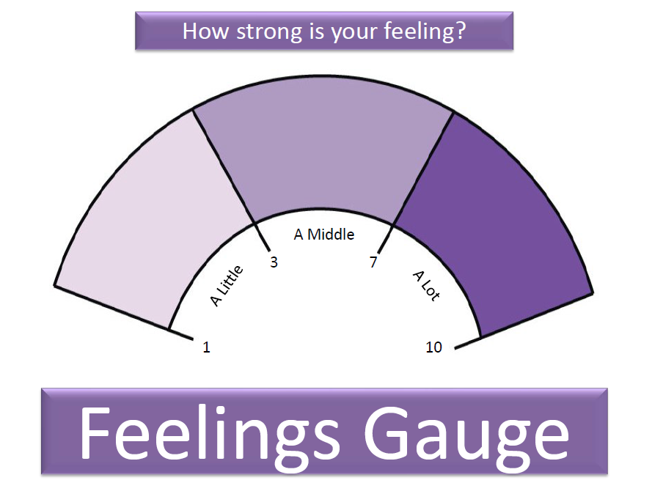
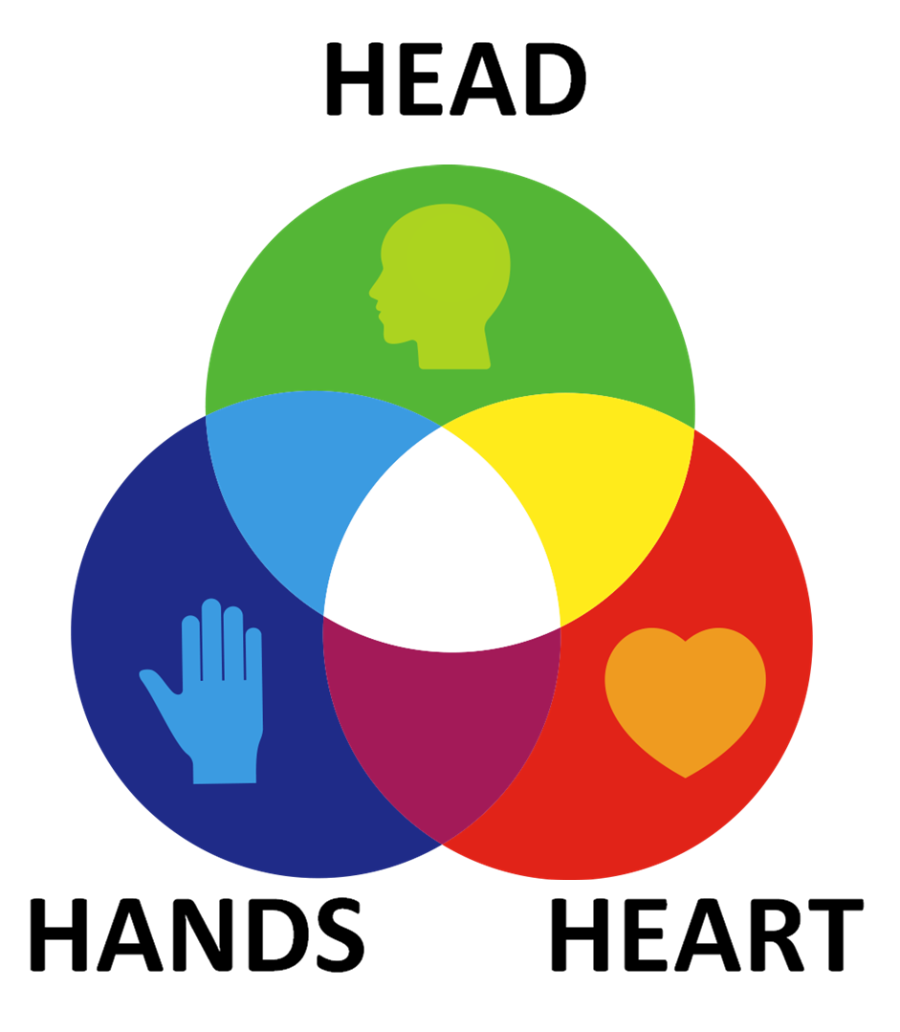
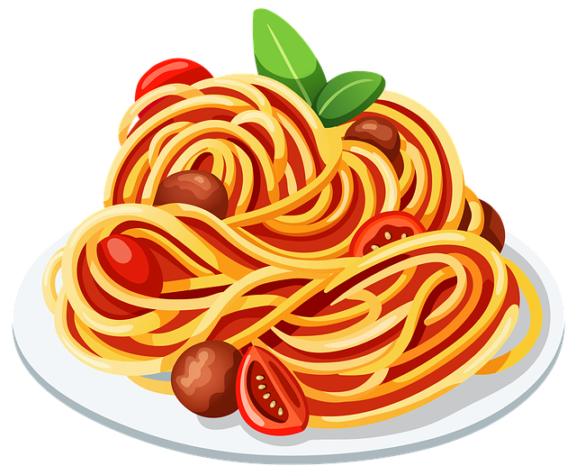
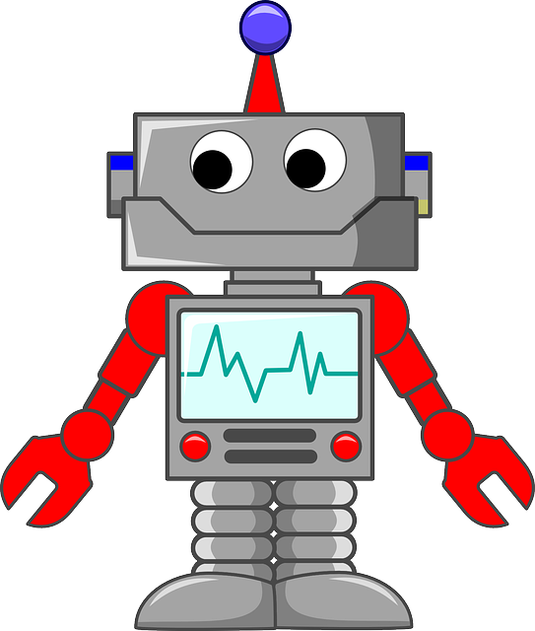
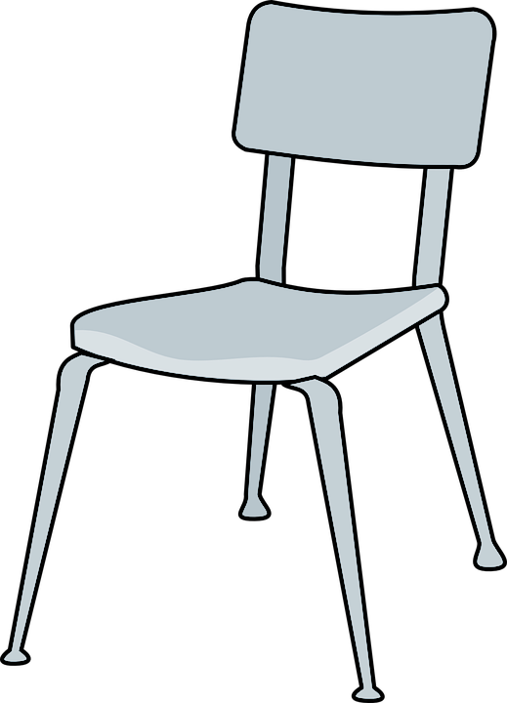
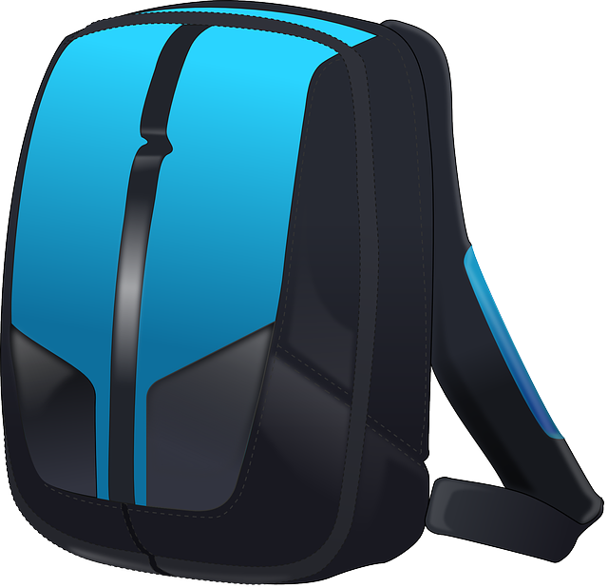
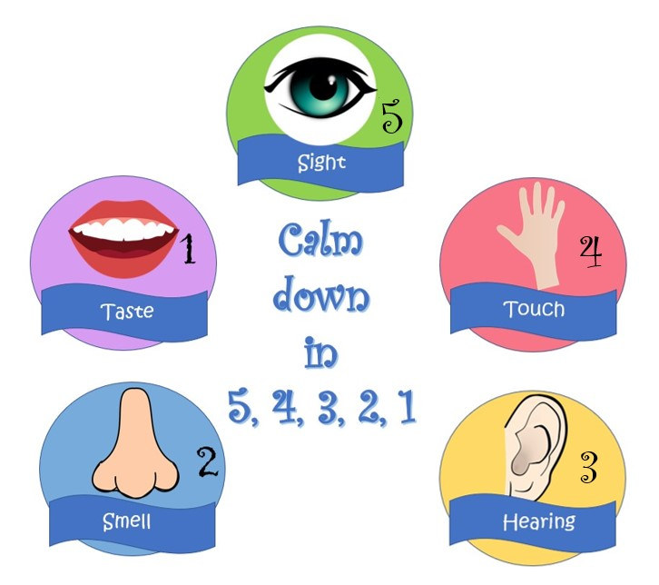
Child Trauma Services Program
© 2021 The Board of Regents of The University of Oklahoma

Slide 4
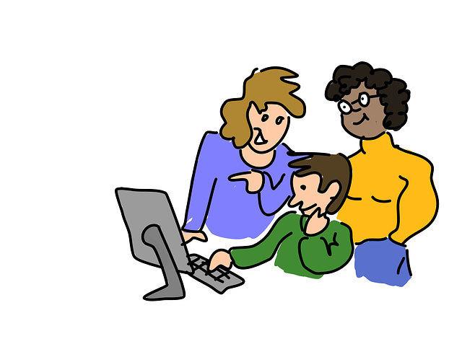
GROUP RULES
Zoom
Use the bathroom before or after group.
Be in a private space.
Keep everyone’s information private or confidential.
Take turns talking.
Keep yourself on mute.
Keep your camera on.
Be nice.
Just Be On Zoom!
Child Trauma Services Program
© 2021 The Board of Regents of The University of Oklahoma

Slide 5
Child Name 1
Child Name 2
Child Name 3
Child Name 4
Child Name 5
Child Trauma Services Program
© 2021 The Board of Regents of The University of Oklahoma

Slide 6
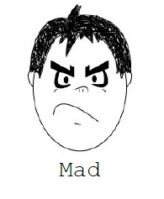
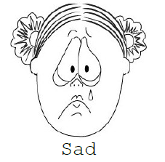
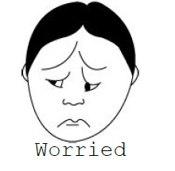
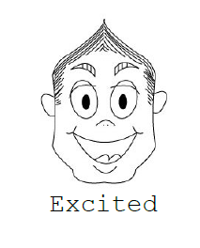
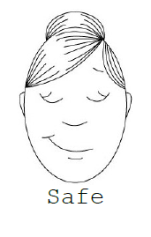
Child Trauma Services Program
© 2021 The Board of Regents of The University of Oklahoma

Slide 7
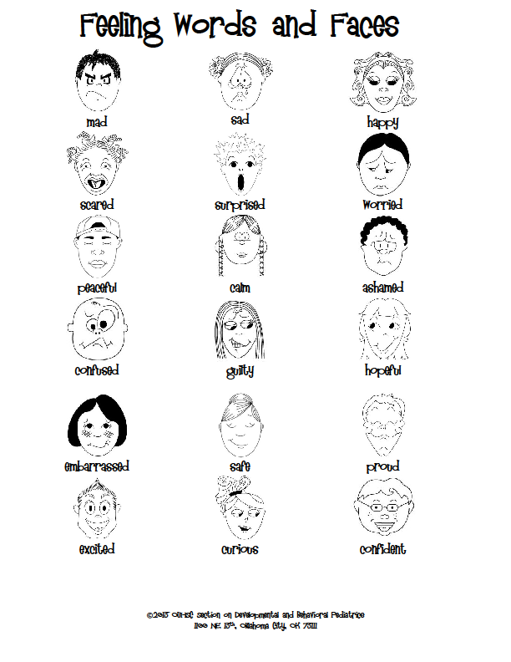
Child Trauma Services Program
© 2021 The Board of Regents of The University of Oklahoma

Slide 8
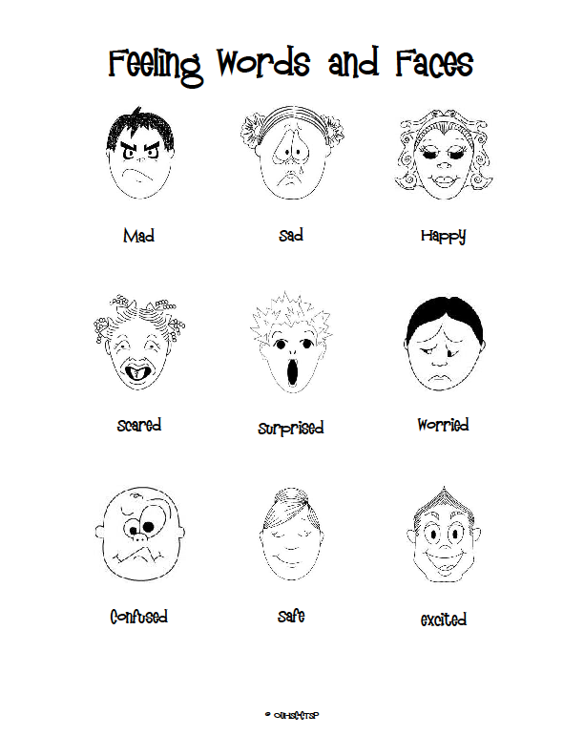
Child Trauma Services Program
© 2021 The Board of Regents of The University of Oklahoma

Slide 9
Power breaths
Breathing is the most efficient and helpful way to
calm our bodies down when we feel stress, fear, sadness, or anger. Breathing in specific ways actually tricks our brain into thinking we are at rest, and our body (our lungs and heart) follow the brain’s lead. Power breathing for 15-30 seconds can calm our bodies down without anyone else even having to know.
Put a hand on your chest and one on your stomach.
Breathe in through your nose for 4 seconds. Focus on breathing as steadily as possible and fill your lungs and stomach as much as you can.
Breathe slowly and consistently out of your mouth for 8 full seconds.
Repeat this step 3-4 times to calm your body down.
STRAUS, S. (2013). HEALING DAYS. MAGINATION Press.
Child Trauma Services Program
© 2021 The Board of Regents of The University of Oklahoma

Slide 10
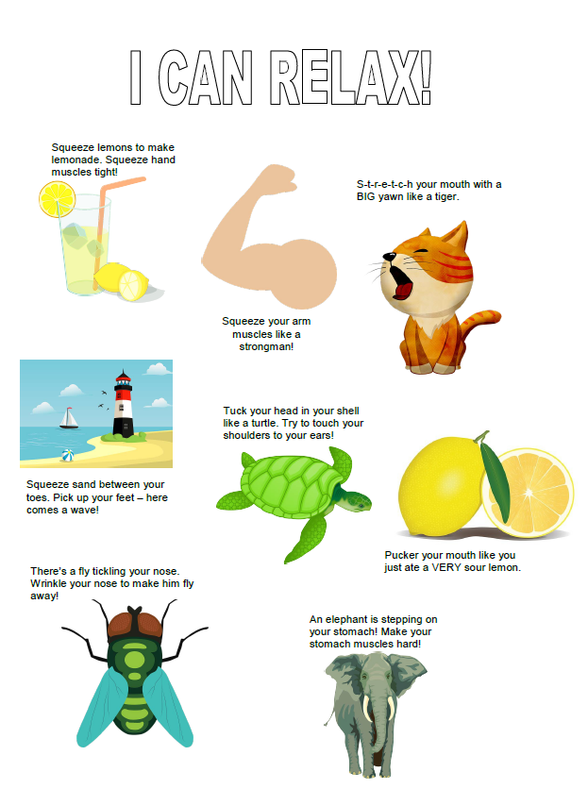
Child Trauma Services Program
© 2021 The Board of Regents of The University of Oklahoma

Slide 11
Sit in a comfortable chair. Now imagine that you are piece of cooked spaghetti. Tighten both your fists and arms, squeeze your legs and stomach and make your whole body as stiff as possible, so that you can’t bend. Keep your whole body tense until you count to five. Now relax.
Pretend that you are now a piece of cooked spaghetti. Let your whole body become loose and floppy. Let go of all of the tension in your body. Relax your shoulders and stomach, take a deep breath, and let your body be as loose and floppy as cooked spaghetti. Which feels better, being cooked or uncooked spaghetti?
Now become raw spaghetti again. Squeeze all the muscles in your body until you are as stiff as raw spaghetti. Even make your face tense – squeeze all the muscles in your mouth and forehead. Squeeze your shoulders up to your ears. Make fists with your hands. Squeeze your eyes shut and push your feet into the floor. Hold your body stiff like raw spaghetti until the count of five.
Now relax your whole body. Go floppy like raw spaghetti. Relax your face, your shoulders, your stomach, your arms and your legs. Now which felt better, being cooked or uncooked spaghetti?
Become the raw spaghetti one last time and tense your whole body from head to toe. Make every part of your body as tense and stiff as you can until the count of five.
Now relax your body like raw spaghetti. It takes a lot of work to be as tense as raw spaghetti, and can make you feel tired to do this all day. When you notice that your body is feeling stiff or tense, don’t forget that you can make yourself feel like cooked spaghetti by relaxing the muscles in your body.
Child Trauma Services Program
© 2021 The Board of Regents of The University of Oklahoma

Slide 12
5 Senses Grounding
5
4
3
Child Trauma Services Program
© 2021 The Board of Regents of The University of Oklahoma

Slide 13
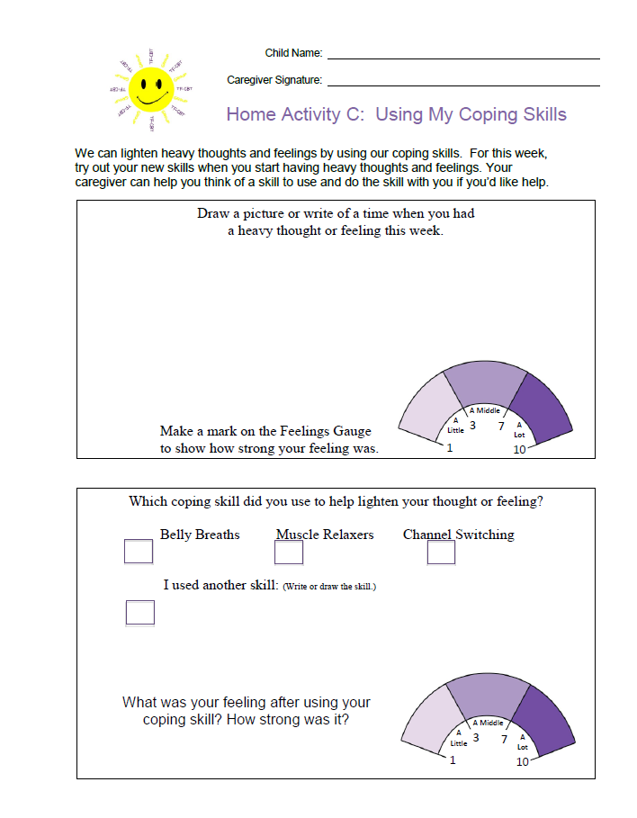
HOMEWORK REVIEW
Share a time last week when you used a relaxer to lighten a heavy thought or feeling.
Child Trauma Services Program
© 2021 The Board of Regents of The University of Oklahoma

Slide 14
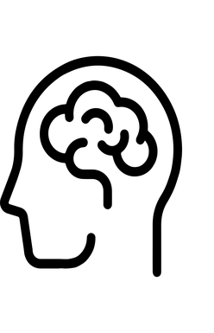
Jesse is watching a scary movie alone in the living room and hears a LOUD NOISE coming from another room in the house.
THINK
DO
FEEL
Child Trauma Services Program
© 2021 The Board of Regents of The University of Oklahoma
Notes:
Review the THINK-FEEL-DO Connection. Ask for thoughts-feelings-behavior of the child after hearing the loud noise. Then introduce the new info that a parent comes into the room and says that they accidentally knocked over a chair. Ask the children for new thoughts & feelings and what they might do next.

Slide 15
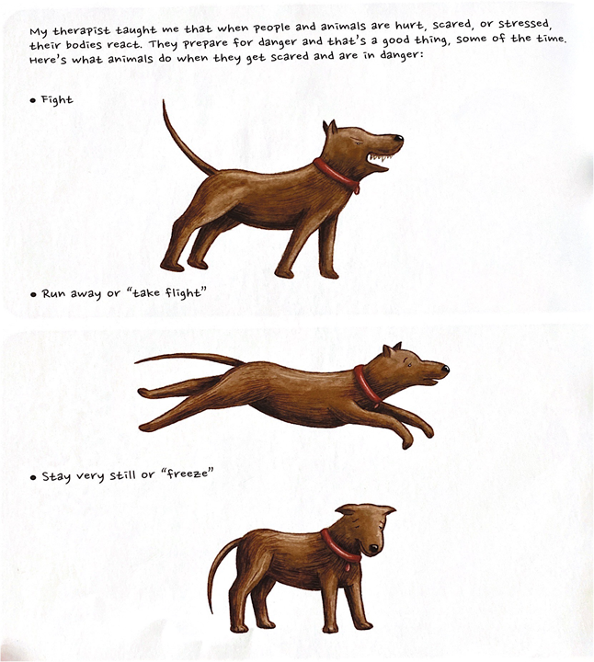
Our
Body’s
Alarm
System
What relaxers can help reset our alarm system?
STRAUS, S. (2013). HEALING DAYS. MAGINATION Press.
Child Trauma Services Program
© 2021 The Board of Regents of The University of Oklahoma

Slide 16
Instructions
You have learned so much in counseling and now it’s time to put it all together!
There are 3 sets of questions in this game:
HEAD: What have YOU learned so far in counseling?
HEART: What do YOU know about feelings?
HANDS: How well do YOU know how thoughts,
feelings and behaviors connect?
Take turns picking a card from each deck to earn HEAD, HEART and HANDS points.
Child Trauma Services Program
© 2021 The Board of Regents of The University of Oklahoma

Slide 17
HEAD
Child Trauma Services Program
© 2021 The Board of Regents of The University of Oklahoma
Notes:
What have you learned so far in counseling?

Slide 18
HEART
Child Trauma Services Program
© 2021 The Board of Regents of The University of Oklahoma
Notes:
What do you know about feelings?

Slide 19
HANDS
Child Trauma Services Program
© 2021 The Board of Regents of The University of Oklahoma
Notes:
What do you know about what people think, feel and do?

Slide 20
Every child in this group has gone through one or more really scary or upsetting experiences.
These are also called what word that starts with a “T” and rhymes with “LLAMA.”
Try saying
“TRAUMA LLAMA”
3 times in a row!
HEAD
Child Trauma Services Program
© 2021 The Board of Regents of The University of Oklahoma
Notes:
What have you learned so far in counseling?

Slide 21
Is trauma something that happens in:
-Lots of families?
-Or not many families?
What would you say to a friend who thought that the trauma that they went through was their fault?
HEAD
Child Trauma Services Program
© 2021 The Board of Regents of The University of Oklahoma
Notes:
What have you learned so far in counseling?

Slide 22
After a trauma, do children sometimes have bad dreams about it?
To get back to sleep after a bad dream, what can a child:
Say to themselves to feel less scared?
Do as a relaxer lying down in their bed to calm their body?
HEAD
Child Trauma Services Program
© 2021 The Board of Regents of The University of Oklahoma
Notes:
What have you learned so far in counseling?

Slide 23
After a trauma, do children try hard not to remember what happened? Why?
What are 3 things a child can do to feel better when trauma memories get stuck in their brain?
HEAD
Child Trauma Services Program
© 2021 The Board of Regents of The University of Oklahoma
Notes:
What have you learned so far in counseling?

Slide 24
Since the trauma happened, Reece worries that something bad will happen when she is away from her family.
Pretend that you are helping Reece feel less worried. What can you say to help her know that her grown-ups are safe?
HEAD
Child Trauma Services Program
© 2021 The Board of Regents of The University of Oklahoma
Notes:
What have you learned so far in counseling?

Slide 25
After the trauma, Julio worries that something bad will happen when he is at school. Sometimes he tries to stay home from school because he is so worried.
What are 3 ways grown-ups make sure that kids at school are safe?
Could remembering this help Julio feel safer?
HEAD
Child Trauma Services Program
© 2021 The Board of Regents of The University of Oklahoma
Notes:
What have you learned so far in counseling?

Slide 26
Daria worries that others won’t want to be her friend because of the trauma she went through.
Is this a worry lots of kids have?
What are 3 ways you are a good friend to others?
HEAD
Child Trauma Services Program
© 2021 The Board of Regents of The University of Oklahoma
Notes:
What have you learned so far in counseling?

Slide 27
Reggie is watching a TV show. In the story, people start yelling. Then Reggie’s body alarm starts going off. his heart starts racing and his stomach gets jittery.Is Reggie in danger?
Since the TV show is pretend, Reggie is safe. Pretend that you are telling this to Reggie’s alarm system. Your counselor can act like Reggie’s alarm system.
HEAD
Child Trauma Services Program
© 2021 The Board of Regents of The University of Oklahoma
Notes:
What have you learned so far in counseling?

Slide 28
Pick one group member and ask them to take turns saying light feelings with you. How many can you come up with together in 1 minute?
act out a light feeling and try to get the group to guess it.
HEART
Child Trauma Services Program
© 2021 The Board of Regents of The University of Oklahoma
Notes:
What do you know about feelings?

Slide 29
Pick one group member and ask them to take turns saying heavy feelings with you. How many can you come up with together in 1 minute?
With that group member, act out a heavy feeling and try to get the group to guess it.
HEART
Child Trauma Services Program
© 2021 The Board of Regents of The University of Oklahoma
Notes:
What do you know about feelings?

Slide 30
Name 4 heavy feelings that kids might have after going through a trauma.
Who are 3 helpful adults you can go to for support if you are having heavy feelings?
Pretend that you are telling a counselor that you are having a heavy feeling and would like to do a relaxer.
HEART
Child Trauma Services Program
© 2021 The Board of Regents of The University of Oklahoma
Notes:
What do you know about feelings?

Slide 31
After Amy went through a trauma, she feels afraid in lots of different situations.
Do many kids feel afraid after trauma happens?
Pretend that you are telling a grown up that you are feeling afraid and would like their help to feel better.
HEART
Child Trauma Services Program
© 2021 The Board of Regents of The University of Oklahoma
Notes:
What do you know about feelings?

Slide 32
What scale can we use to describe how much of a feeling we are having?
What is 1 feeling you had during your trauma and what number was it on the scale?
What is 1 feeling you are having now and what level?
HEART
Child Trauma Services Program
© 2021 The Board of Regents of The University of Oklahoma
Notes:
What do you know about feelings?

Slide 33
After Brian went through a trauma, he gets mad easily and gets in trouble more often.
Do some kids feel mad more often after trauma happens?
What can Brian do to lighten his mad feeling?
HEART
Child Trauma Services Program
© 2021 The Board of Regents of The University of Oklahoma
Notes:
What do you know about feelings?

Slide 34
When Sophie is reminded of the trauma that happened, she has strong feelings in her body.
What are 4 body reactions we might feel when we are scared or upset?
HEART
Child Trauma Services Program
© 2021 The Board of Regents of The University of Oklahoma
Notes:
What do you know about feelings?

Slide 35
How can we find out how someone is feeling?
Ask someone in the group how they are feeling and how much of the feeling they are having. You can use the feelings scale to help.
HEART
Child Trauma Services Program
© 2021 The Board of Regents of The University of Oklahoma
Notes:
What do you know about feelings?

Slide 36
When Mindy feels scared, deep breaths help lighten her feeling.
Lead others in doing 3 deep breaths.
HANDS
Child Trauma Services Program
© 2021 The Board of Regents of The University of Oklahoma
Notes:
What do you know about what people think, feel and do?

Slide 37
When Lionel gets mad, muscle relaxers help lighten his feeling.
Lead others in doing a muscle relaxer of your choice.
HANDS
Child Trauma Services Program
© 2021 The Board of Regents of The University of Oklahoma
Notes:
What do you know about what people think, feel and do?

Slide 38
When Luke feels upset,the 5 Senses help lighten his feelings.
Lead others in the 5 Senses.
5 things you see.
4 things you feel.
3 things you hear.
2 things you smell.
1 thing you taste.
HANDS
Child Trauma Services Program
© 2021 The Board of Regents of The University of Oklahoma
Notes:
What do you know about what people think, feel and do?

Slide 39
Sirens remind Katy of the day the trauma happened.
What’s 1 muscle relaxer Katy can do to lighten her heavy feelings when she hears sirens?
Lead others in doing a muscle relaxer of your choice.
HANDS
Child Trauma Services Program
© 2021 The Board of Regents of The University of Oklahoma
Notes:
What do you know about what people think, feel and do?

Slide 40
Daisy the Deer is walking through the forest when she sees something move in the grass. Right away, she stops so still that nothing can see her!
Which of these did Daisy’s body use for protection?
Fight
Flight
Freeze
HANDS
Child Trauma Services Program
© 2021 The Board of Regents of The University of Oklahoma
Notes:
What do you know about what people think, feel and do?

Slide 41
Lafayette the Labrador barks at every noise he hears. His body alarm tells him that there might be danger.
Which one is his barking - Fight, Flight or Freeze?
What would you do to help Lafayette calm down if there’s no danger?
HANDS
Child Trauma Services Program
© 2021 The Board of Regents of The University of Oklahoma
Notes:
What do you know about what people think, feel and do?

Slide 42
Fun activities can help lighten our heavy thoughts, feelings and memories.
Let’s do some charades!
Using no words, get others to guess 3 activities that are fun for you.
Some ideas include: dancing, video games, writing in a journal, basketball, singing
HANDS
Child Trauma Services Program
© 2021 The Board of Regents of The University of Oklahoma
Notes:
What do you know about what people think, feel and do?

Slide 43
It’s good to relax our bodies throughout the day to keep our alarm systems from going off when they shouldn’t.
When are 2 times each day that you can do a relaxer? Which relaxers will you do?
HANDS
Child Trauma Services Program
© 2021 The Board of Regents of The University of Oklahoma
Notes:
What do you know about what people think, feel and do?

Slide 44
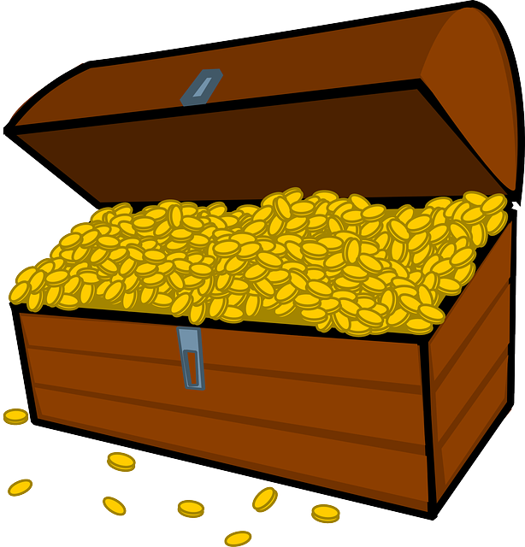
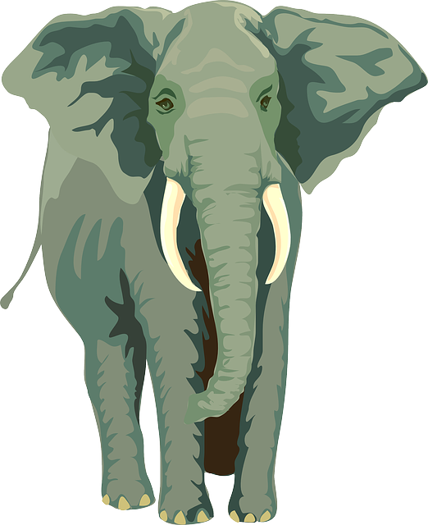
I spy,
with my little eye
Child Trauma Services Program
© 2021 The Board of Regents of The University of Oklahoma

Slide 45
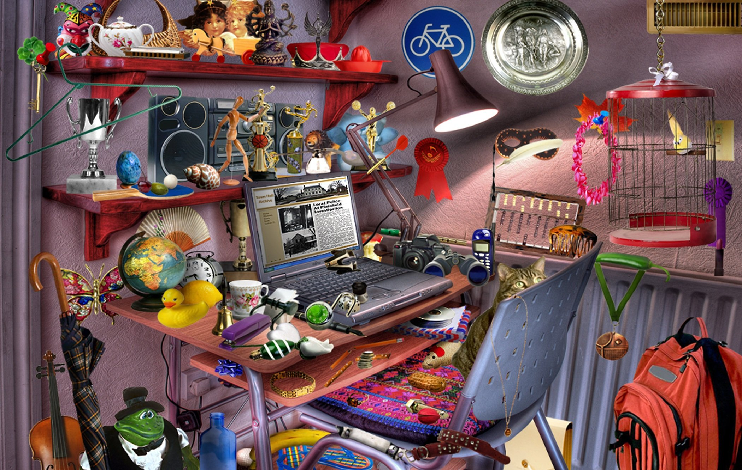
Child Trauma Services Program
© 2021 The Board of Regents of The University of Oklahoma

Slide 46
Find something that starts with the first letter of your name | Find something made of plastic | Find something that makes you smile
Find something that is green | Find something with numbers on it | Find something with a face on it
Find something with wheels | Find something that you made | Find something that is blue
Child Trauma Services Program
© 2021 The Board of Regents of The University of Oklahoma

Slide 47
Welcome to TF-CBT Group Combined Time!
Child Trauma Services Program
© 2021 The Board of Regents of The University of Oklahoma

Slide 48
Combined Time Instructions
Your family has learned so much in counseling and now it’s time to put it all together!
There are 3 types of questions in this Activity:
HEAD: What has YOUR FAMILY learned so far in counseling?
HEART: What does YOUR FAMILY know about feelings?
HANDS: How well does YOUR FAMILY know how thoughts,
feelings and behaviors connect?
The goal for your family is to work together to earn HEAD, HEART, and HANDS Points.
Family members can help each other when needed!
Child Trauma Services Program
© 2021 The Board of Regents of The University of Oklahoma

Slide 49
Combined
Child Trauma Services Program
© 2021 The Board of Regents of The University of Oklahoma
Notes:
What have you learned so far in counseling?

Slide 50
Show us how well your family knows feelings!
Take turns as a family saying as many feelings words your family knows in 1 minute.
Combined
Child Trauma Services Program
© 2021 The Board of Regents of The University of Oklahoma
Notes:
What have you learned so far in counseling?

Slide 51
Show us how well your family knows your senses!
Have each member take turns saying one thing they can see, feel, hear, smell or taste.
Combined
Child Trauma Services Program
© 2021 The Board of Regents of The University of Oklahoma
Notes:
What have you learned so far in counseling?

Slide 52
How well does your family show your feelings?
Work together with your family to act out 5 feelings and get the group to guess them.
Remember, all family members should act out the feelings!
Combined
Child Trauma Services Program
© 2021 The Board of Regents of The University of Oklahoma
Notes:
What have you learned so far in counseling?

Slide 53
How well does your family know the feelings scale?
Work with your family to act out what a little, a middle and a lot of a feeling looks like and get the group to guess.
Do this for 2 different feelings.
Combined
Child Trauma Services Program
© 2021 The Board of Regents of The University of Oklahoma
Notes:
What have you learned so far in counseling?

Slide 54
Kids might feel down on themselves after a trauma happens. They can lighten their heavy thoughts by remembering all the ways they’re awesome!
Family, for the next 30 seconds, take turns telling each other how the members of your family are awesome!
Combined
Child Trauma Services Program
© 2021 The Board of Regents of The University of Oklahoma
Notes:
What have you learned so far in counseling?

Slide 55
T/F | Trauma is something that doesn’t happen to many children.
T/F | When trauma happens, it is probably the child’s fault.
T/F | Lots of children may have heavy thoughts, feelings and reactions after going through trauma.
T/F | People can tell just by looking at a child that they have gone through a trauma.
T/F | Heavy trauma-related thoughts, feelings and reactions will never get better for children.
T/F | Children and families can heal and grow stronger through counseling.
Combined
Child Trauma Services Program
© 2021 The Board of Regents of The University of Oklahoma
Notes:
What have you learned so far in counseling?

Slide 56
Using the Think-Feel-Do Triangle, help Essence choose helpful thoughts and behaviors to lighten her heavy memories and turn off her body alarm:
Essence is reading a book during free time in class and a trauma memory comes into her mind. Essence feels like she’s right back in the trauma.
THINK
Combined
DO
FEEL
Child Trauma Services Program
© 2021 The Board of Regents of The University of Oklahoma
Notes:
What have you learned so far in counseling?

Slide 57
When we have heavy thoughts, feelings or memories, we can do something fun to feel better.
Family, for the next 30 seconds, take turns saying free fun things your family can do to relax together.
Combined
Child Trauma Services Program
© 2021 The Board of Regents of The University of Oklahoma
Notes:
What have you learned so far in counseling?

Slide 58
Practicing relaxation is important for keeping our body alarms from going off when there isn’t danger.
Lead everyone in 3 deep breaths.
Inhale through your nose for 3.
Exhale through your mouth for 3.
Combined
Child Trauma Services Program
© 2021 The Board of Regents of The University of Oklahoma
Notes:
What have you learned so far in counseling?

Slide 59
When we are reminded of an upsetting or scary experience, our body alarm may go off. To help our body calm down, it is helpful to do a relaxer.
Lead everyone in a muscle relaxer of your family’s choice.
Combined
Child Trauma Services Program
© 2021 The Board of Regents of The University of Oklahoma
Notes:
What have you learned so far in counseling?

Slide 60
When we sense danger, our body alarm system activates to protect us.
Act each of the body alarm’s 3 F’s (Fight, Flight, Freeze) and get the group to guess them.
Combined
Child Trauma Services Program
© 2021 The Board of Regents of The University of Oklahoma
Notes:
What have you learned so far in counseling?

Slide 61
How we think, what we feel and what we do are all connected.
Using the Think-Feel-Do Triangle, walk through this situation:
Xavier walks into the lunch room and sees his best friends. They see him, whisper to each other, and laugh.
THINK
Combined
DO
FEEL
Child Trauma Services Program
© 2021 The Board of Regents of The University of Oklahoma
Notes:
What have you learned so far in counseling?

Slide 62
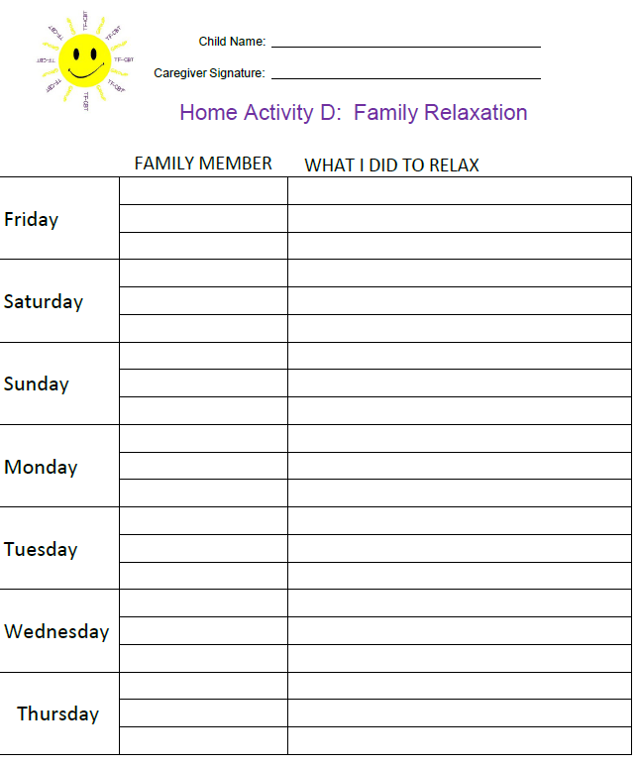
HOME
Activity
All family members will practice daily relaxation on their own and as a family.
Remember to bring back your completed home activity sheet to be entered into the prize drawing!
Child Trauma Services Program
© 2021 The Board of Regents of The University of Oklahoma

Slide 63
HOME Activity Prize drawing
Who completed their weekly home activity?
Child Trauma Services Program
© 2021 The Board of Regents of The University of Oklahoma

Slide 64
Participation prize
Child Trauma Services Program
© 2021 The Board of Regents of The University of Oklahoma

