Slide 1
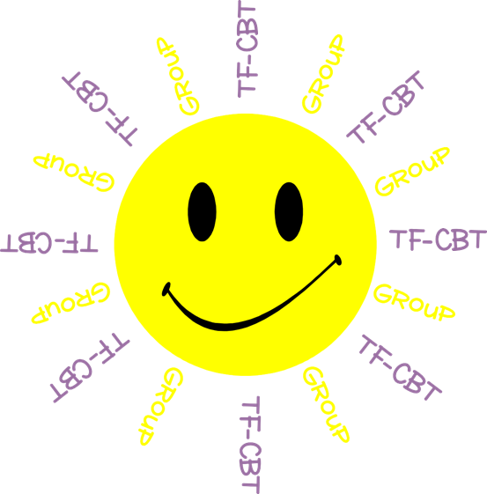
Welcome to TF-CBT Group!
Today is Group 3 of 5.
Child Trauma Services Program
© 2021 The Board of Regents of The University of Oklahoma

Slide 2
Acknowledgment
This treatment session manual for implementation of Trauma-Focused Cognitive-Behavioral Therapy (TF-CBT) in a group format was originally developed under a grant from the Oklahoma Department of Mental Health and Substance Abuse Services awarded to Drs. Susan Schmidt and Elizabeth Risch from the University of Oklahoma Health Sciences Center. This manual was developed with support by the TF-CBT treatment developers Esther Deblinger, PhD, Anthony Mannarino, PhD, and Judith Cohen, MD. The federal government’s Substance Abuse and Mental Health Services Administration has recognized TF-CBT as a Model Program due to the extensive outcome data from randomized controlled trials that support its effectiveness in improving a variety of problems in youth who have experienced trauma.
The current TF-CBT Group Curriculum Manual was developed and refined through many years of application of the treatment. Amanda Mitten, Natalie Gallo, Hannah Frye, Melissa Bernstein, and Saba Shahid contributed significantly to previous revisions of the manual. We wish to also thank Lindsey Peters, Kate Theimer, and Ashley Galsky for their assistance. This manual and work is dedicated to the families who have cared for children with a trauma history with whom we have worked.
Copyrighted The Board of Regents of the University of Oklahoma
All rights reserved. The materials contained herein are copyright protected by the University of Oklahoma and are provided for review only. No part of this publication may be reproduced, distributed, transmitted, derived or practiced in any form or by any means without the prior written permission of the University of Oklahoma, except in the case of brief quotations embodied in critical reviews and certain other noncommercial and non-medical uses permitted by copyright law.
Contact Information
OKTF-CBT
University of Oklahoma Health Sciences Center
Center on Child Abuse and Neglect
1100 NE 13th Street
Oklahoma City, OK 73117
(405) 271-5700
OKTF-CBT@ouhsc.edu
Child Trauma Services Program
© 2021 The Board of Regents of The University of Oklahoma

Slide 3
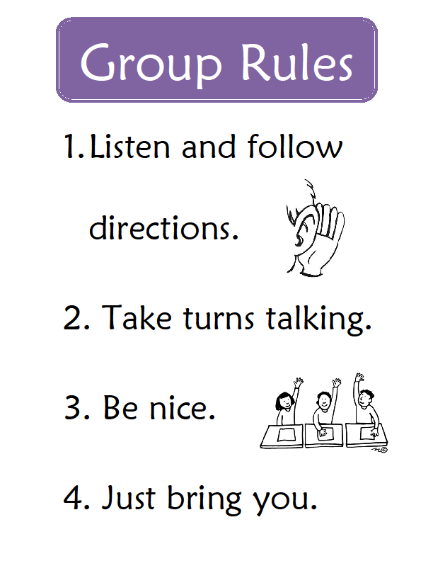
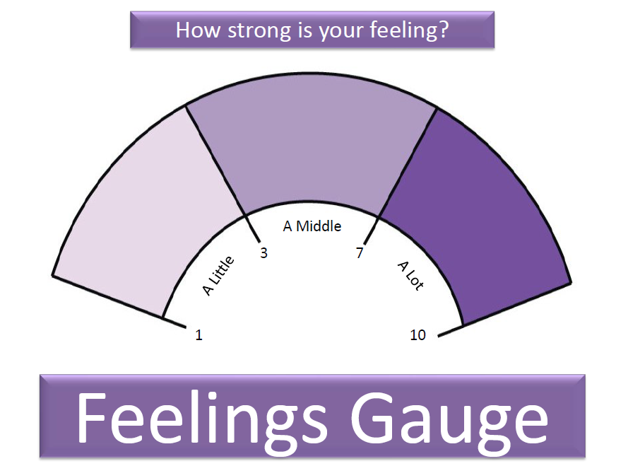
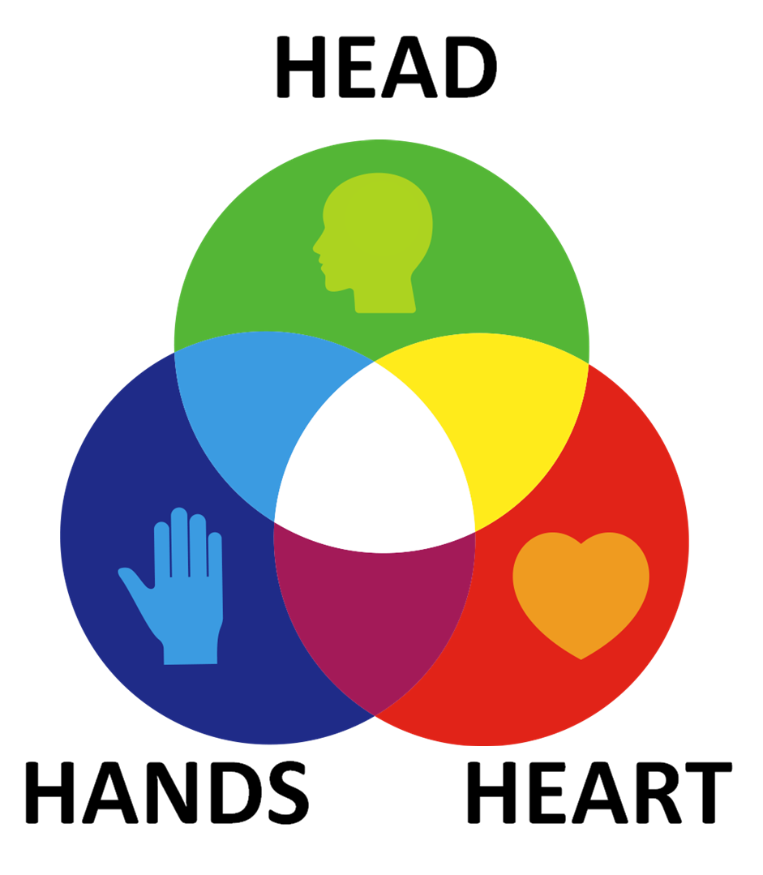
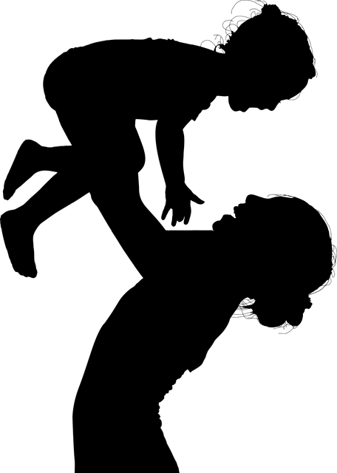
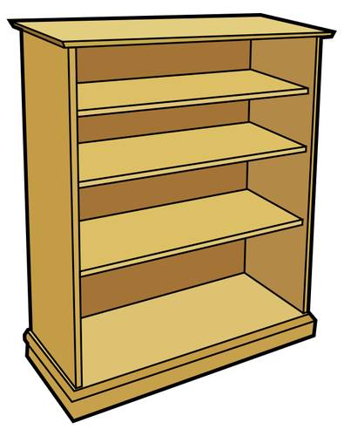
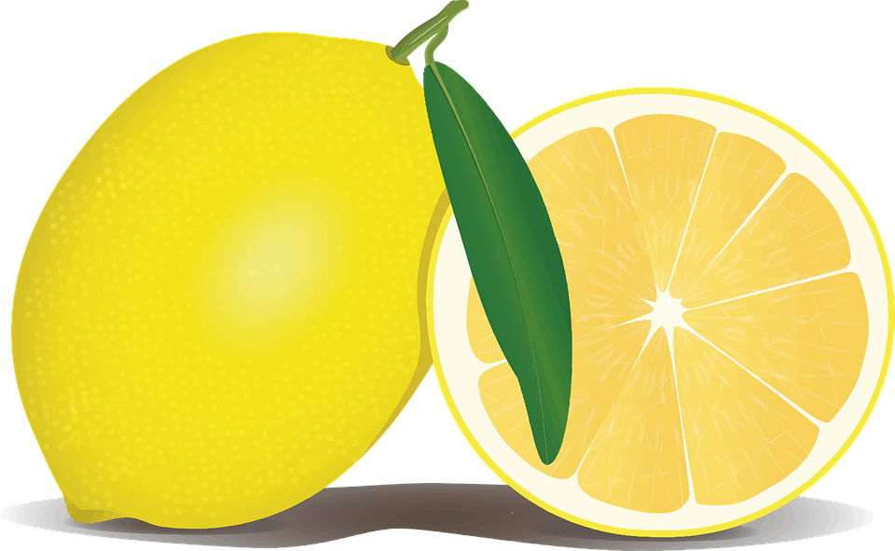
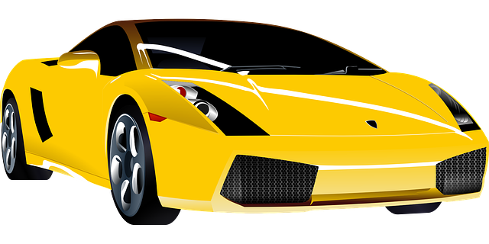
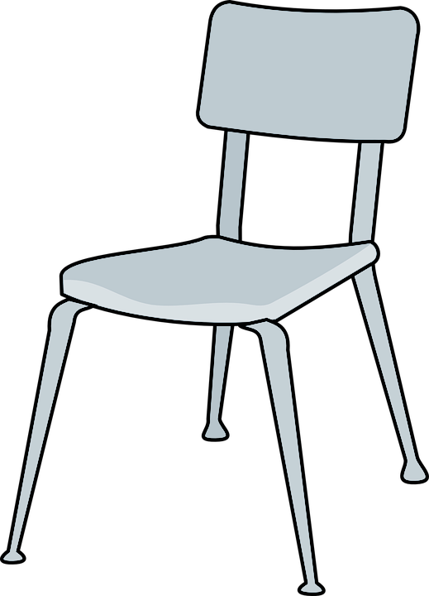
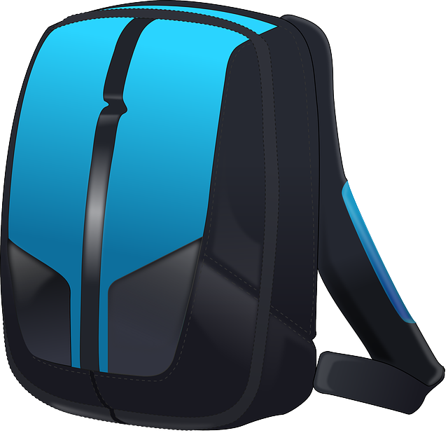
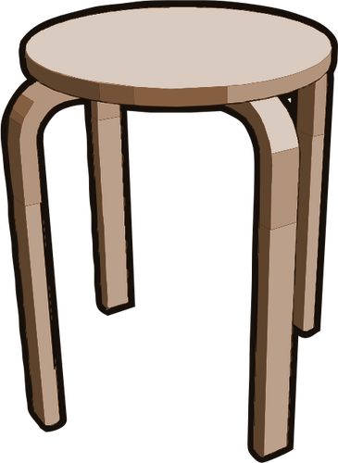
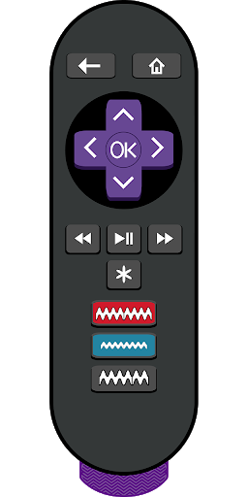
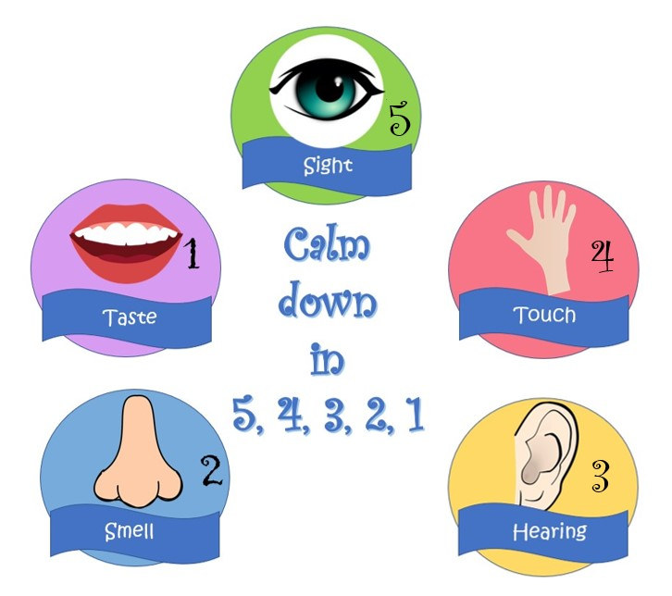
Child Trauma Services Program
© 2021 The Board of Regents of The University of Oklahoma

Slide 4
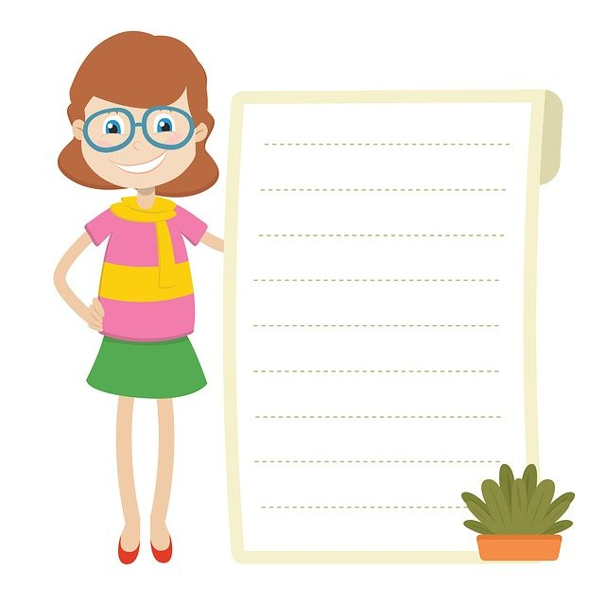
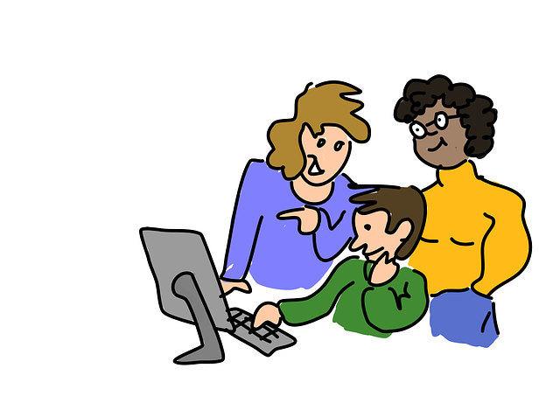
GROUP RULES
Use the bathroom before or after group.
Be in a private space.
Keep everyone’s information private or confidential.
Take turns talking.
Keep yourself on mute.
Keep your camera on.
Be nice.
Just Be On Zoom!
Child Trauma Services Program
© 2021 The Board of Regents of The University of Oklahoma

Slide 5
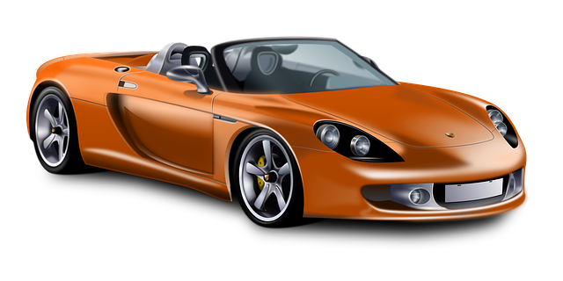
Youth A
Youth B
Youth C
Youth D
Youth E
Youth F
Child Trauma Services Program
© 2021 The Board of Regents of The University of Oklahoma

Slide 6
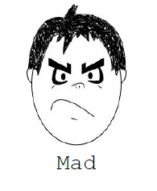
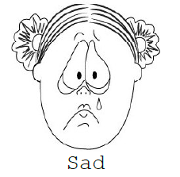
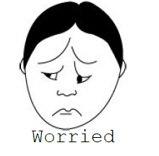
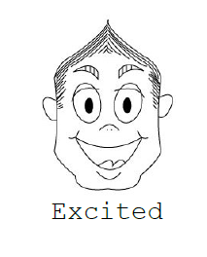
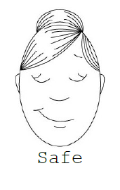
Child Trauma Services Program
© 2021 The Board of Regents of The University of Oklahoma

Slide 7
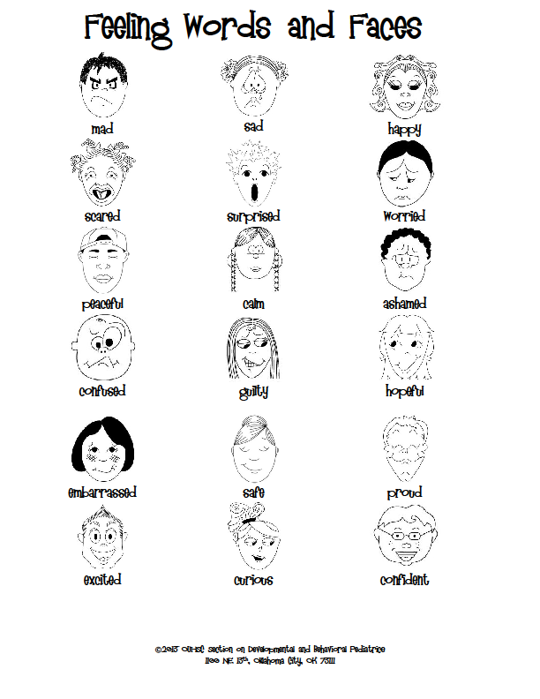
Child Trauma Services Program
© 2021 The Board of Regents of The University of Oklahoma

Slide 8
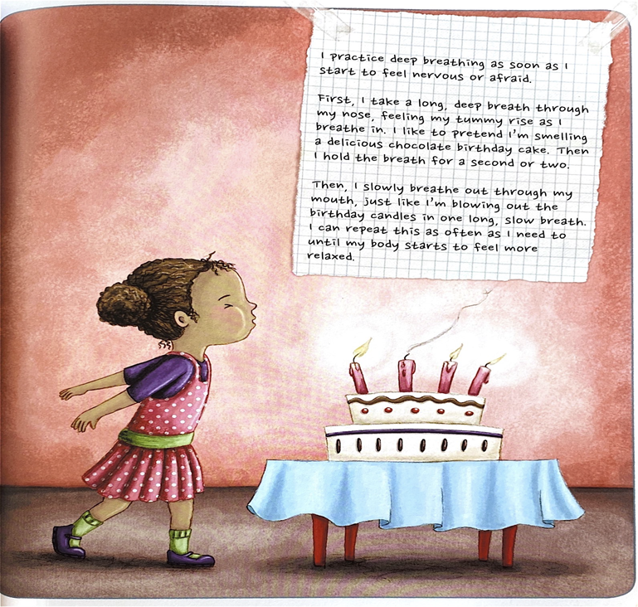
Deep Breaths
STRAUS, S. (2013). HEALING DAYS. MAGINATION Press.
Child Trauma Services Program
© 2021 The Board of Regents of The University of Oklahoma

Slide 9
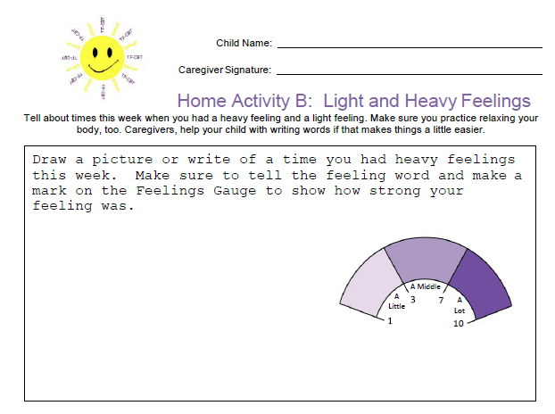
HOME
Activity review
Share about a time you Had a light or heavy feeling.
Child Trauma Services Program
© 2021 The Board of Regents of The University of Oklahoma

Slide 10
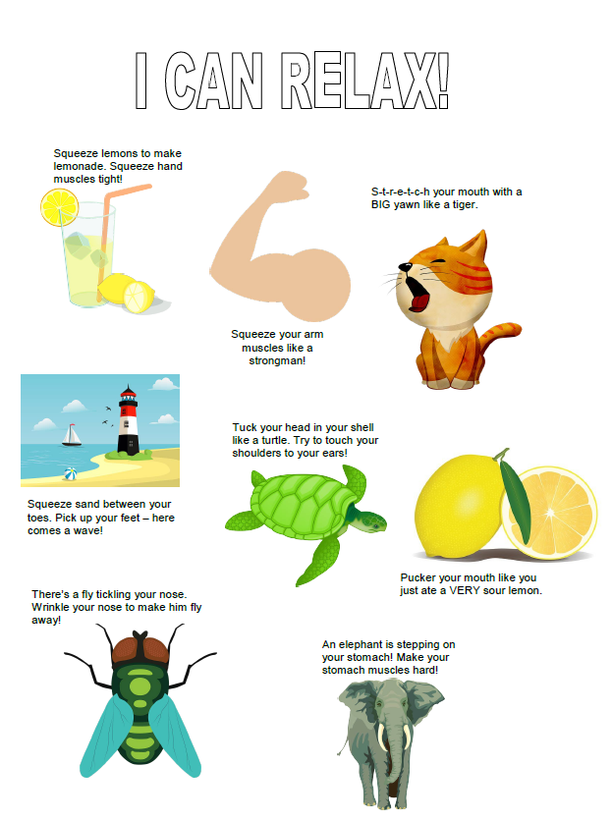
Muscle Relaxers
Child Trauma Services Program
© 2021 The Board of Regents of The University of Oklahoma

Slide 11
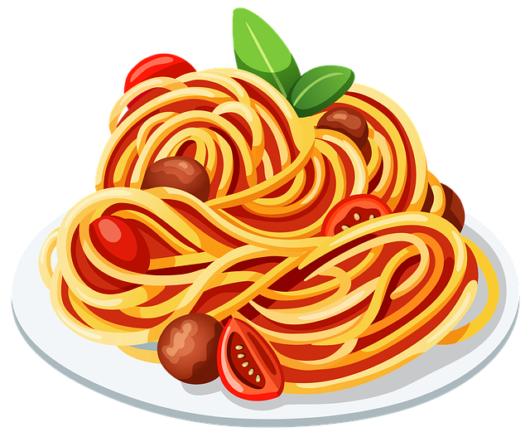
Sit in a comfortable chair. Now imagine that you are piece of cooked spaghetti. Tighten both your fists and arms, squeeze your legs and stomach and make your whole body as stiff as possible, so that you can’t bend. Keep your whole body tense until you count to five. Now relax.
Pretend that you are now a piece of cooked spaghetti. Let your whole body become loose and floppy. Let go of all of the tension in your body. Relax your shoulders and stomach, take a deep breath, and let your body be as loose and floppy as cooked spaghetti. Which feels better, being cooked or uncooked spaghetti?
Now become raw spaghetti again. Squeeze all the muscles in your body until you are as stiff as raw spaghetti. Even make your face tense – squeeze all the muscles in your mouth and forehead. Squeeze your shoulders up to your ears. Make fists with your hands. Squeeze your eyes shut and push your feet into the floor. Hold your body stiff like raw spaghetti until the count of five.
Now relax your whole body. Go floppy like raw spaghetti. Relax your face, your shoulders, your stomach, your arms and your legs. Now which felt better, being cooked or uncooked spaghetti?
Become the raw spaghetti one last time and tense your whole body from head to toe. Make every part of your body as tense and stiff as you can until the count of five.
Now relax your body like raw spaghetti. It takes a lot of work to be as tense as raw spaghetti, and can make you feel tired to do this all day. When you notice that your body is feeling stiff or tense, don’t forget that you can make yourself feel like cooked spaghetti by relaxing the muscles in your body.
Child Trauma Services Program
© 2021 The Board of Regents of The University of Oklahoma

Slide 12
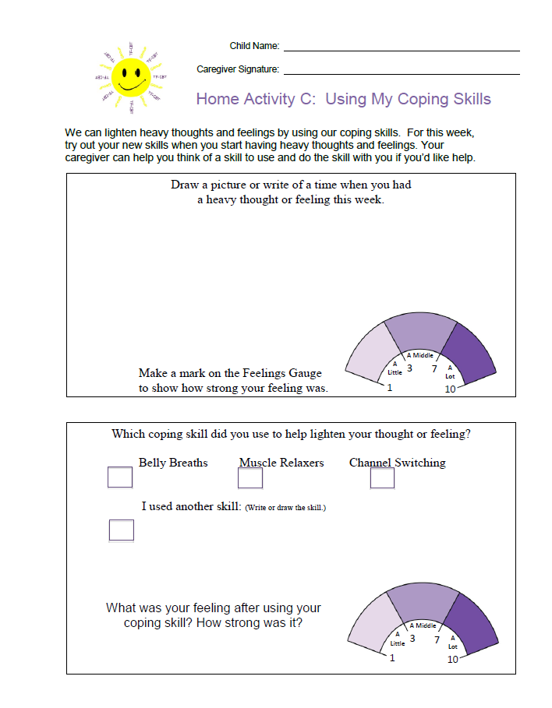
HOMEWORK REVIEW
Share a time last week when you used a relaxer to lighten a heavy thought or feeling.
Child Trauma Services Program
© 2021 The Board of Regents of The University of Oklahoma

Slide 13
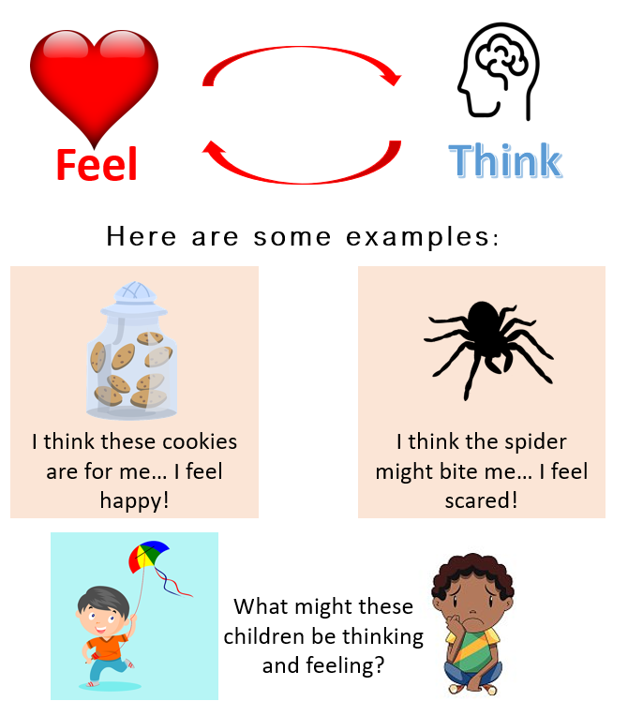
Did you know that our feelings and thoughts are connected?
Child Trauma Services Program
© 2021 The Board of Regents of The University of Oklahoma

Slide 14
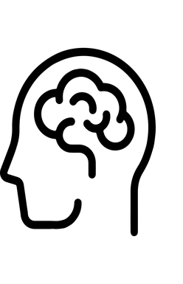
Pizza is my favorite!!!
THINK
DO
FEEL
Child Trauma Services Program
© 2021 The Board of Regents of The University of Oklahoma

Slide 15
Mushrooms are disgusting!!
THINK
DO
FEEL
Child Trauma Services Program
© 2021 The Board of Regents of The University of Oklahoma

Slide 16
Now I can’t eat it!! No one cares what I want.
THINK
DO
FEEL
Child Trauma Services Program
© 2021 The Board of Regents of The University of Oklahoma

Slide 17
I will get a good grade on my test because I studied A LOT.
THINK
DO
FEEL
Child Trauma Services Program
© 2021 The Board of Regents of The University of Oklahoma

Slide 18
Walk into class and 2 kids start laughing
THINK
DO
FEEL
Child Trauma Services Program
© 2021 The Board of Regents of The University of Oklahoma
Notes:
Use different colors to show connected think – feel – do.

Slide 19
Jesse walks into class and says “hi” as she goes past her best friend’s desk. Her best friend doesn’t look at her or say anything.
THINK
DO
FEEL
Child Trauma Services Program
© 2021 The Board of Regents of The University of Oklahoma
Notes:
Review the THINK-FEEL-DO Connection. Ask for thoughts-feelings-behavior of Jesse. Ask the children for new thoughts & feelings and what they might do next.

Slide 20
Hear a loud noise in the house at night
THINK
DO
FEEL
Child Trauma Services Program
© 2021 The Board of Regents of The University of Oklahoma

Slide 21
Jace is in the lunch line with a full tray of food. Someone bumps him from behind. Jace drops his tray and food spills all over his new hoodie.
Thought:
Behavior:
THINK
New Thought:
New Behavior:
DO
FEEL
Feelings
New Feeling & #:
Child Trauma Services Program
© 2021 The Board of Regents of The University of Oklahoma
Notes:
Use different colors to show connected think – feel – do.

Slide 22
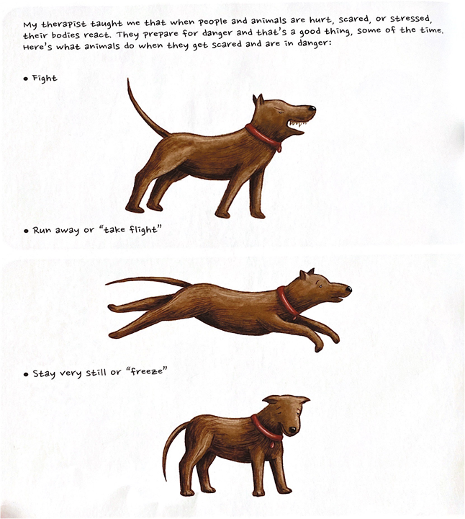
Our
Body’s
Alarm
System
What relaxers can help reset our alarm system?
STRAUS, S. (2013). HEALING DAYS. MAGINATION Press.
Child Trauma Services Program
© 2021 The Board of Regents of The University of Oklahoma

Slide 23
Welcome to TF-CBT Group Combined Time!
Child Trauma Services Program
© 2021 The Board of Regents of The University of Oklahoma

Slide 24
5 Senses Grounding
5
4
3
Child Trauma Services Program
© 2021 The Board of Regents of The University of Oklahoma

Slide 25
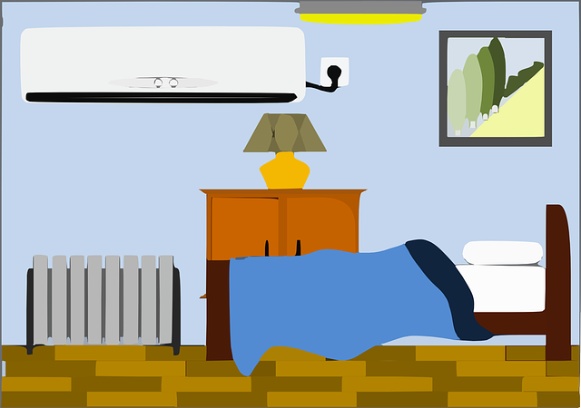
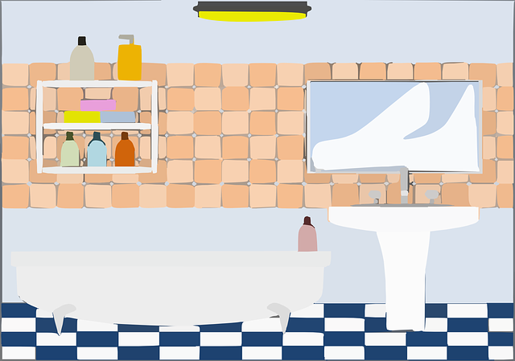
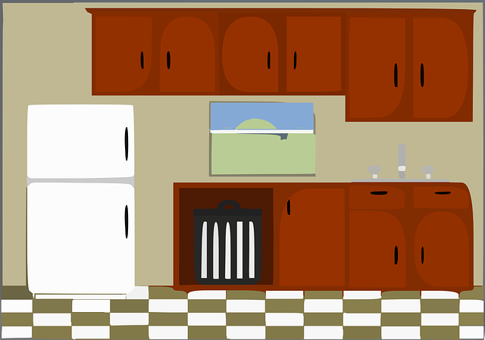
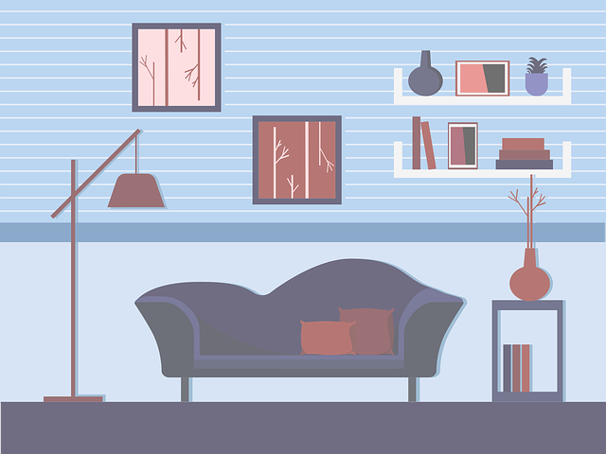
1
2
3
5
6
4
Child Trauma Services Program
© 2021 The Board of Regents of The University of Oklahoma
Notes:
Build a house activity – each family can solve to add one room to the house

Slide 26
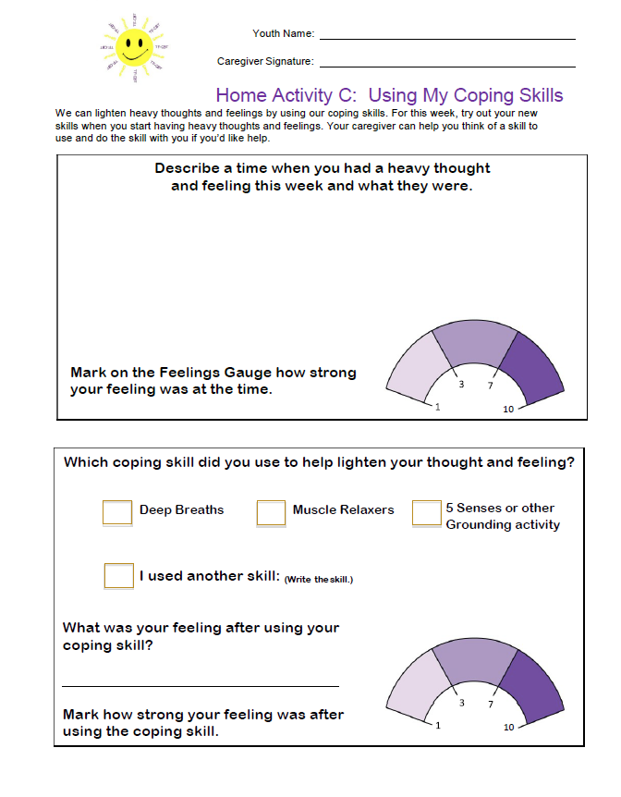
HOME
Activity
Two different times this week, write about a time you had heavy thoughts. Mark on the Feelings Gauge how heavy your feeling was. Track What coping skill you used.
Remember to bring back your completed home activity sheet to be entered into the prize drawing!
Child Trauma Services Program
© 2021 The Board of Regents of The University of Oklahoma

Slide 27
HOME Activity Prize Drawing
Who completed their weekly home activity?
Child Trauma Services Program
© 2021 The Board of Regents of The University of Oklahoma

Slide 28
Participation Prize
Child Trauma Services Program
© 2021 The Board of Regents of The University of Oklahoma

