Slide 1
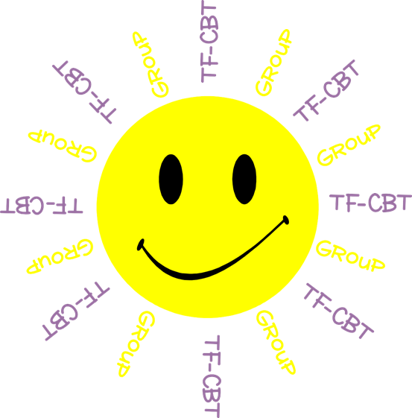
Welcome to TF-CBT Group!
Today is Group 3 of 5.
Child Trauma Services Program
© 2021 The Board of Regents of The University of Oklahoma

Slide 2
Acknowledgment
This treatment session manual for implementation of Trauma-Focused Cognitive-Behavioral Therapy (TF-CBT) in a group format was originally developed under a grant from the Oklahoma Department of Mental Health and Substance Abuse Services awarded to Drs. Susan Schmidt and Elizabeth Risch from the University of Oklahoma Health Sciences Center. This manual was developed with support by the TF-CBT treatment developers Esther Deblinger, PhD, Anthony Mannarino, PhD, and Judith Cohen, MD. The federal government’s Substance Abuse and Mental Health Services Administration has recognized TF-CBT as a Model Program due to the extensive outcome data from randomized controlled trials that support its effectiveness in improving a variety of problems in youth who have experienced trauma.
The current TF-CBT Group Curriculum Manual was developed and refined through many years of application of the treatment. Amanda Mitten, Natalie Gallo, Hannah Frye, Melissa Bernstein, and Saba Shahid contributed significantly to previous revisions of the manual. We wish to also thank Lindsey Peters, Kate Theimer, and Ashley Galsky for their assistance. This manual and work is dedicated to the families who have cared for children with a trauma history with whom we have worked.
Copyrighted The Board of Regents of the University of Oklahoma
All rights reserved. The materials contained herein are copyright protected by the University of Oklahoma and are provided for review only. No part of this publication may be reproduced, distributed, transmitted, derived or practiced in any form or by any means without the prior written permission of the University of Oklahoma, except in the case of brief quotations embodied in critical reviews and certain other noncommercial and non-medical uses permitted by copyright law.
Contact Information
OKTF-CBT
University of Oklahoma Health Sciences Center
Center on Child Abuse and Neglect
1100 NE 13th Street
Oklahoma City, OK 73117
(405) 271-5700
OKTF-CBT@ouhsc.edu
Child Trauma Services Program
© 2021 The Board of Regents of The University of Oklahoma

Slide 3
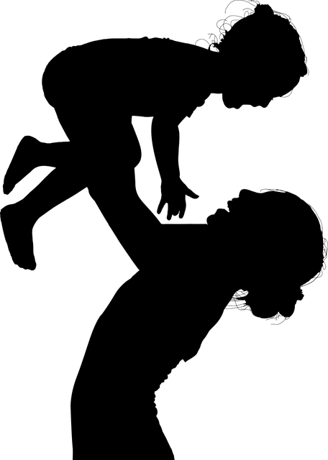
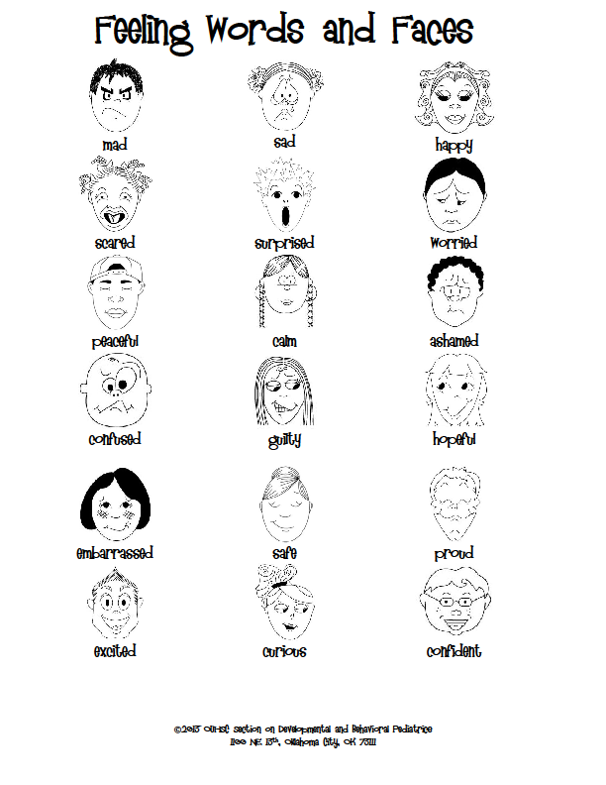
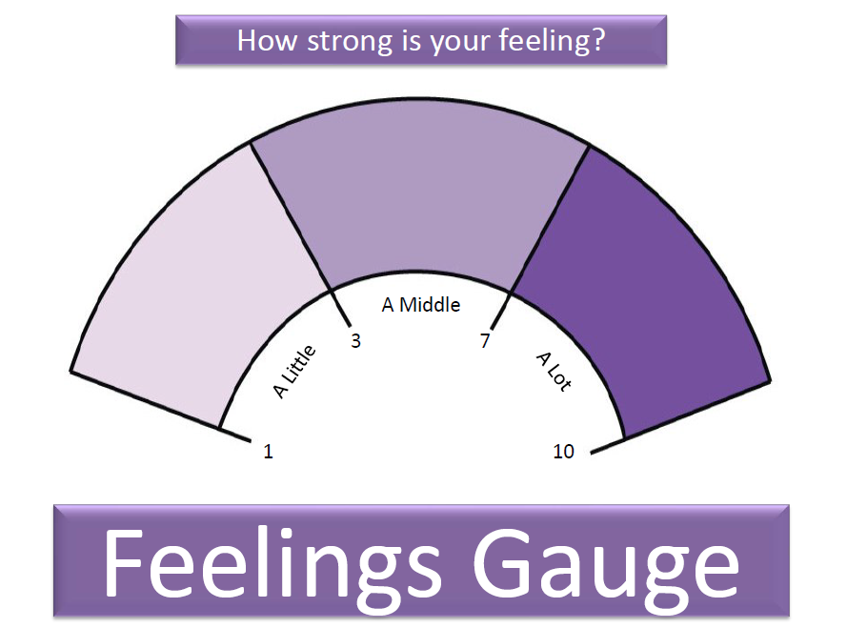
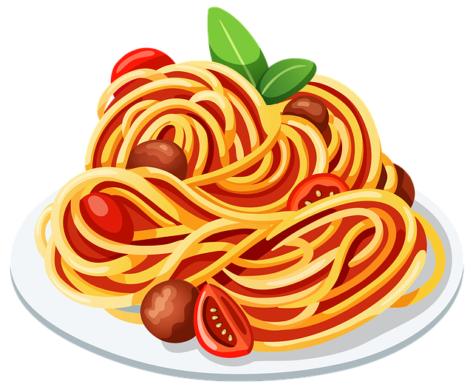
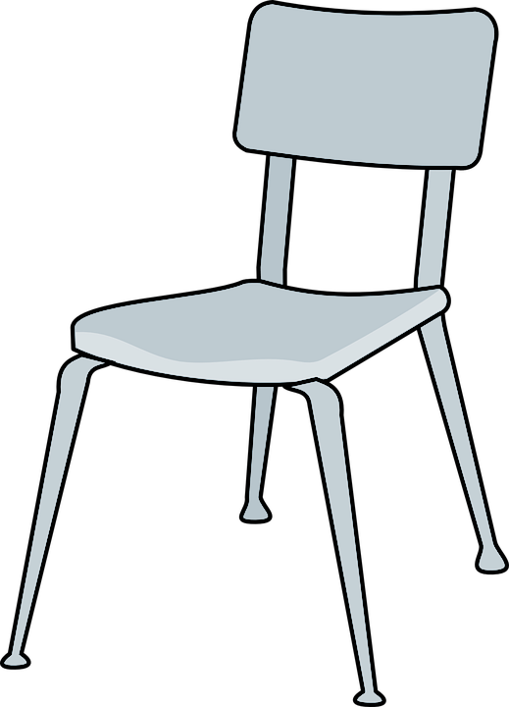
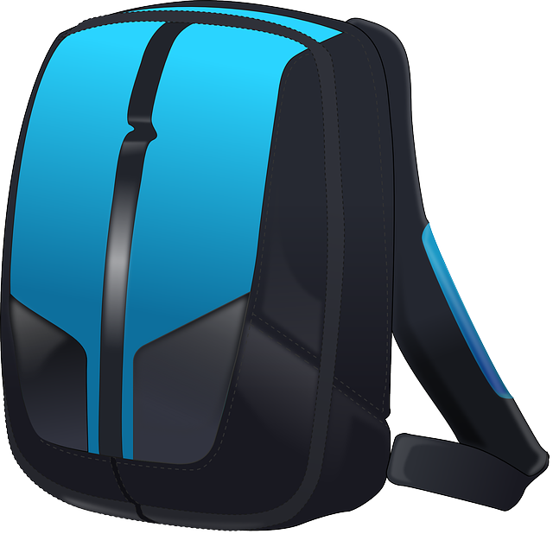
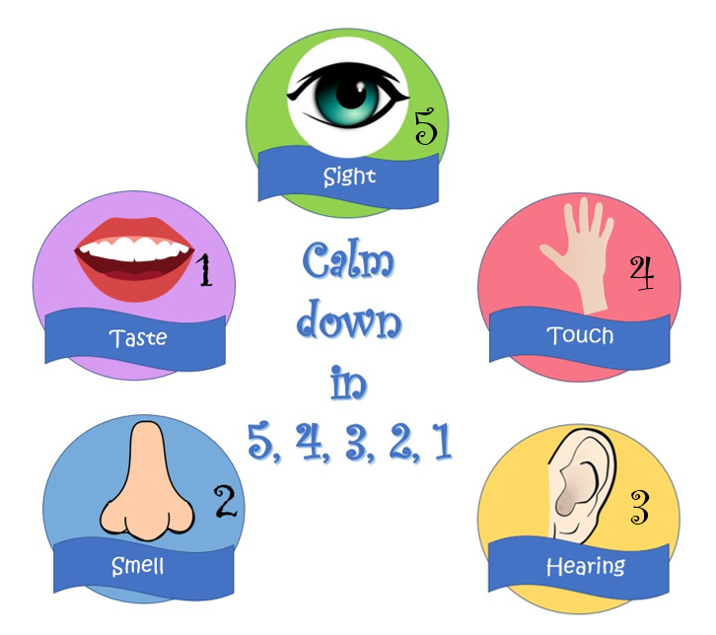
GROUP
NEXT
RULES
THESE ARE A FEW OF MY
FAVORITE THINGS
Child Trauma Services Program
© 2021 The Board of Regents of The University of Oklahoma

Slide 4
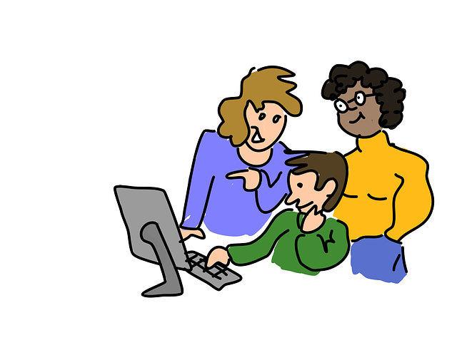
GROUP RULES
Zoom
Use the bathroom before or after group.
Be in a private space.
Keep everyone’s information private or confidential.
Take turns talking.
Keep yourself on mute.
Keep your camera on.
Be nice.
Just Be On Zoom!
Child Trauma Services Program
© 2021 The Board of Regents of The University of Oklahoma

Slide 5
Child Name 1
Child Name 2
Child Name 3
Child Name 4
Child Name 5
Child Trauma Services Program
© 2021 The Board of Regents of The University of Oklahoma

Slide 6
Power breaths
Breathing is the most efficient and helpful way to
calm our bodies down when we feel stress, fear, sadness, or anger. Breathing in specific ways actually tricks our brain into thinking we are at rest, and our body (our lungs and heart) follow the brain’s lead. Power breathing for 15-30 seconds can calm our bodies down without anyone else even having to know.
Put a hand on your chest and one on your stomach.
Breathe in through your nose for 4 seconds. Focus on breathing as steadily as possible and fill your lungs and stomach as much as you can.
Breathe slowly and consistently out of your mouth for 8 full seconds.
Repeat this step 3-4 times to calm your body down.
**To put our body back at rest, we have to breathe at a ratio of 1:2, which means that however long we breathe in, we need to breathe out for twice as long**
Child Trauma Services Program
© 2021 The Board of Regents of The University of Oklahoma

Slide 7
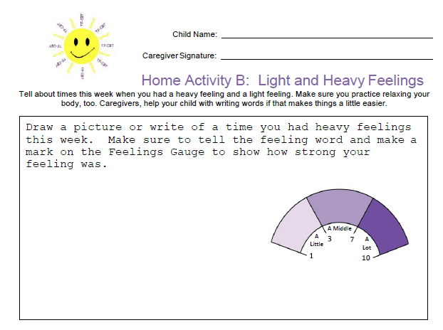
HOME
Activity review
Share about a time you Had A Light or heavy feeling.
Child Trauma Services Program
© 2021 The Board of Regents of The University of Oklahoma

Slide 8
Child Trauma Services Program
© 2021 The Board of Regents of The University of Oklahoma

Slide 9
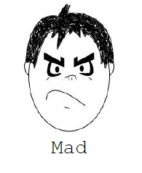
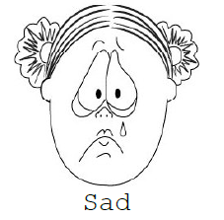
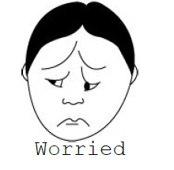
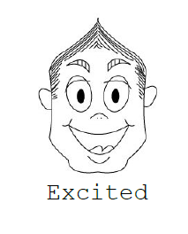
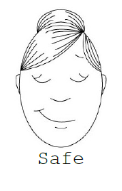
Child Trauma Services Program
© 2021 The Board of Regents of The University of Oklahoma

Slide 10
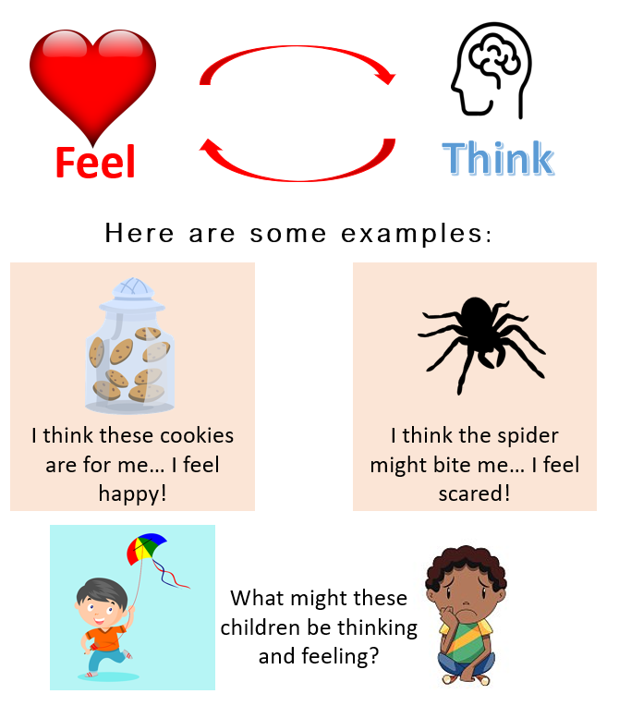
Did you know that our feelings and thoughts are connected?
Child Trauma Services Program
© 2021 The Board of Regents of The University of Oklahoma

Slide 11
Jesse walks into class and says “hi” as she goes past her best friend’s desk. Her best friend doesn’t look at her or say anything.
THINK
DO
FEEL
Child Trauma Services Program
© 2021 The Board of Regents of The University of Oklahoma
Notes:
Review the THINK-FEEL-DO Connection. Ask for thoughts-feelings-behavior of Jesse. Ask the children for new thoughts & feelings and what they might do next.

Slide 12
Pizza is my favorite!!!
THINK
DO
FEEL
Child Trauma Services Program
© 2021 The Board of Regents of The University of Oklahoma

Slide 13
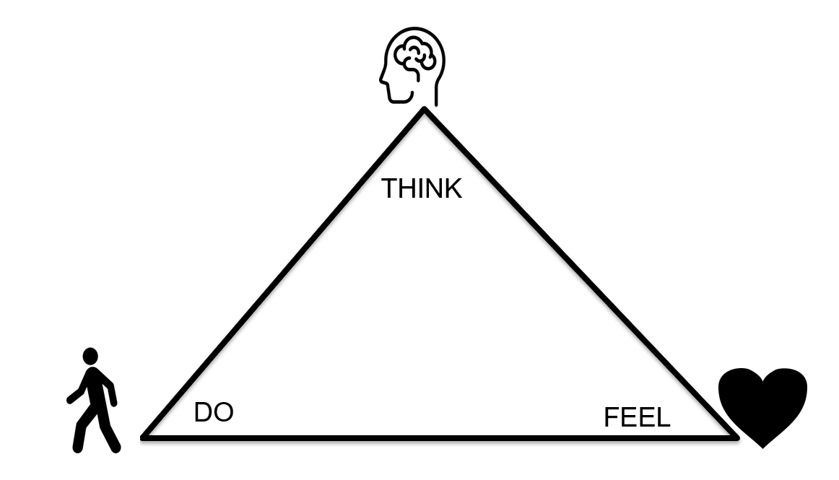
Mushrooms are disgusting!! Now I can’t eat it!
Child Trauma Services Program
© 2021 The Board of Regents of The University of Oklahoma

Slide 14
No one cares what I want.
Child Trauma Services Program
© 2021 The Board of Regents of The University of Oklahoma

Slide 15
I will get a good grade on my test because I studied A LOT.
Child Trauma Services Program
© 2021 The Board of Regents of The University of Oklahoma

Slide 16
Walk into class and 2 kids start laughing
Child Trauma Services Program
© 2021 The Board of Regents of The University of Oklahoma
Notes:
Use different colors to show connected think – feel – do.

Slide 17
Hear a loud noise in the house at night
Child Trauma Services Program
© 2021 The Board of Regents of The University of Oklahoma

Slide 18
Bumped in lunch line & drop your tray
Child Trauma Services Program
© 2021 The Board of Regents of The University of Oklahoma
Notes:
Use different colors to show connected think – feel – do.

Slide 19
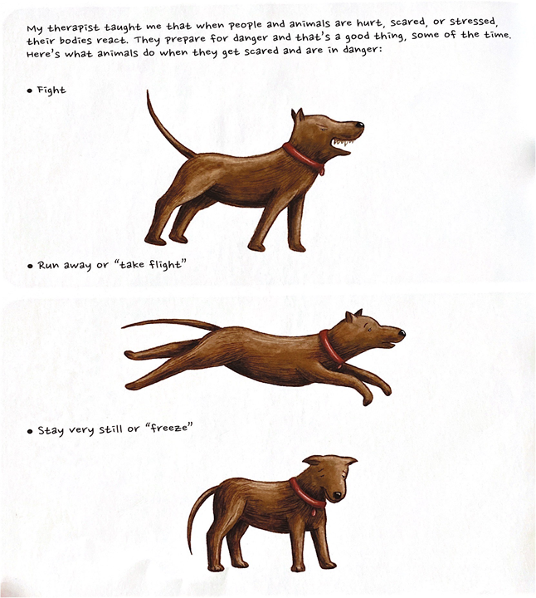
Our
Body’s
Alarm
System
THINK
What relaxers can help reset our alarm system?
STRAUS, S. (2013). HEALING DAYS. MAGINATION Press.
Child Trauma Services Program
© 2021 The Board of Regents of The University of Oklahoma

Slide 20
Find your handout that looks like this!
Child Trauma Services Program
© 2021 The Board of Regents of The University of Oklahoma

Slide 21
ACTIVITY!
ACTIVITY!
What was your favorite part of group?
THESE ARE A FEW OF MY
FAVORITE THINGS
Child Trauma Services Program
© 2021 The Board of Regents of The University of Oklahoma

Slide 22
Welcome to TF-CBT Group Combined Time!
Child Trauma Services Program
© 2021 The Board of Regents of The University of Oklahoma

Slide 23
Grounding
5
4
3
Child Trauma Services Program
© 2021 The Board of Regents of The University of Oklahoma

Slide 24
Muscle Relaxers
Child Trauma Services Program
© 2021 The Board of Regents of The University of Oklahoma
Notes:
Add others as you’d like

Slide 25
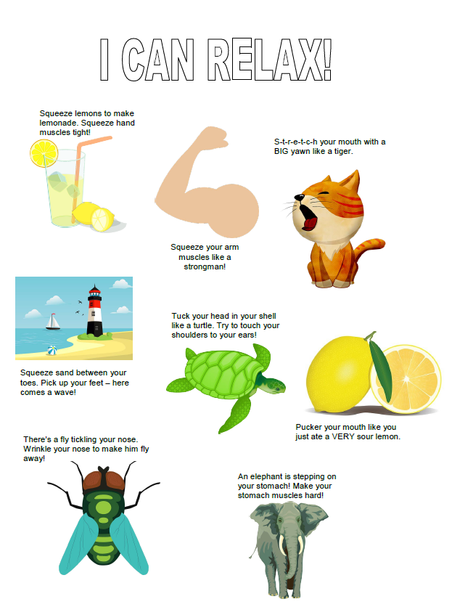
Child Trauma Services Program
© 2021 The Board of Regents of The University of Oklahoma

Slide 26
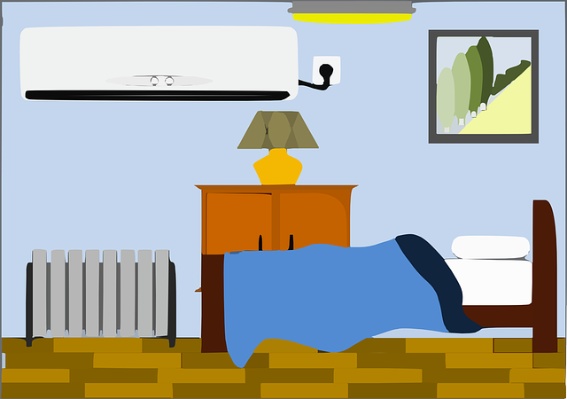
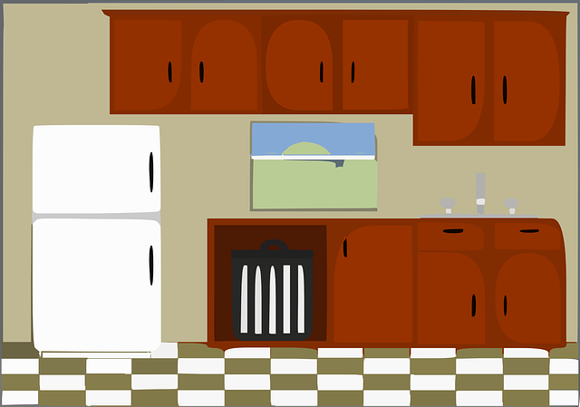
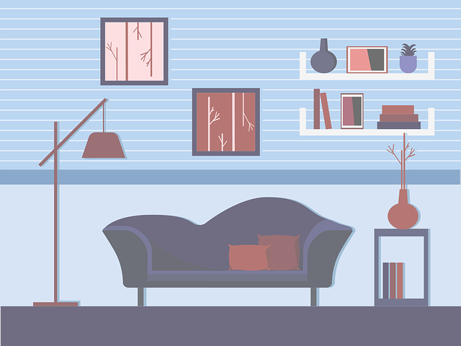
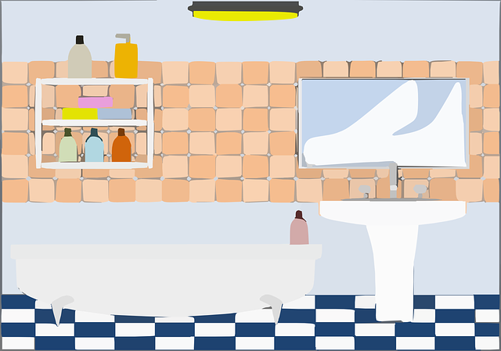
Child Trauma Services Program
© 2021 The Board of Regents of The University of Oklahoma
Notes:
Build a house activity – each family can solve to add one room to the house

Slide 27
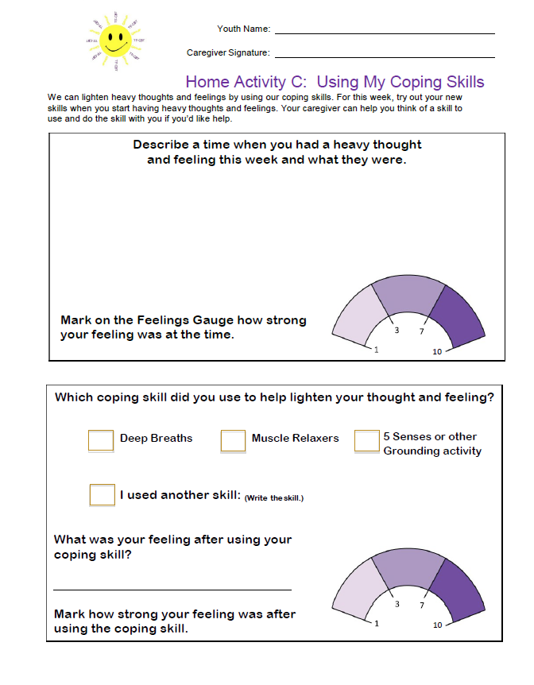
HOME
Activity
Two different times this week, write about a time you had heavy Thoughts. Mark on the Feelings Gauge how heavy your feeling was. Track What coping skill you used.
Remember to bring back your completed home activity sheet to be entered into the prize drawing!
Child Trauma Services Program
© 2021 The Board of Regents of The University of Oklahoma

Slide 28
HOME Activity Prize Drawing
Who completed their weekly home activity?
Child Trauma Services Program
© 2021 The Board of Regents of The University of Oklahoma

Slide 29
Participation prize
Child Trauma Service Program
© 2021 The Board of Regents of The University of Oklahoma

