Slide 1
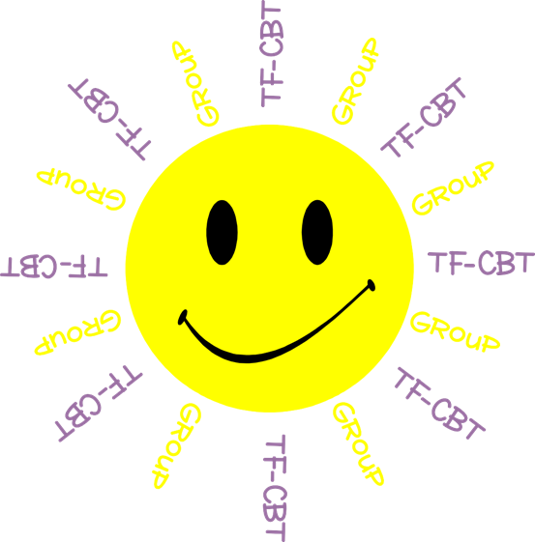
Welcome to TF-CBT Group!
Today is Group 2 of 5.
Child Trauma Services Program
© 2021 The Board of Regents of The University of Oklahoma

Slide 2
Acknowledgment
This treatment session manual for implementation of Trauma-Focused Cognitive-Behavioral Therapy (TF-CBT) in a group format was originally developed under a grant from the Oklahoma Department of Mental Health and Substance Abuse Services awarded to Drs. Susan Schmidt and Elizabeth Risch from the University of Oklahoma Health Sciences Center. This manual was developed with support by the TF-CBT treatment developers Esther Deblinger, PhD, Anthony Mannarino, PhD, and Judith Cohen, MD. The federal government’s Substance Abuse and Mental Health Services Administration has recognized TF-CBT as a Model Program due to the extensive outcome data from randomized controlled trials that support its effectiveness in improving a variety of problems in youth who have experienced trauma.
The current TF-CBT Group Curriculum Manual was developed and refined through many years of application of the treatment. Amanda Mitten, Natalie Gallo, Hannah Frye, Melissa Bernstein, and Saba Shahid contributed significantly to previous revisions of the manual. We wish to also thank Lindsey Peters, Kate Theimer, and Ashley Galsky for their assistance. This manual and work is dedicated to the families who have cared for children with a trauma history with whom we have worked.
Copyrighted The Board of Regents of the University of Oklahoma
All rights reserved. The materials contained herein are copyright protected by the University of Oklahoma and are provided for review only. No part of this publication may be reproduced, distributed, transmitted, derived or practiced in any form or by any means without the prior written permission of the University of Oklahoma, except in the case of brief quotations embodied in critical reviews and certain other noncommercial and non-medical uses permitted by copyright law.
Contact Information
OKTF-CBT
University of Oklahoma Health Sciences Center
Center on Child Abuse and Neglect
1100 NE 13th Street
Oklahoma City, OK 73117
(405) 271-5700
OKTF-CBT@ouhsc.edu
Child Trauma Services Program
© 2021 The Board of Regents of The University of Oklahoma

Slide 3
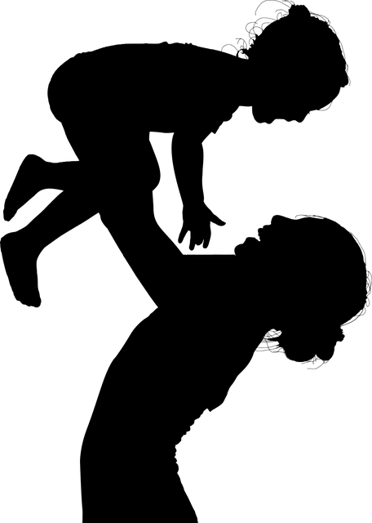
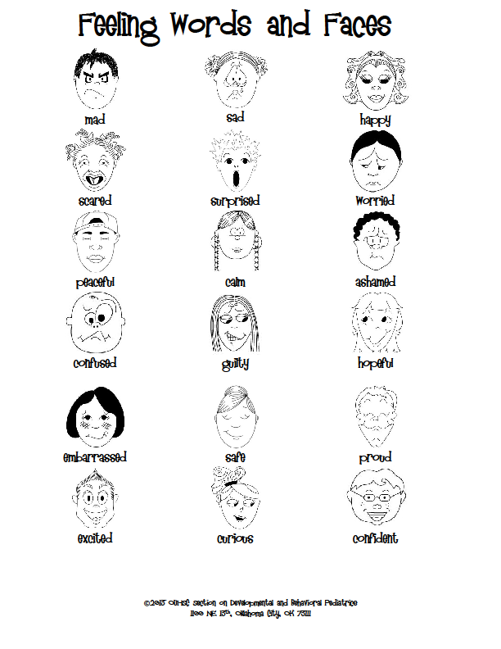
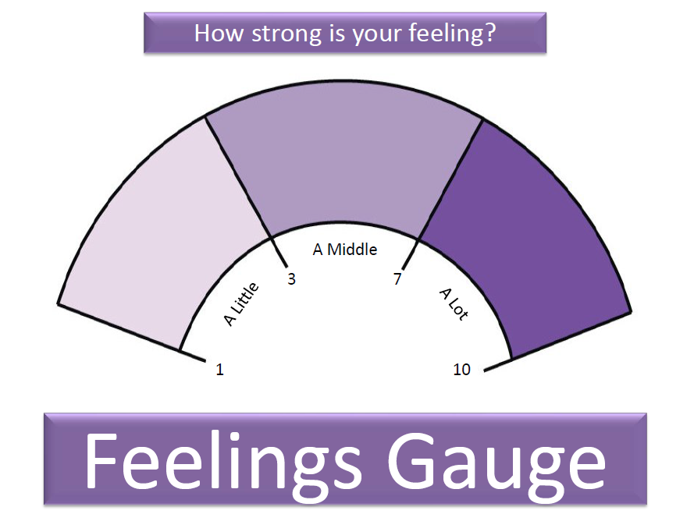
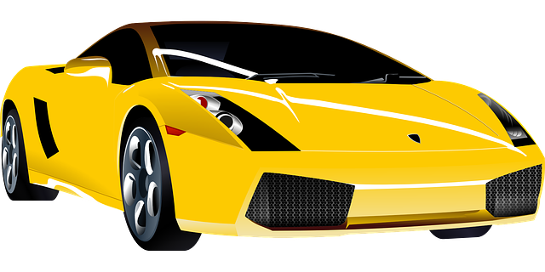
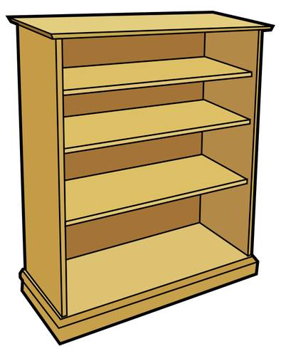
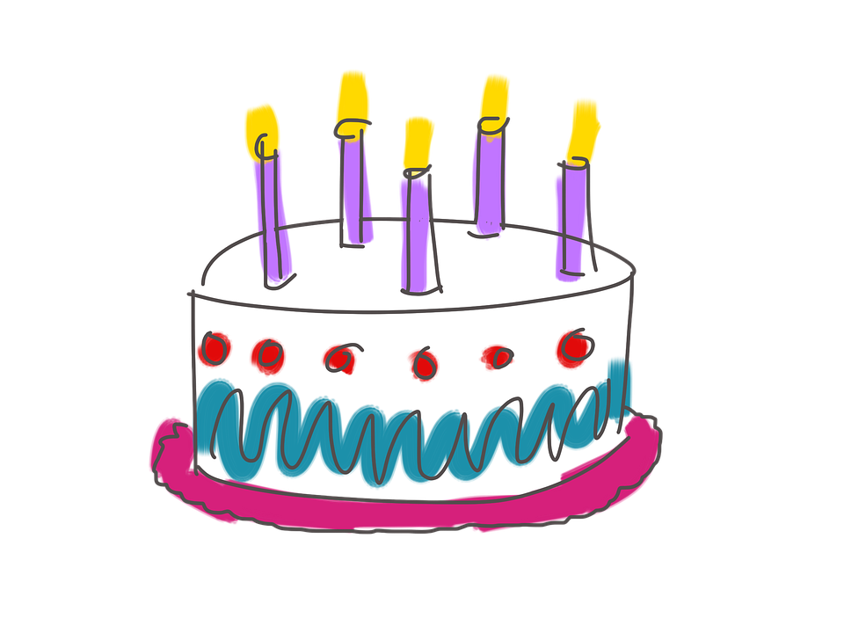
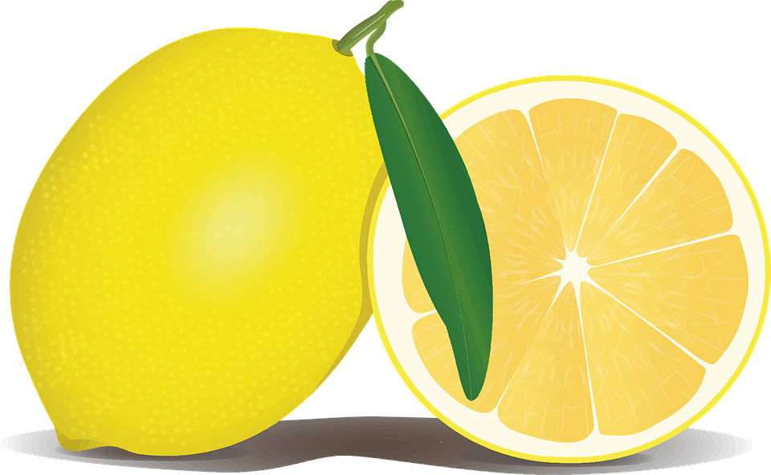
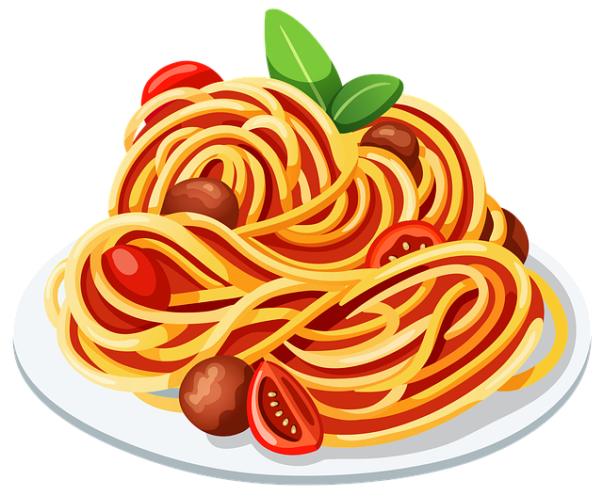
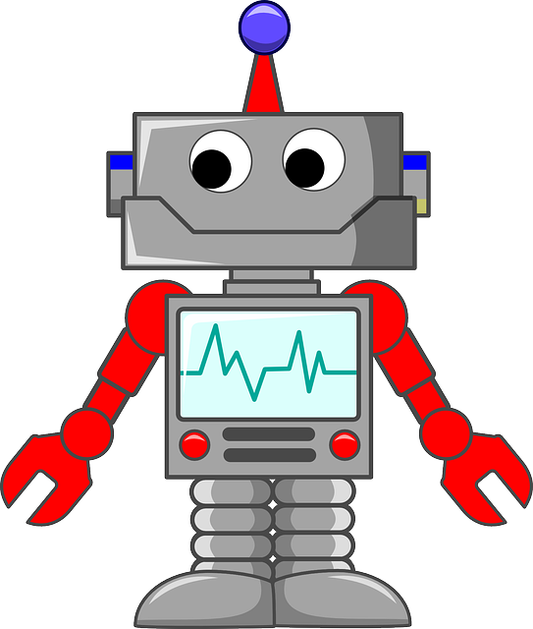
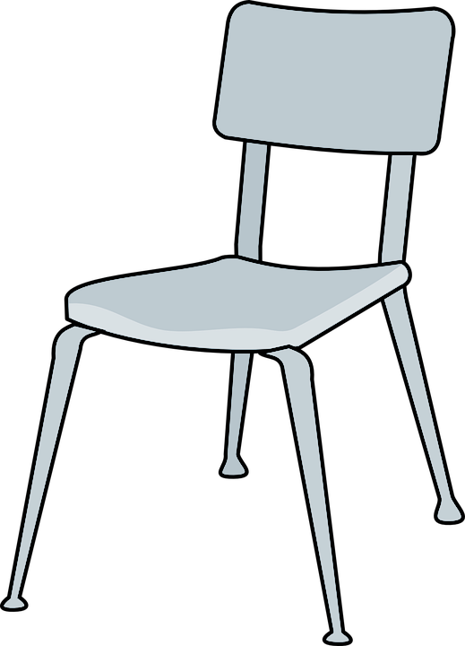
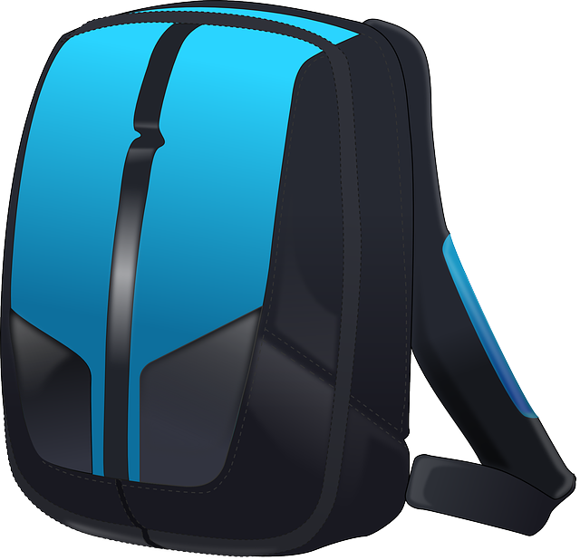
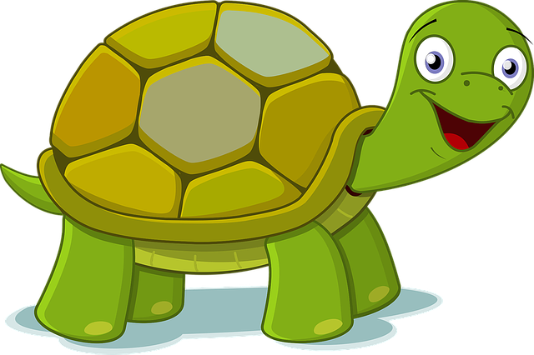
GROUP
NEXT
RULES
THESE ARE A FEW OF MY
FAVORITE THINGS
Feelings
Child Trauma Services Program
© 2021 The Board of Regents of The University of Oklahoma

Slide 4
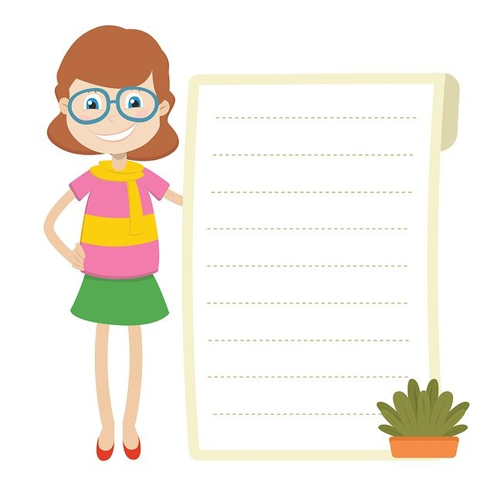
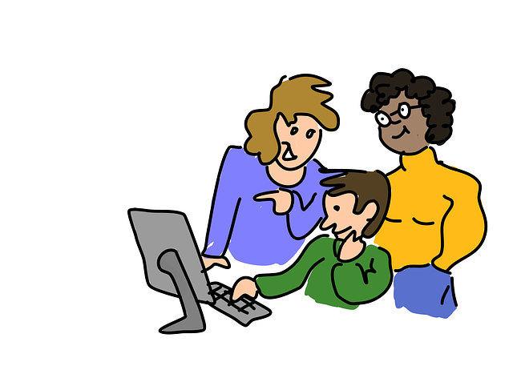
GROUP RULES
Zoom
Use the bathroom before or after group.
Be in a private space.
Keep everyone’s information private or confidential.
Take turns talking.
Keep yourself on mute.
Keep your camera on.
Be nice.
Just Be On Zoom!
Child Trauma Services Program
© 2021 The Board of Regents of The University of Oklahoma

Slide 5
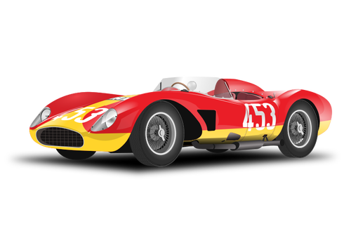
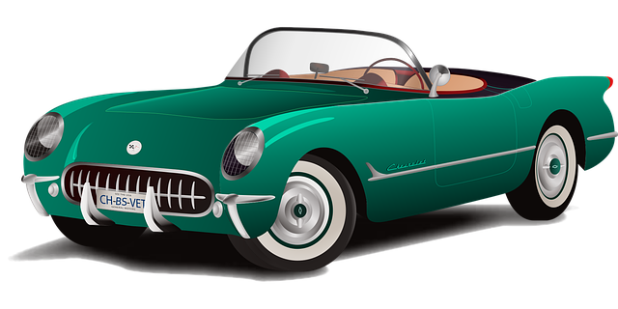
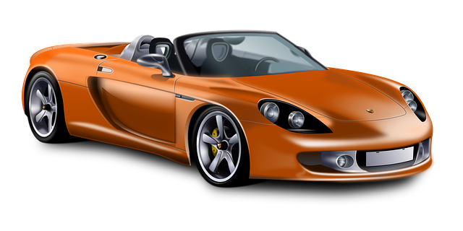
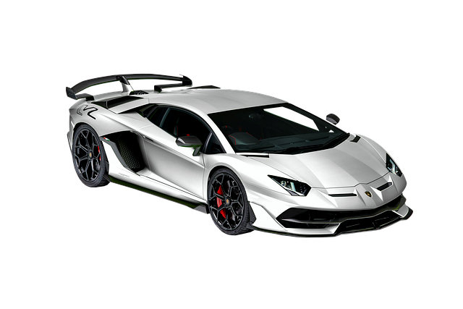
Youth A
Youth B
Youth C
Youth D
Youth E
Youth F
Child Trauma Services Program
© 2021 The Board of Regents of The University of Oklahoma

Slide 6
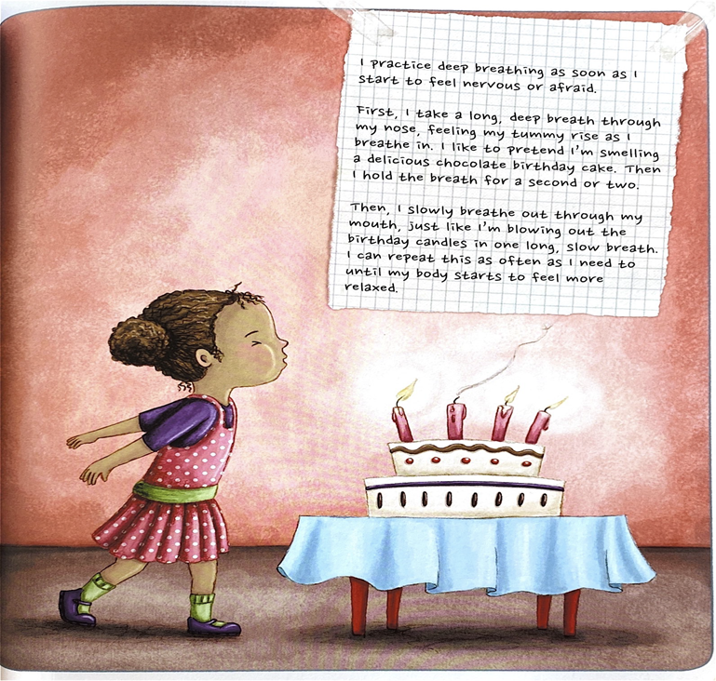
Deep Breaths
STRAUS, S. (2013). HEALING DAYS. MAGINATION Press.
Child Trauma Services Program
© 2021 The Board of Regents of The University of Oklahoma

Slide 7
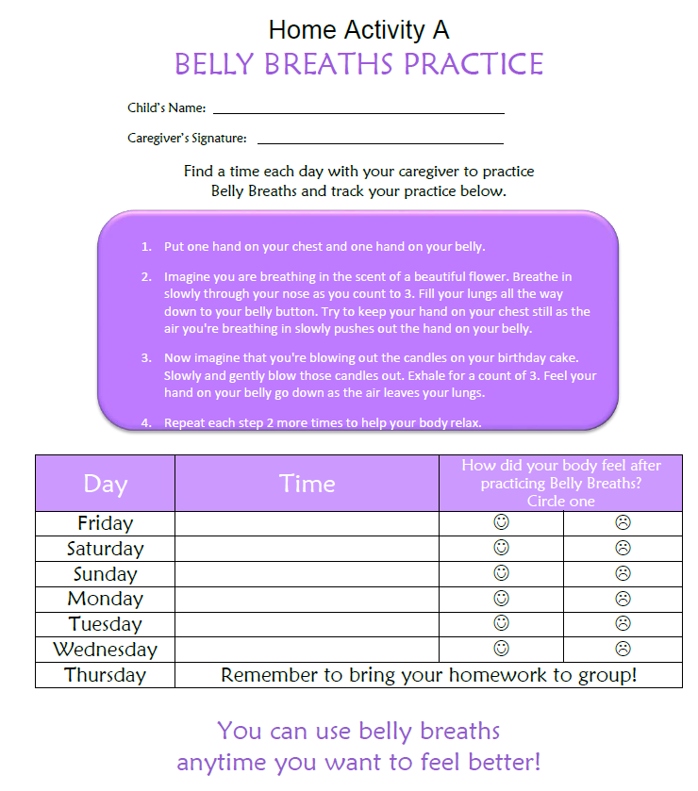
HOME
Activity review
Share about a time you practiced Belly breaths with a caregiver.
Child Trauma Services Program
© 2021 The Board of Regents of The University of Oklahoma

Slide 8
FEELINGS
Take turns adding feelings words!
Child Trauma Services Program
© 2021 The Board of Regents of The University of Oklahoma

Slide 9
Child Trauma Services Program
© 2021 The Board of Regents of The University of Oklahoma

Slide 10
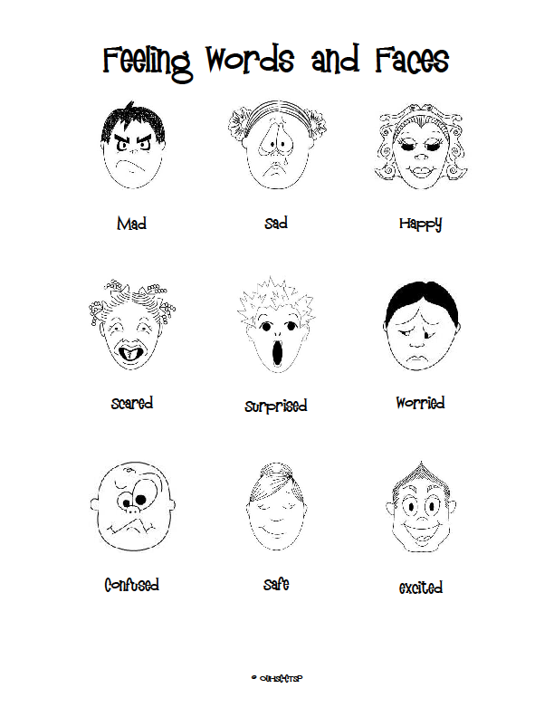
Child Trauma Services Program
© 2021 The Board of Regents of The University of Oklahoma

Slide 11
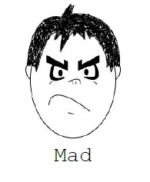
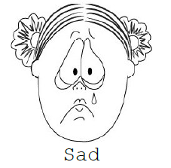
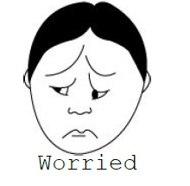
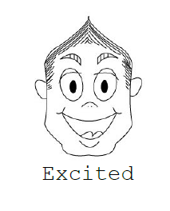
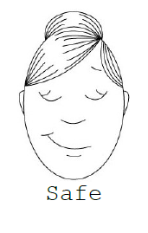
Child Trauma Services Program
© 2021 The Board of Regents of The University of Oklahoma

Slide 12
LIGHT VS. HEAVY FEELINGS
Which feelings are light?
Which feelings are heavy?
Child Trauma Services Program
© 2021 The Board of Regents of The University of Oklahoma

Slide 13
FEELINGS STORY
Mad
Worried
Embarrassed
Sad
Scared
Guilty
Child Trauma Services Program
© 2021 The Board of Regents of The University of Oklahoma
Notes:
Add feelings rocks as you tell the story. Consider making story trauma-focused for gradual exposure. For example, kiddo woke up from a nightmare reminding them of the tough and scary thing that happened.

Slide 14
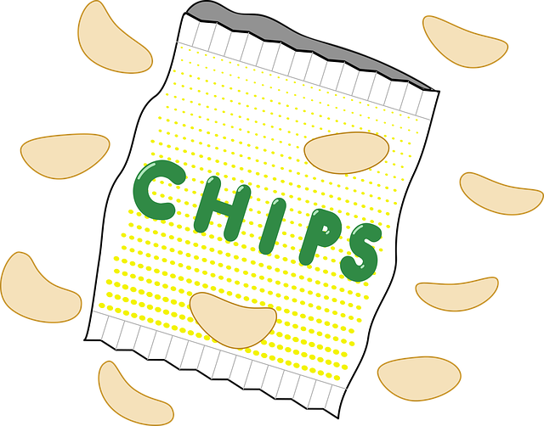
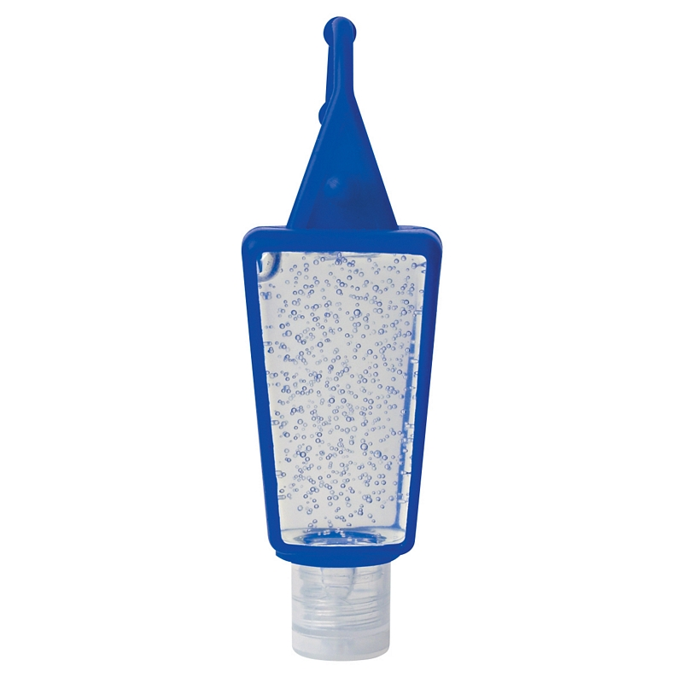
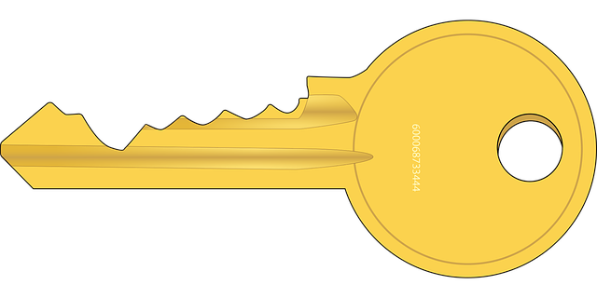
FEELINGS STORY:
LIGHTENING HEAVY FEELINGS
Happy
Proud
Calm
Excited
Confident
Safe
Child Trauma Services Program
© 2021 The Board of Regents of The University of Oklahoma
Notes:
Add light items to the back pack as you tell the lightened story. Reflect on how heavy the backpack would be (not heavy) for carrying around

Slide 15
FEELINGS QUESTIONS
Allison got a special game she asked for on her birthday. She feels…
Brandon wants to play outside, but it is raining. He feels…
Ellie felt lonely, so she told her caregiver. Now they are playing a game together. She feels…
Frankie hears adults arguing loudly. He feels…
Olivia scores a goal in her soccer game. She feels…
Greta had a bad dream about an upsetting thing that happened to her. She feels…
Isabel thinks it is her fault that the scary, upsetting thing happened. She feels…
Raven earns a prize for working hard and following group rules. She feels…
Maria remembers when she was hurt by someone else. She feels…
Child Trauma Services Program
© 2021 The Board of Regents of The University of Oklahoma

Slide 16
ACTIVITY!
ACTIVITY!
What was your favorite part of group?
THESE ARE A FEW OF MY
FAVORITE THINGS
Child Trauma Services Program
© 2021 The Board of Regents of The University of Oklahoma

Slide 17
Welcome to TF-CBT Group Combined Time!
Child Trauma Services Program
© 2021 The Board of Regents of The University of Oklahoma

Slide 18
Trauma-Related Feelings
What might kids feel when tough and scary things are happening?
Child Trauma Services Program
© 2021 The Board of Regents of The University of Oklahoma

Slide 19
Trauma-Related Feelings
What might kids feel when they remember the tough and scary things that happened?
Child Trauma Services Program
© 2021 The Board of Regents of The University of Oklahoma

Slide 20
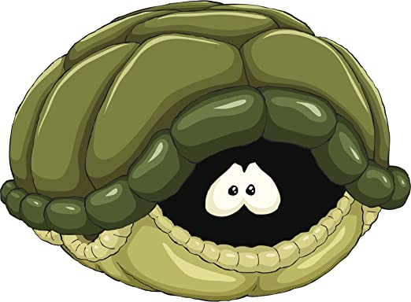
Muscle Relaxers
Child Trauma Services Program
© 2021 The Board of Regents of The University of Oklahoma
Notes:
Add others as you’d like

Slide 21
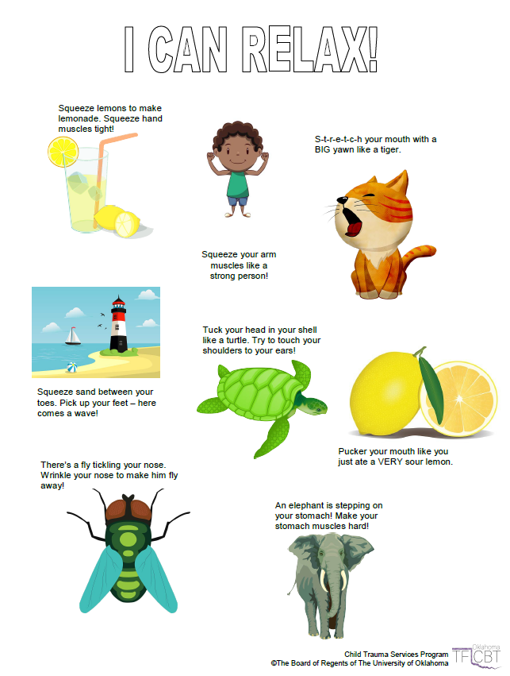
Child Trauma Services Program
© 2021 The Board of Regents of The University of Oklahoma

Slide 22
Sit in a comfortable chair. Now imagine that you are piece of cooked spaghetti. Tighten both your fists and arms, squeeze your legs and stomach and make your whole body as stiff as possible, so that you can’t bend. Keep your whole body tense until you count to five. Now relax.
Pretend that you are now a piece of cooked spaghetti. Let your whole body become loose and floppy. Let go of all of the tension in your body. Relax your shoulders and stomach, take a deep breath, and let your body be as loose and floppy as cooked spaghetti. Which feels better, being cooked or uncooked spaghetti?
Now become raw spaghetti again. Squeeze all the muscles in your body until you are as stiff as raw spaghetti. Even make your face tense – squeeze all the muscles in your mouth and forehead. Squeeze your shoulders up to your ears. Make fists with your hands. Squeeze your eyes shut and push your feet into the floor. Hold your body stiff like raw spaghetti until the count of five.
Now relax your whole body. Go floppy like raw spaghetti. Relax your face, your shoulders, your stomach, your arms and your legs. Now which felt better, being cooked or uncooked spaghetti?
Become the raw spaghetti one last time and tense your whole body from head to toe. Make every part of your body as tense and stiff as you can until the count of five.
Now relax your body like raw spaghetti. It takes a lot of work to be as tense as raw spaghetti, and can make you feel tired to do this all day. When you notice that your body is feeling stiff or tense, don’t forget that you can make yourself feel like cooked spaghetti by relaxing the muscles in your body.
Child Trauma Services Program
© 2021 The Board of Regents of The University of Oklahoma

Slide 23
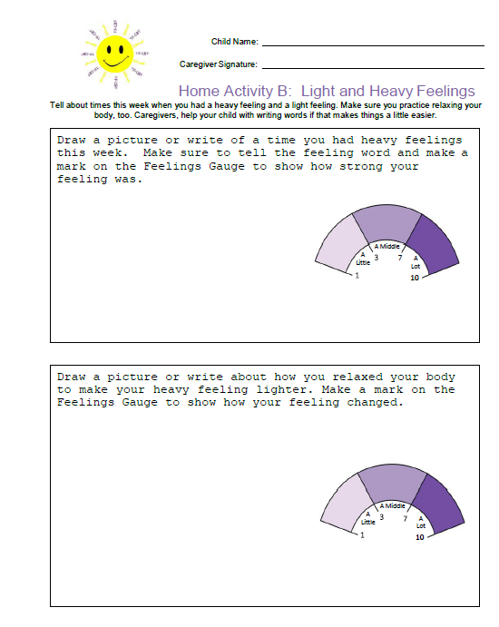
HOME
Activity
Two different times this week, draw or write about a time you had heavy feelings. Mark on the Feelings Gauge how heavy your feeling was.
Remember to bring back your completed home activity sheet to be entered into the prize drawing!
Child Trauma Services Program
© 2021 The Board of Regents of The University of Oklahoma

Slide 24
HOME Activity Prize drawing
Who completed their weekly home activity?
Child Trauma Services Program
© 2021 The Board of Regents of The University of Oklahoma

Slide 25
Participation prize
Child Trauma Services Program
© 2021 The Board of Regents of The University of Oklahoma

