Slide 1
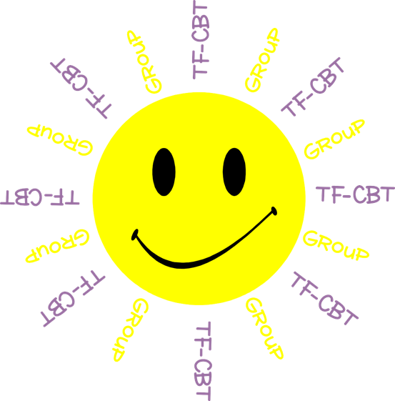
Welcome to TF-CBT Group!
Today is Group 1 of 5.
Child Trauma Services Program
© 2021 The Board of Regents of The University of Oklahoma

Slide 2
Acknowledgment
This treatment session manual for implementation of Trauma-Focused Cognitive-Behavioral Therapy (TF-CBT) in a group format was originally developed under a grant from the Oklahoma Department of Mental Health and Substance Abuse Services awarded to Drs. Susan Schmidt and Elizabeth Risch from the University of Oklahoma Health Sciences Center. This manual was developed with support by the TF-CBT treatment developers Esther Deblinger, PhD, Anthony Mannarino, PhD, and Judith Cohen, MD. The federal government’s Substance Abuse and Mental Health Services Administration has recognized TF-CBT as a Model Program due to the extensive outcome data from randomized controlled trials that support its effectiveness in improving a variety of problems in youth who have experienced trauma.
The current TF-CBT Group Curriculum Manual was developed and refined through many years of application of the treatment. Amanda Mitten, Natalie Gallo, Hannah Frye, Melissa Bernstein, and Saba Shahid contributed significantly to previous revisions of the manual. We wish to also thank Lindsey Peters, Kate Theimer, and Ashley Galsky for their assistance. This manual and work is dedicated to the families who have cared for children with a trauma history with whom we have worked.
Copyrighted The Board of Regents of the University of Oklahoma
All rights reserved. The materials contained herein are copyright protected by the University of Oklahoma and are provided for review only. No part of this publication may be reproduced, distributed, transmitted, derived or practiced in any form or by any means without the prior written permission of the University of Oklahoma, except in the case of brief quotations embodied in critical reviews and certain other noncommercial and non-medical uses permitted by copyright law.
Contact Information
OKTF-CBT
University of Oklahoma Health Sciences Center
Center on Child Abuse and Neglect
1100 NE 13th Street
Oklahoma City, OK 73117
(405) 271-5700
OKTF-CBT@ouhsc.edu
Child Trauma Services Program
© 2021 The Board of Regents of The University of Oklahoma

Slide 3
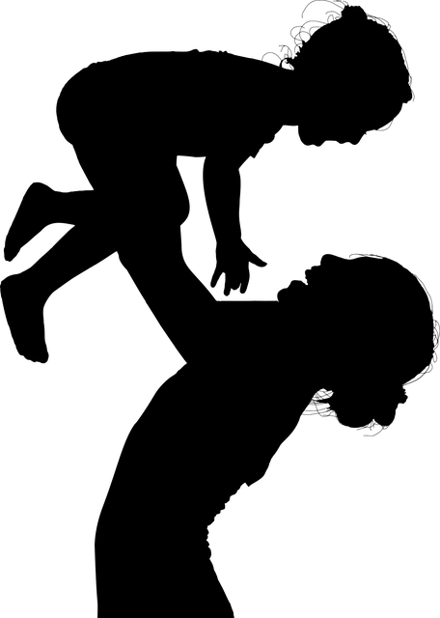
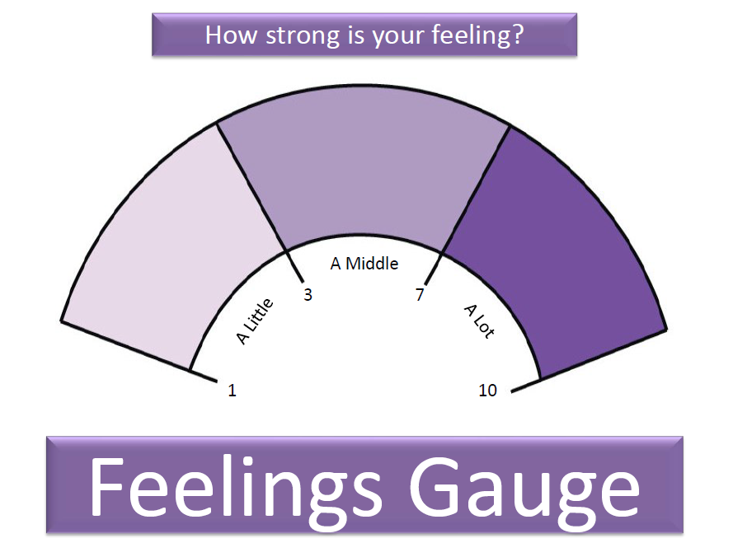
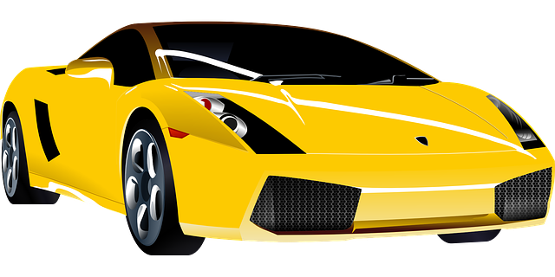
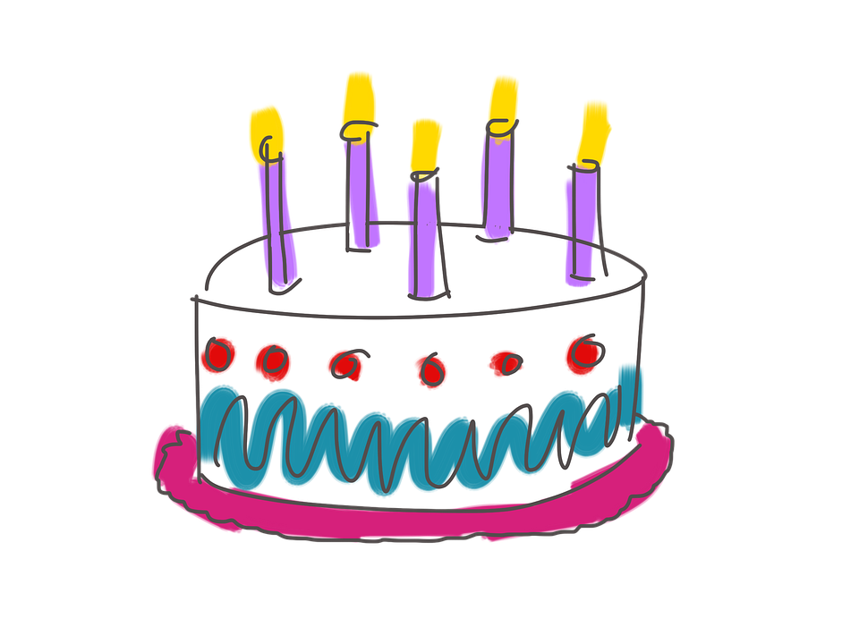
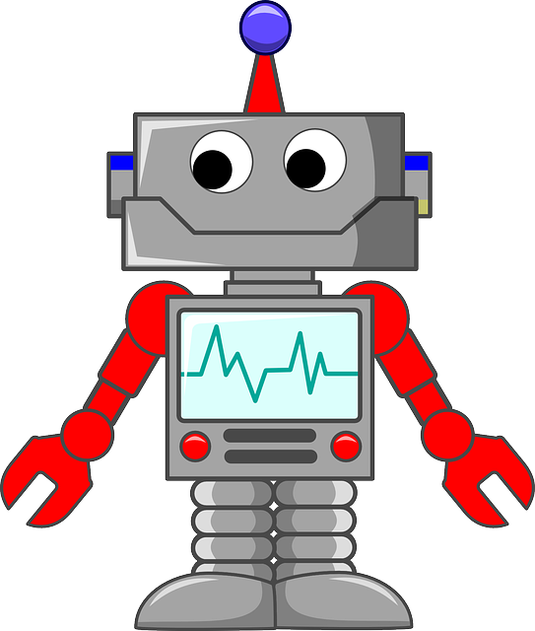
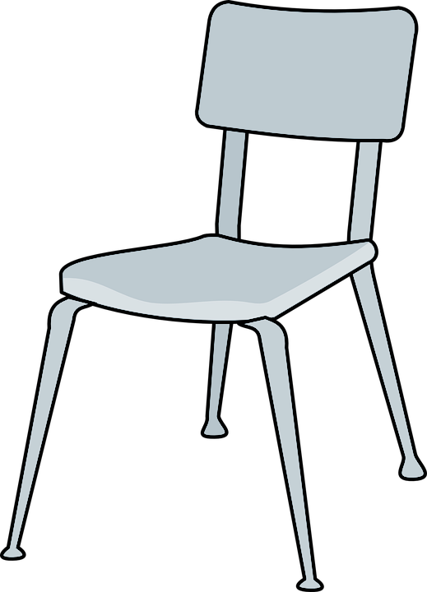
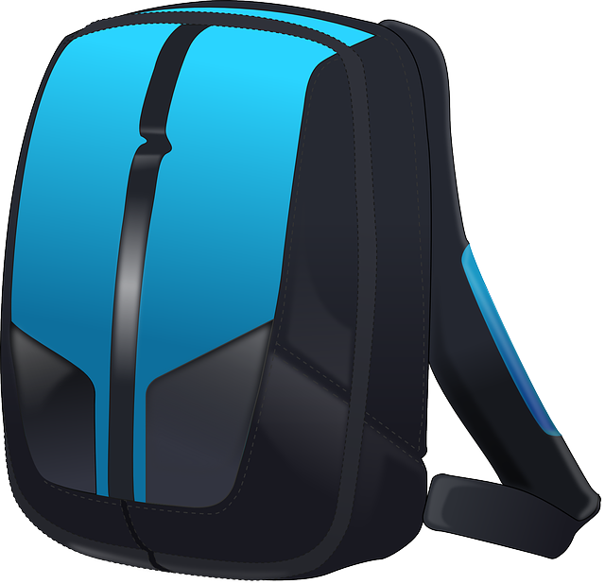
GROUP
NEXT
RULES
PTSD
WHAT IS TRAUMA?
THESE ARE A FEW OF MY
FAVORITE THINGS
Child Trauma Services Program
© 2021 The Board of Regents of The University of Oklahoma

Slide 4
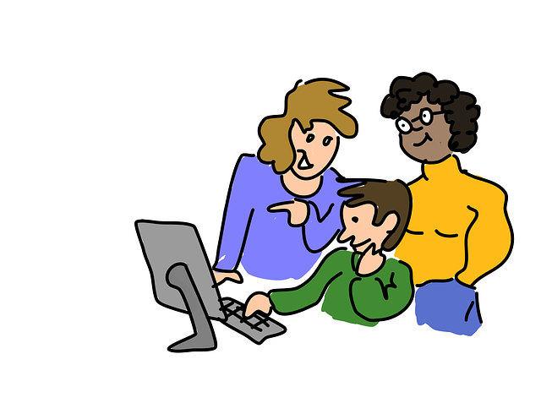
GROUP RULES
Zoom
Use the bathroom before or after group.
Be in a private space.
Keep everyone’s information private or confidential.
Take turns talking.
Keep yourself on mute.
Keep your camera on.
Be nice.
Just Be On Zoom!
Child Trauma Services Program
© 2021 The Board of Regents of The University of Oklahoma

Slide 5
Youth A
Youth B
Youth C
Youth D
Youth E
Youth F
Child Trauma Services Program
© 2021 The Board of Regents of The University of Oklahoma

Slide 6
THE NAME GAME
RULES:
The person whose name is called will repeat the previous person’s name and their favorite color, ice cream, etc. and then state their name and favorite
Child Trauma Services Program
© 2021 The Board of Regents of The University of Oklahoma

Slide 7
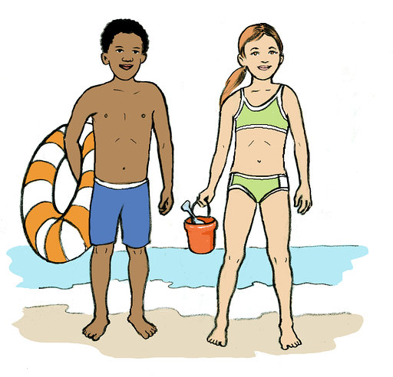
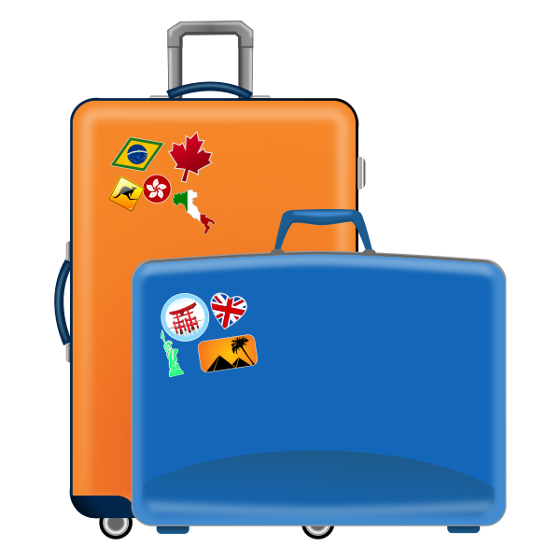
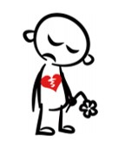
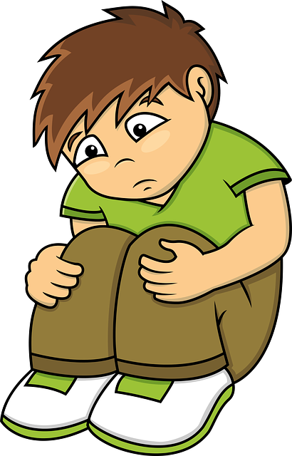
WHAT IS TRAUMA?
Someone broke the private part rule
Grown-ups in the family hit each other, or yell, or hurt
Moving to a new home
Grown-up hit or hurt kids
Someone you love leaving or dying
Kid didn’t have food and hugs and clothes and things kids need
Scary things happening with the weather
Child Trauma Services Program
© 2021 The Board of Regents of The University of Oklahoma
Notes:
Children should NOT be asked to identify their own trauma exposures.

Slide 8
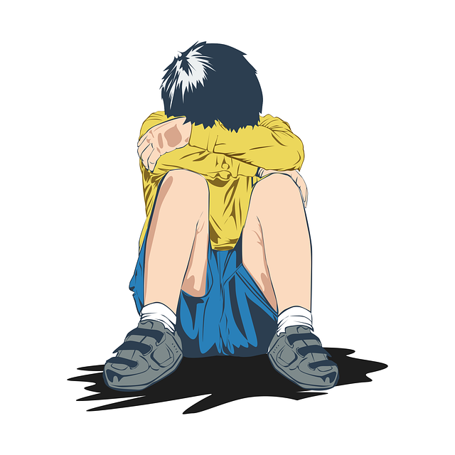
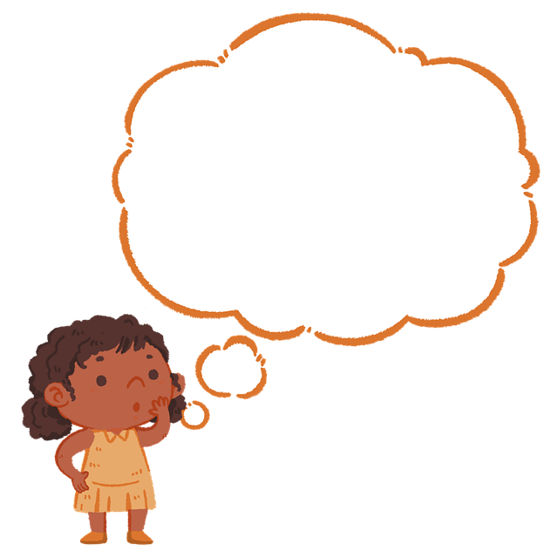
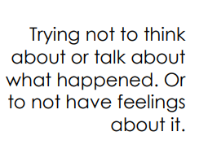
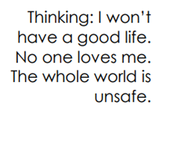
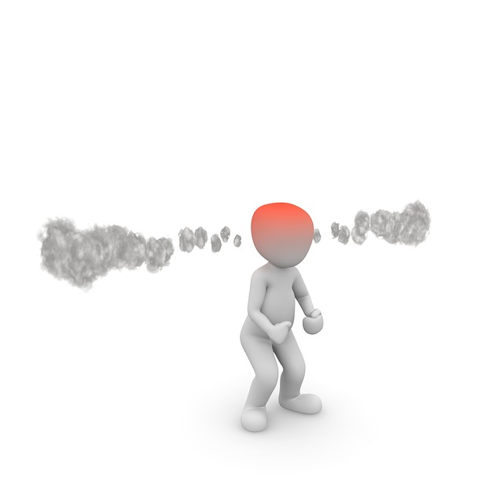
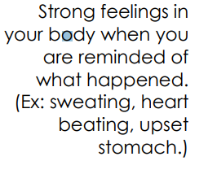
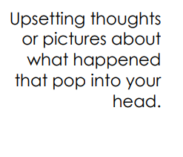
IDENTIFYING PTSD SYMPTOMS
Child Trauma Services Program
© 2021 The Board of Regents of The University of Oklahoma

Slide 9
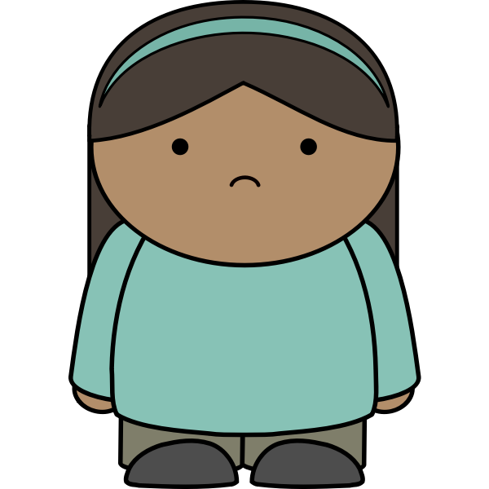
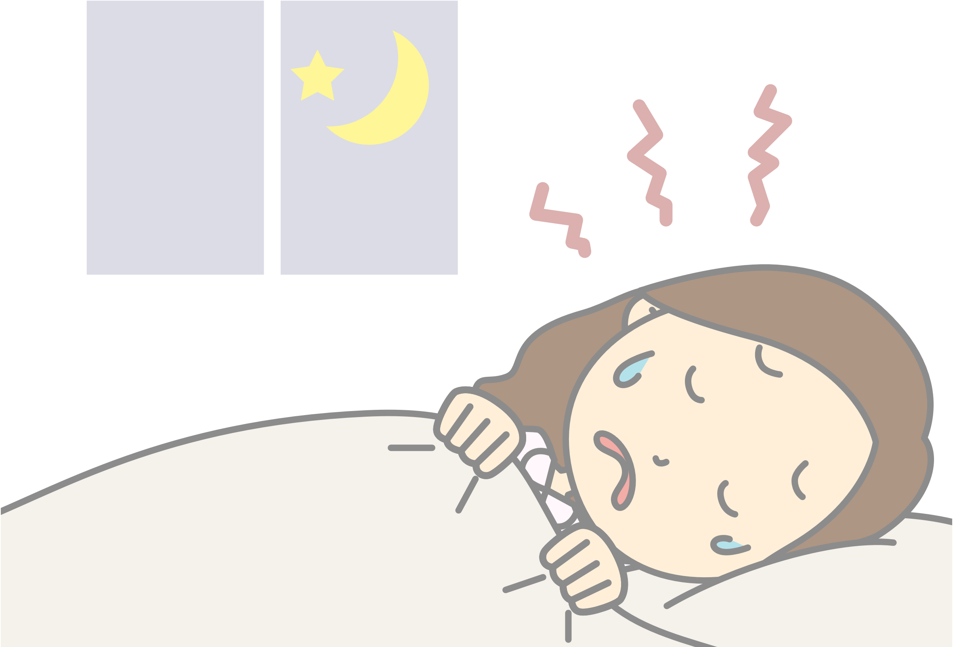
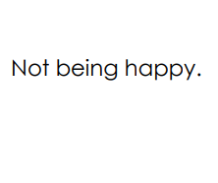
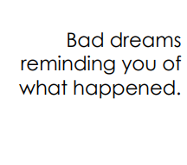
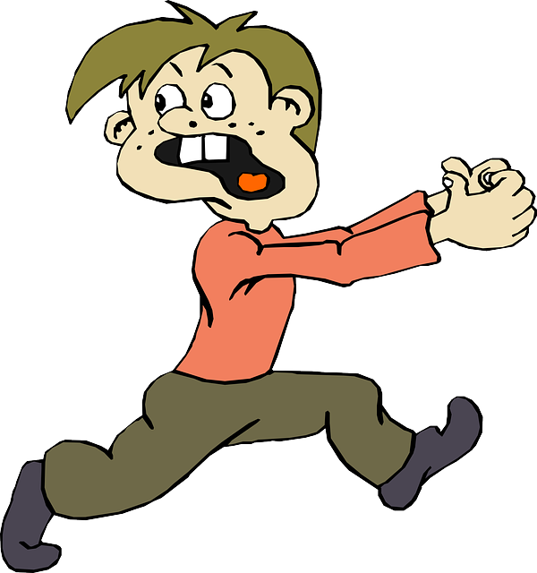
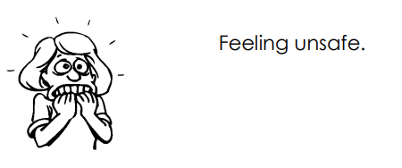
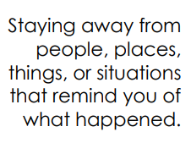
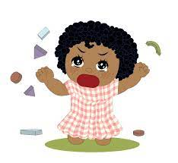
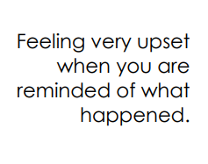
Child Trauma Services Program
© 2021 The Board of Regents of The University of Oklahoma
Notes:
PTSD symptoms – Could use to sort at ones they have or simply to name them

Slide 10
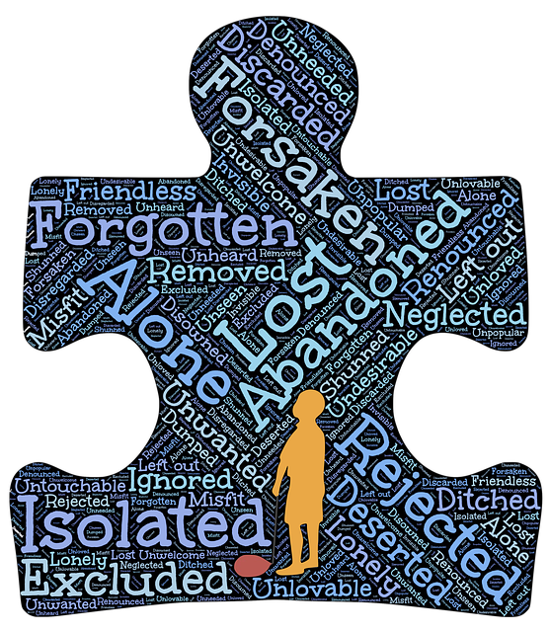
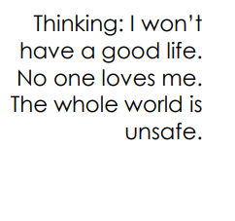
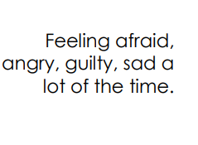
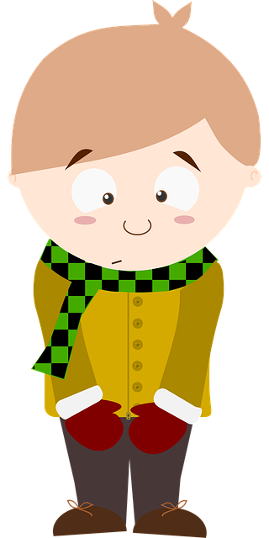
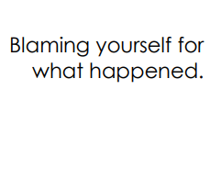
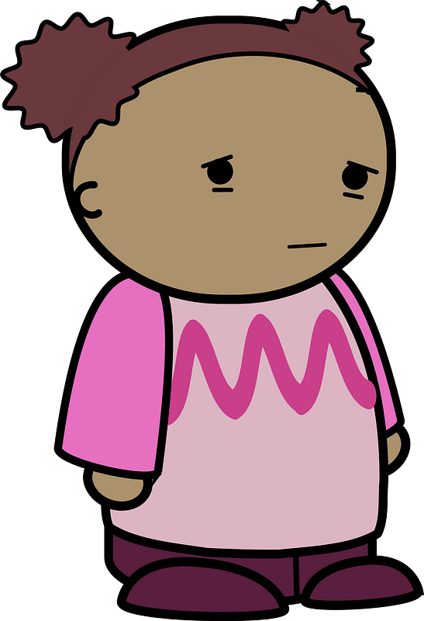
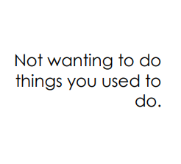
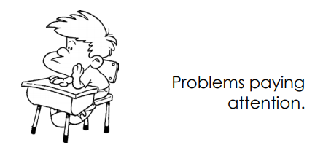
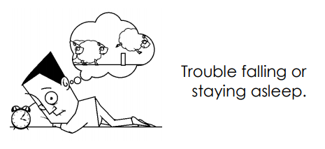
Child Trauma Services Program
© 2021 The Board of Regents of The University of Oklahoma

Slide 11
ACTIVITY!
ACTIVITY!
What was your favorite part of group?
THESE ARE A FEW OF MY
FAVORITE THINGS
Child Trauma Services Program
© 2021 The Board of Regents of The University of Oklahoma

Slide 12
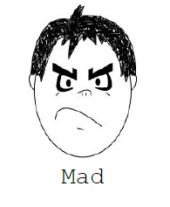
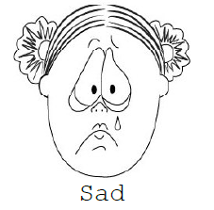
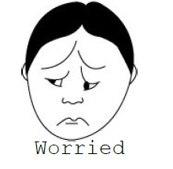
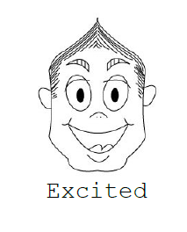
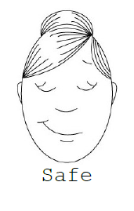
Child Trauma Services Program
© 2021 The Board of Regents of The University of Oklahoma

Slide 13
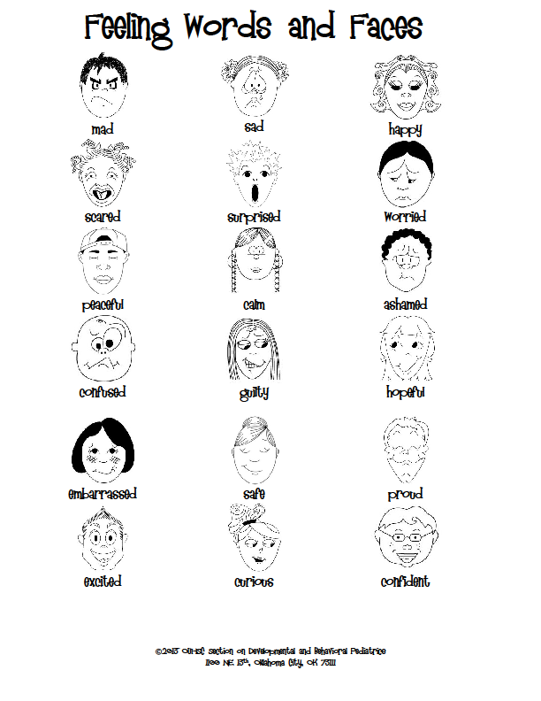
Child Trauma Services Program
© 2021 The Board of Regents of The University of Oklahoma

Slide 14
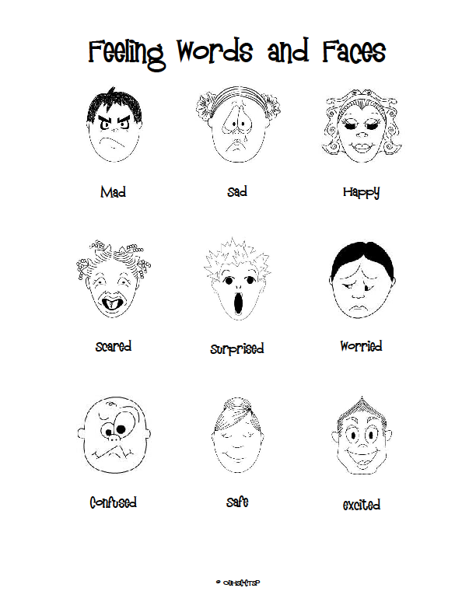
Child Trauma Services Program
© 2021 The Board of Regents of The University of Oklahoma

Slide 15
Welcome to TF-CBT Group Combined Time!
Child Trauma Services Program
© 2021 The Board of Regents of The University of Oklahoma

Slide 16
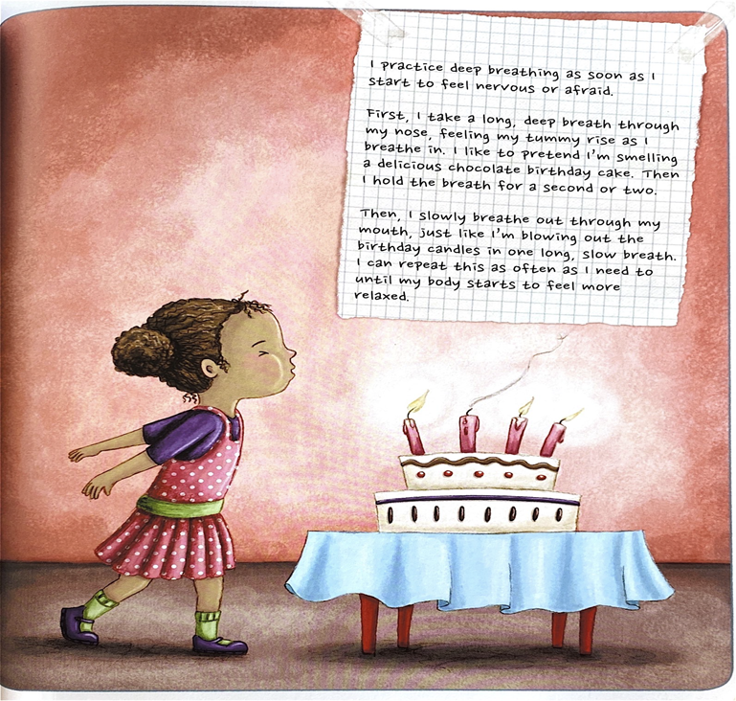
Deep Breaths
STRAUS, S. (2013). HEALING DAYS. MAGINATION Press.
Child Trauma Services Program
© 2021 The Board of Regents of The University of Oklahoma

Slide 17
Child Trauma Services Program
© 2021 The Board of Regents of The University of Oklahoma

Slide 18
Child Trauma Services Program
© 2021 The Board of Regents of The University of Oklahoma

Slide 19
I CAN DO THESE HELPFUL THINGS:
Child Trauma Services Program
© 2021 The Board of Regents of The University of Oklahoma
Notes:
Use this if needed! If not, just facilitate discussion without slide.

Slide 20
I CAN TALK TO THESE HELPFUL ADULTS:
Child Trauma Services Program
© 2021 The Board of Regents of The University of Oklahoma
Notes:
Use this if needed! If not, just facilitate discussion without slide.

Slide 21
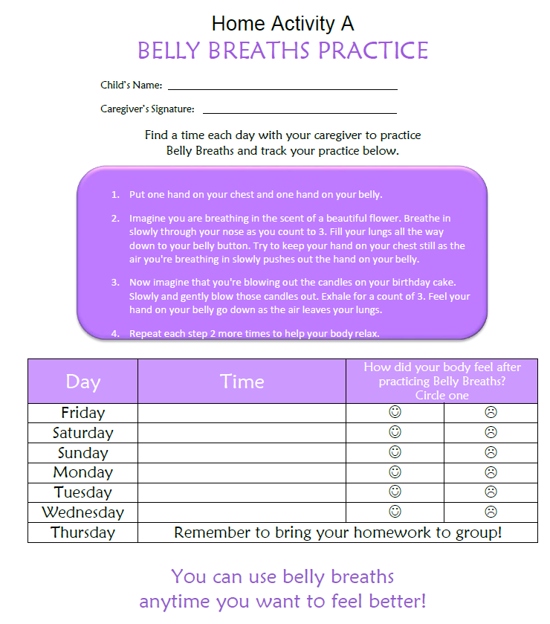
HOME
Activity
Find a time each day to practice Belly breaths with a caregiver.
Remember to bring back your completed home activity sheet to be entered into the prize drawing!
Child Trauma Services Program
© 2021 The Board of Regents of The University of Oklahoma

Slide 22
Participation prize
Child Trauma Services Program
© 2021 The Board of Regents of The University of Oklahoma

