Slide 1
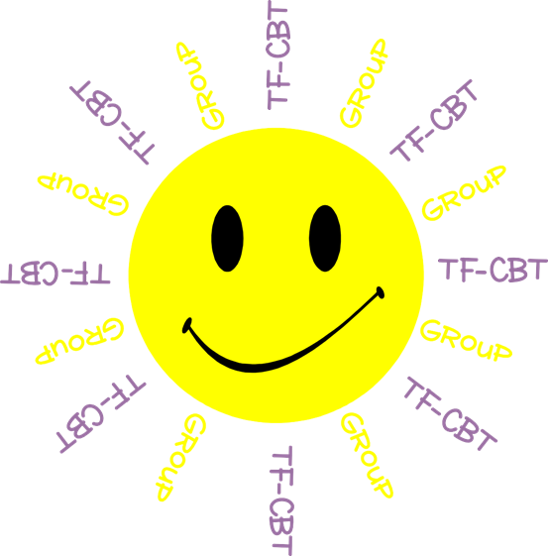
Welcome to TF-CBT Group!
Today is Group 1 of 5.
Child Trauma Services Program
© 2021 The Board of Regents of The University of Oklahoma

Slide 2
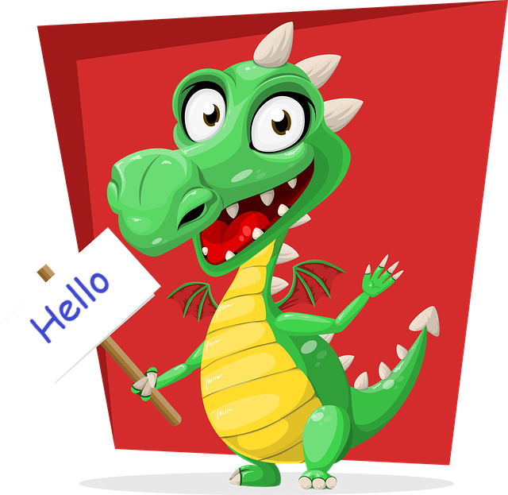
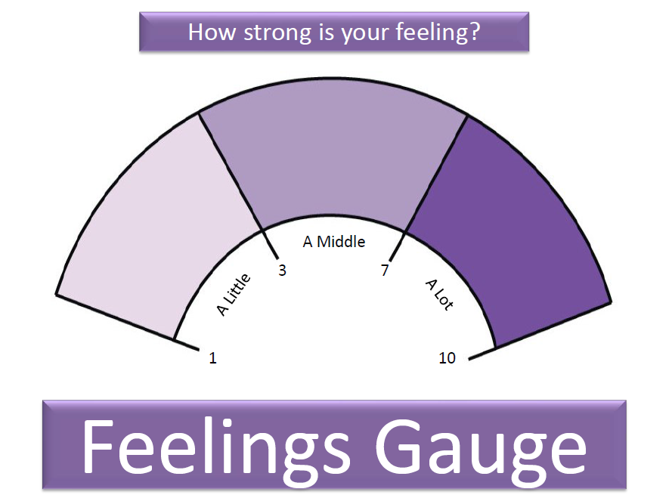
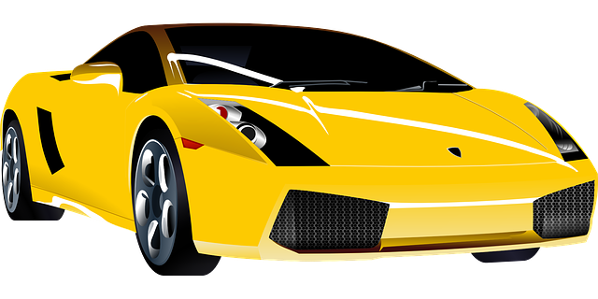
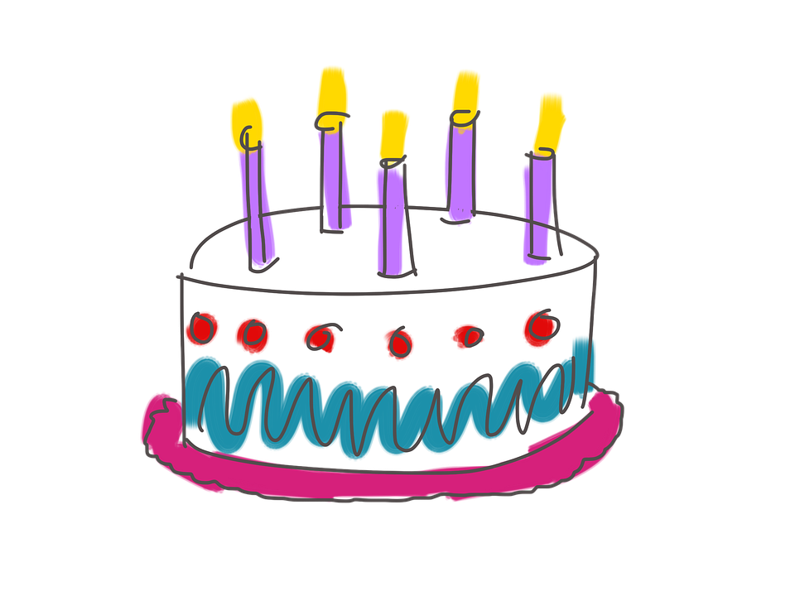
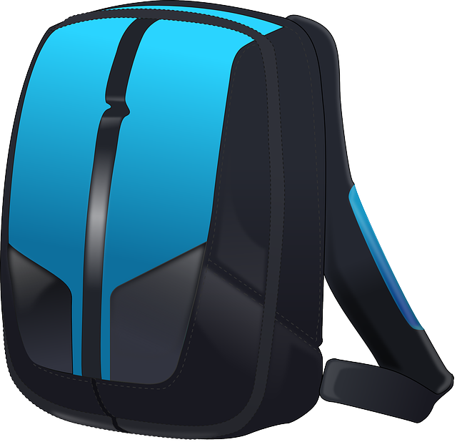
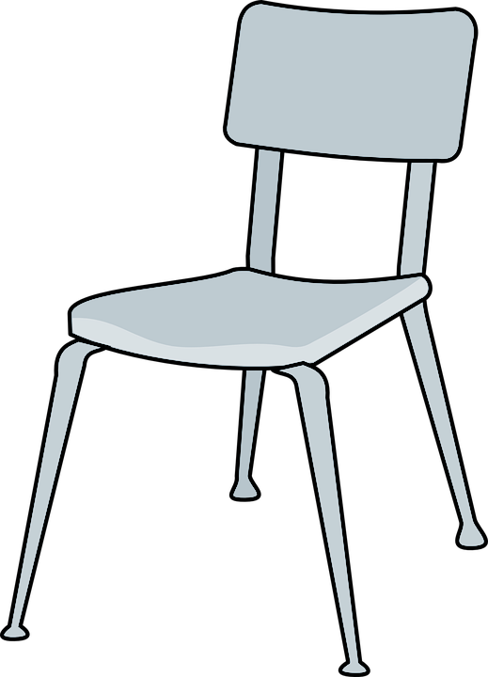
GROUP
NEXT
RULES
PTSD
WHAT IS TRAUMA?
Child Trauma Services Program
© 2021 The Board of Regents of The University of Oklahoma

Slide 3
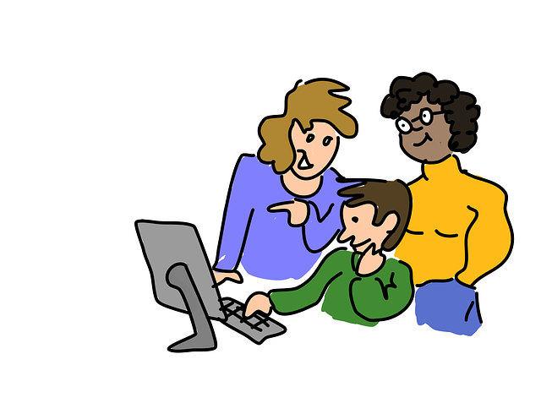
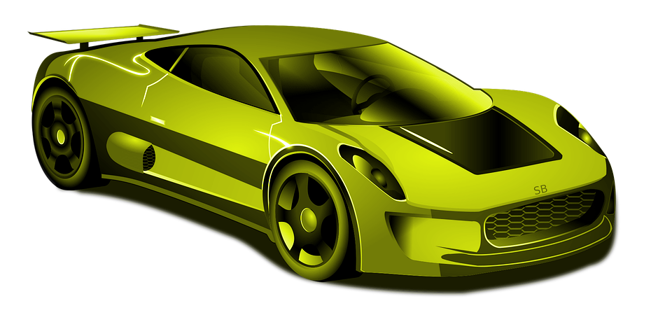
GROUP RULES
Zoom
Use the bathroom before or after group.
Be in a private space.
Keep everyone’s information private or confidential.
Take turns talking.
Keep yourself on mute.
Keep your camera on.
Be nice.
Just Be On Zoom!
Child Trauma Services Program
© 2021 The Board of Regents of The University of Oklahoma

Slide 4
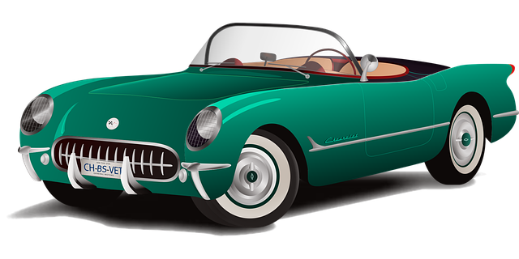
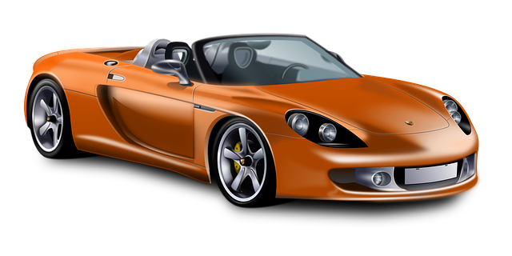
Youth A
Youth B
Youth C
Youth D
Youth E
Youth F
Child Trauma Services Program
© 2021 The Board of Regents of The University of Oklahoma

Slide 5
THE NAME GAME
RULES:
The person whose name is called will repeat the previous person’s name and their favorite color, ice cream, etc. and then state their name and favorite
Child Trauma Services Program
© 2021 The Board of Regents of The University of Oklahoma

Slide 6
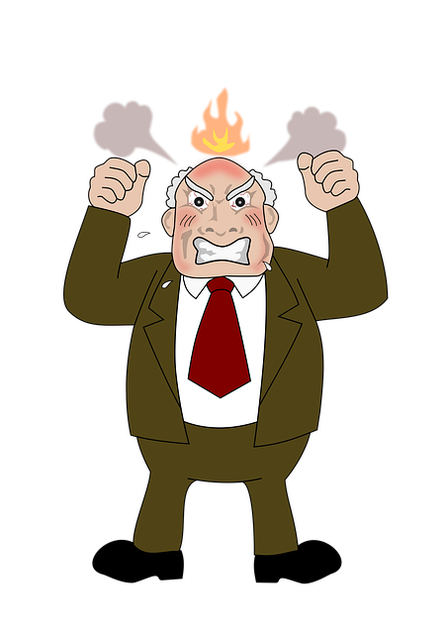
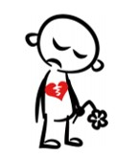
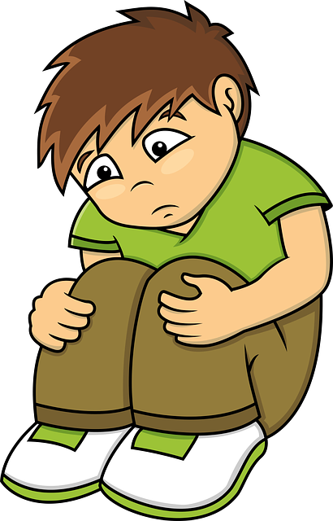
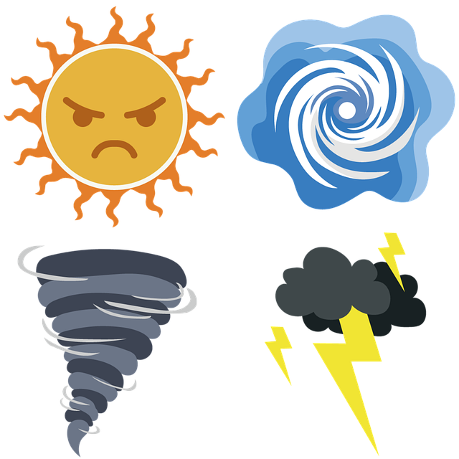
WHAT IS TRAUMA?
Someone broke the private part rule
Grown-ups in the family hit each other, or yell, or hurt
Moving to a new home
Grown-up hit or hurt kids
Someone you love leaving or dying
Kid didn’t have food and hugs and clothes and things kids need
Scary things happening with the weather
Child Trauma Services Program
© 2021 The Board of Regents of The University of Oklahoma
Notes:
Children should NOT be asked to identify their own trauma exposures.

Slide 7
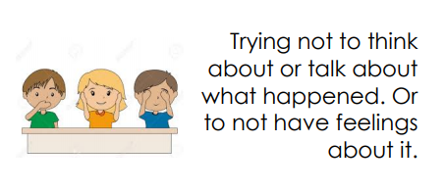
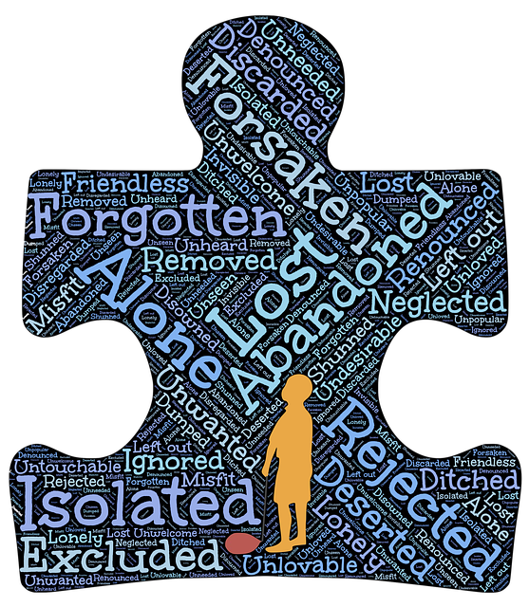
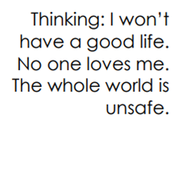
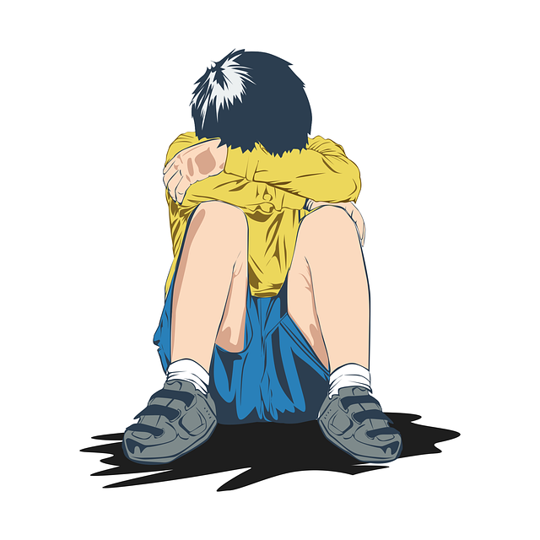
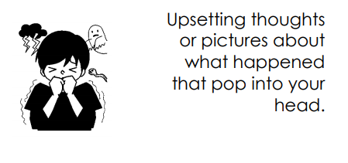
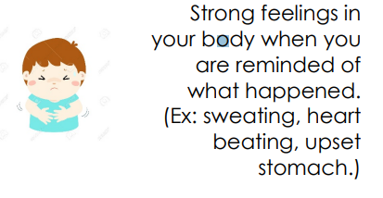
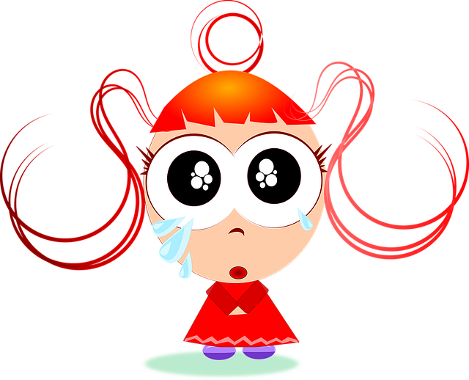
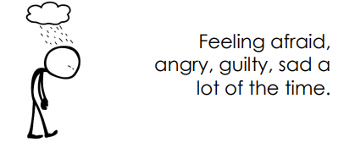
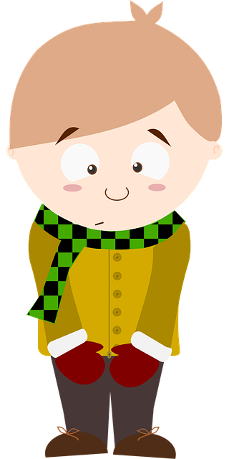
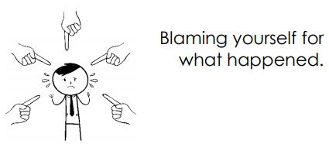
IDENTIFYING PTSD SYMPTOMS
What happens after kids go through tough and scary things?
Child Trauma Services Program
© 2021 The Board of Regents of The University of Oklahoma

Slide 8
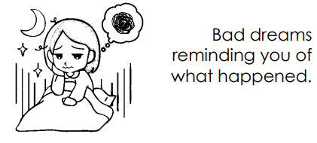
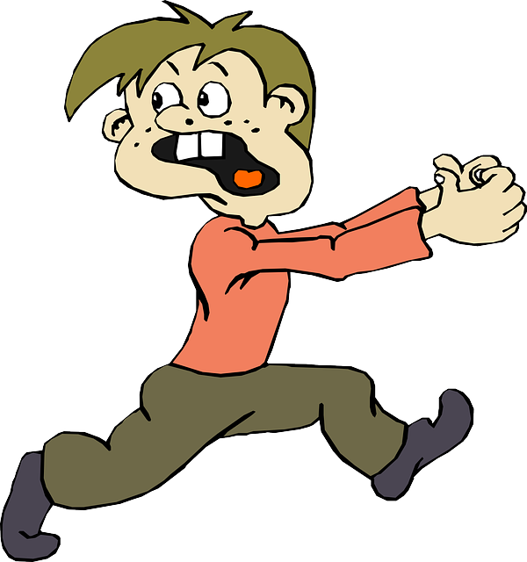
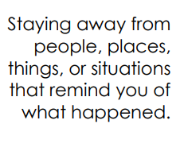
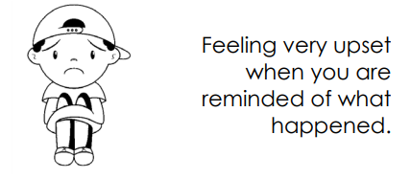
Child Trauma Services Program
© 2021 The Board of Regents of The University of Oklahoma
Notes:
PTSD symptoms – Could use to sort at ones they have or simply to name them

Slide 9
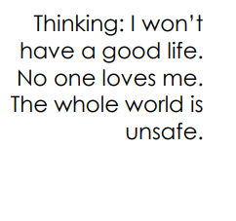
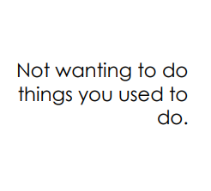
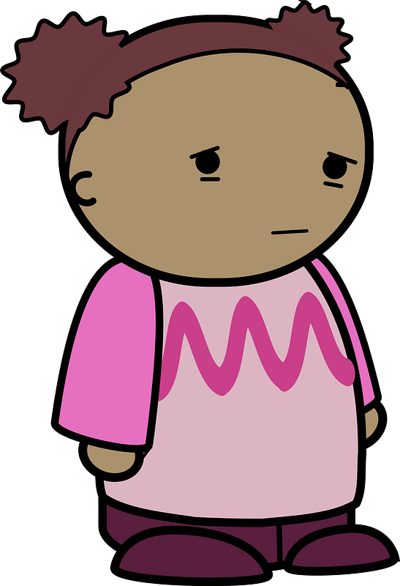
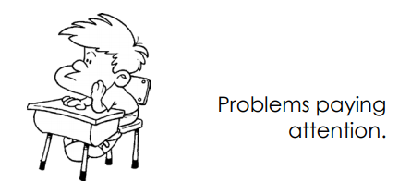
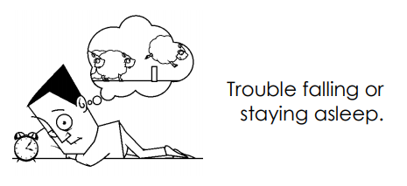
Child Trauma Services Program
© 2021 The Board of Regents of The University of Oklahoma

Slide 10
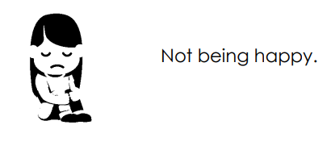
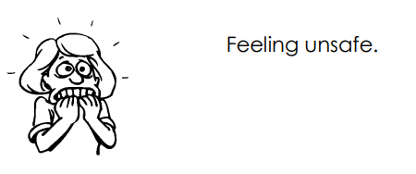
Child Trauma Services Program
© 2021 The Board of Regents of The University of Oklahoma

Slide 11
ACTIVITY!
ACTIVITY!
What was your favorite part of group?
Child Trauma Services Program
© 2021 The Board of Regents of The University of Oklahoma

Slide 12
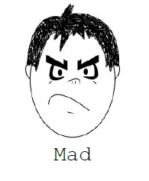
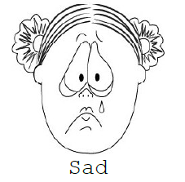
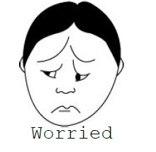
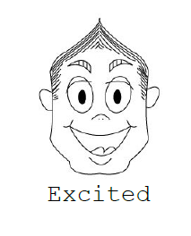
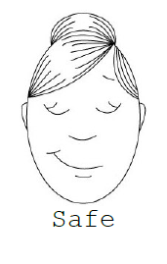
Child Trauma Services Program
© 2021 The Board of Regents of The University of Oklahoma

Slide 13
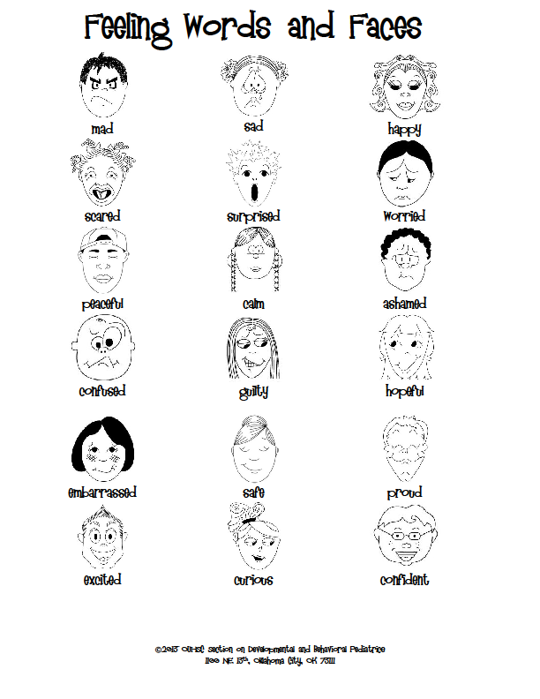
Child Trauma Services Program
© 2021 The Board of Regents of The University of Oklahoma

Slide 14
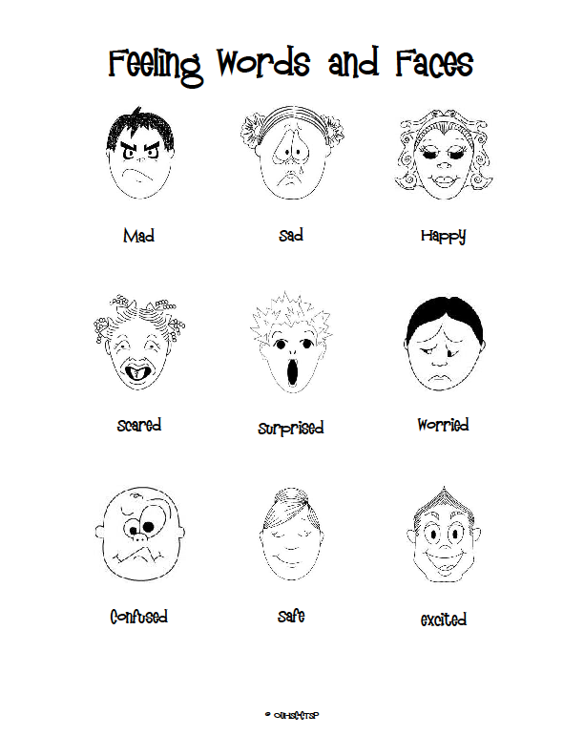
Child Trauma Services Program
© 2021 The Board of Regents of The University of Oklahoma

Slide 15
Welcome to TF-CBT Group Combined Time!
Child Trauma Services Program
© 2021 The Board of Regents of The University of Oklahoma

Slide 16
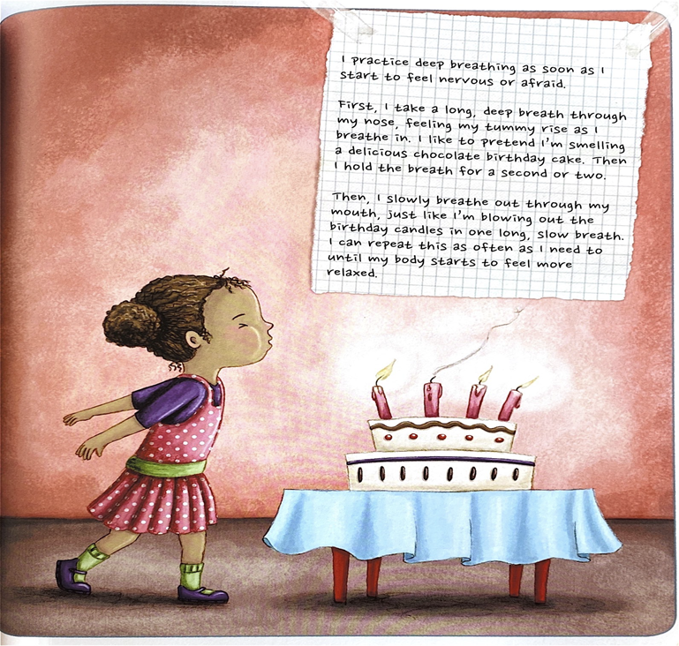
Deep Breaths
Child Trauma Services Program
© 2021 The Board of Regents of The University of Oklahoma

Slide 17
Child Trauma Services Program
© 2021 The Board of Regents of The University of Oklahoma

Slide 18
Child Trauma Services Program
© 2021 The Board of Regents of The University of Oklahoma

Slide 19
I CAN DO THESE HELPFUL THINGS:
Drive in the car
Listen to music
Distraction - tablet
Take Deep Breaths
Color
Go for a walk
Short break - Reading/YouTube Video
ANIMALS - Love our pets! Play with & feed them
Dance Party
Child Trauma Services Program
© 2021 The Board of Regents of The University of Oklahoma
Notes:
Use this if needed! If not, just facilitate discussion without slide.

Slide 20
I CAN TALK TO THESE HELPFUL ADULTS:
Call the suicide helpline
Parents/Caregivers
Teachers
School Counselor
Aunts/Uncles
Child Trauma Services Program
© 2021 The Board of Regents of The University of Oklahoma
Notes:
Use this if needed! If not, just facilitate discussion without slide.

Slide 21
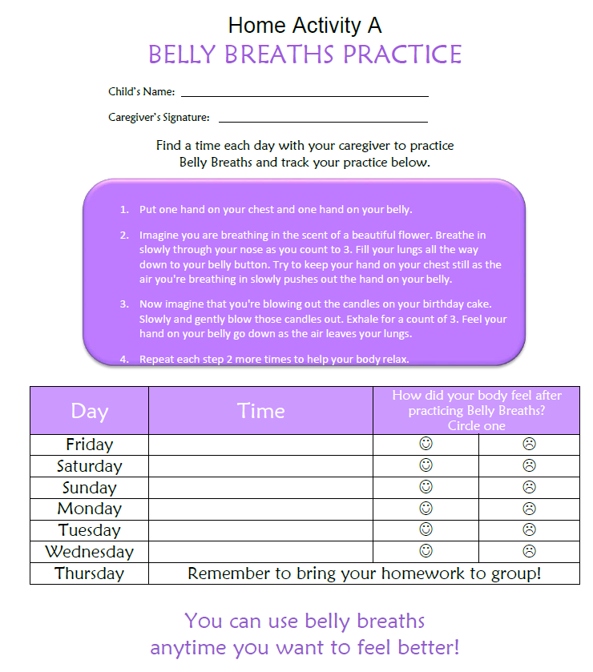
HOME
Activity
Find a time each day to practice Belly breaths with a caregiver.
Remember to bring back your completed home activity sheet to be entered into the prize drawing!
Child Trauma Services Program
© 2021 The Board of Regents of The University of Oklahoma

Slide 22
Participation prize
Child Trauma Services Program
© 2021 The Board of Regents of The University of Oklahoma

