Slide 1
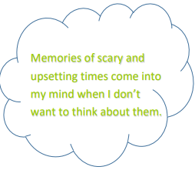
Thoughts

Slide 2
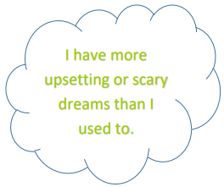
Feelings

Slide 3
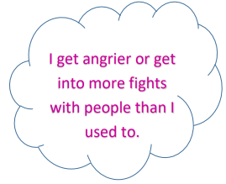
Behaviors

Slide 4
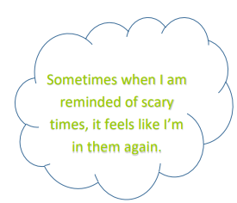
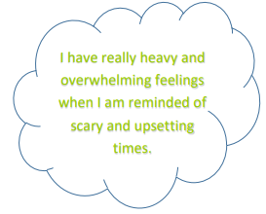
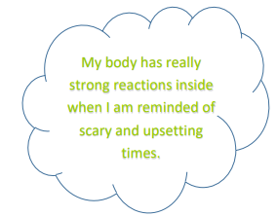
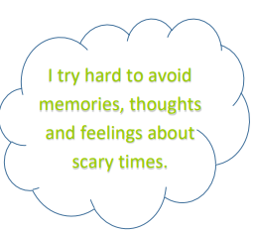

Slide 5
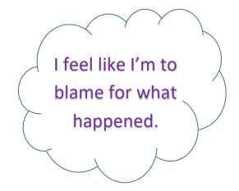
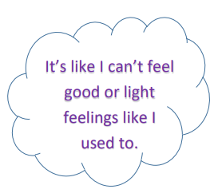
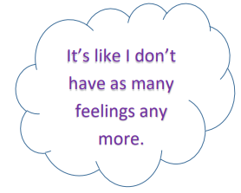

Slide 6
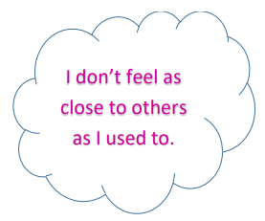
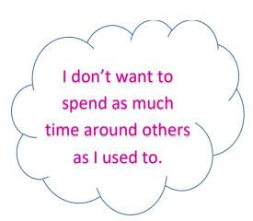
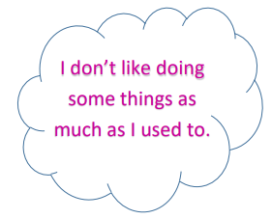
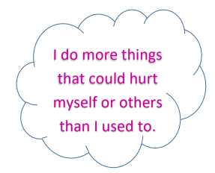
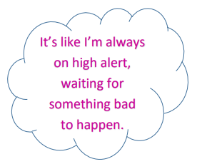

Slide 7
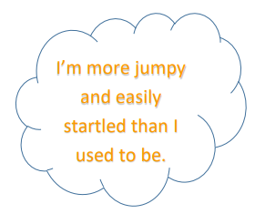
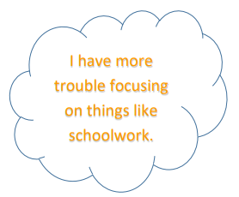
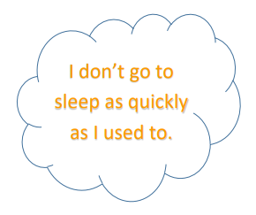
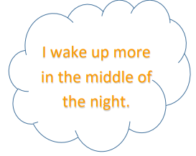
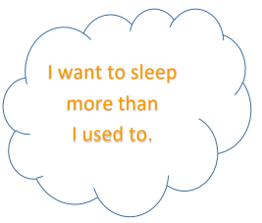
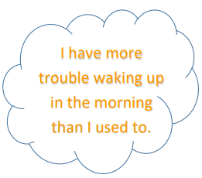

Slide 8
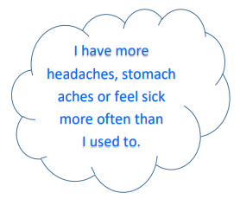
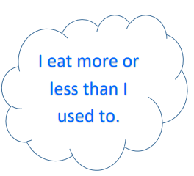
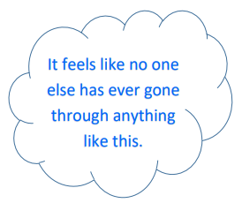
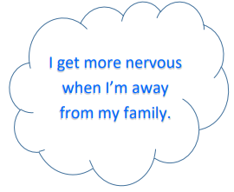
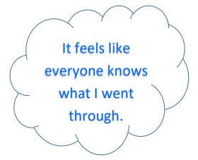
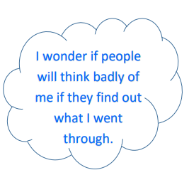

Slide 9
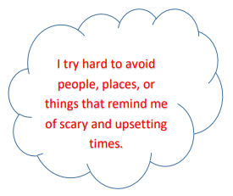
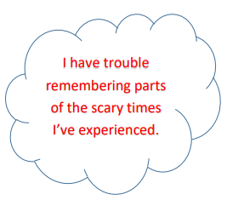
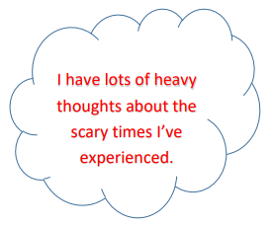
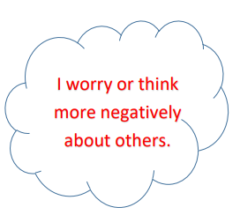
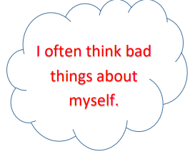
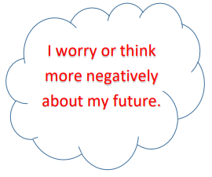

Slide 10
What is ________?

Slide 11
What are some examples of __________?

Slide 12
How do kids feel when/who have been __________?

Slide 13
How many kids does _________ happen to?

Slide 14
What kinds of kids does _______ happen to?

Slide 15
What kinds of worries do kids who’ve seen family fighting have?

Slide 16
What are some common things that kids do after they’ve been through ________?

Slide 17
How can you tell if another kid has been through _________?

Slide 18
Can other people tell that you’ve experienced ___________?

Slide 19
What happens to kids who have experienced __________, when they grow up?

Slide 20
What are some reason that some kids don’t tell/get help right away if they’re experiencing ______________?

Slide 21
What are some things that a kid could do if they wanted to get help with ___________?

Slide 22
Whose fault or responsibility is_________?

Slide 23
Is it ever a kid’s fault?

Slide 24
Why does __________ happen?

Slide 25
What do adults say to kids about _______?

Slide 26
What kind of help is there for caregivers who ____________?

Slide 27
What happens to adults who __________?

Slide 28
When adults do________ does it mean that they hate kids/are angry at kids?

